Slide 2
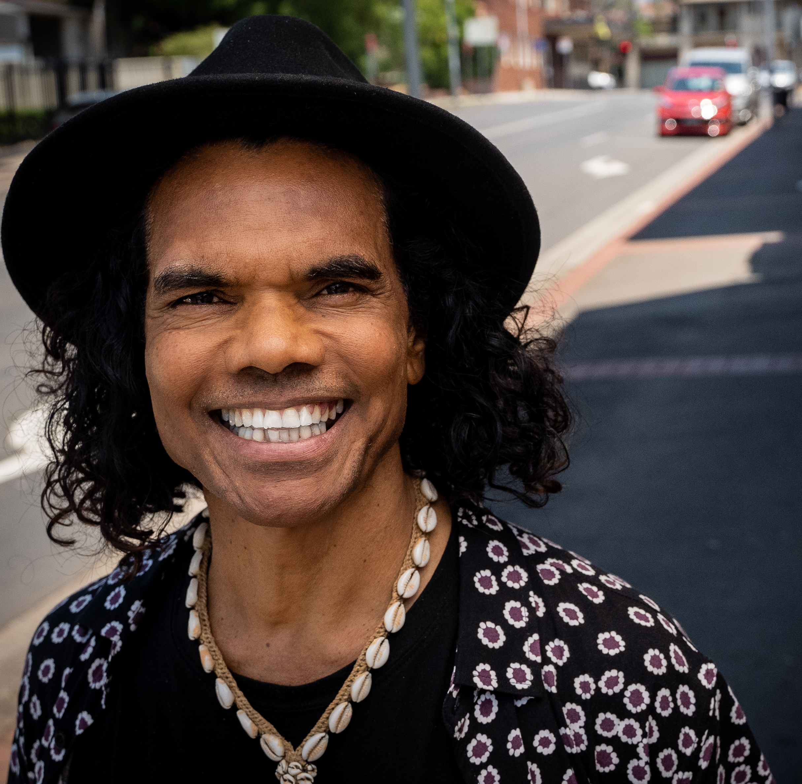
TEXT AND IMAGE TEMPLATE
(delete this box before finalising):
Change the image (instructions on page 1)
You can also include text or quote with the photo
“LOOK AFTER YOURSELF BECAUSE WE NEED DEADLY BLACK PEOPLE LIKE YOU. GET A REGULAR 715 HEALTH CHECK.”

Slide 3
IMAGE ONLY TEMPLATE
(delete this box before finalising):
Insert an image (see instructions on Page 1) Good images can be your staff or clients that have had a 715 – remember to ask permission to use their photo.

Slide 4
TEXT ONLY TEMPLATE
(delete this box before finalising):
You can also include text that reinforces key messages (see text formatting instructions on Page 1)
  This could be a quote from an ambassador or staff member or a short sentence that tells community how to get their health check

