Slide 1
Template for social media
This template will allow you to upload your photo and then share it across your social media channels with your personal reasons why you are (or have been) getting vaccinated.
There are two different formats of the template to be used across different channels.
HOW TO USE
Click on the template (next slide) and under “Insert” tab, choose Pictures.
Upload photo from your device.
Right click on your photo and choose “Send to Back”
Reposition and adjust the photo to the frame (the photo can be larger than the frame so long as you position it the way you want)
Change the text in a text box.
Take a snip/screengrab of the slide and use it as an image for your social post

Slide 2
Name (no last name needed) identification if comfortable
This template is in a landscape format. Best to be used for: Twitter and Linkedin
Notes:
HOW TO USE
Click on the template and under “Insert” tab, choose Pictures.
Upload photo from your device.
Right click on your photo and choose “Send to Back”
Reposition and adjust the photo to the frame (the photo can be larger than the frame so long as you position it the way you want)
Change the text in a text box.
Take a snip/screengrab of the slide and use it as an image for your social post

Slide 3
EXAMPLE
Social post copy:
I'm glad my nanny is getting vaccinated, so she doesn't get COVID-19 and get really sick. All you mob get vaccinated, and stay deadly like my nanny.

Slide 4
Name (no last name needed) identification if comfortable
This template is in a square format. Best to be used for: Instagram and Facebook
Notes:
HOW TO USE
Click on the template and under “Insert” tab, choose Pictures.
Upload photo from your device.
Right click on your photo and choose “Send to Back”
Reposition and adjust the photo to the frame (the photo can be larger than the frame so long as you position it the way you want)
Change the text in a text box.
Take a snip/screengrab of the slide and use it as an image for your social post

Slide 5
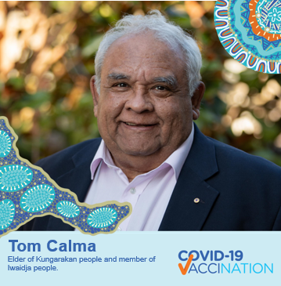
EXAMPLE
Social post copy:
2020 was really hard. I was not able to see my Mum who is 89 years old and who is in an aged care facility in Darwin. Now that both of us are vaccinated, I can go and spend time with her whenever I can. We must protect our Elders.

