Slide 1
Notes
You can edit this poster template for use in your community.
To change the picture in the circle:
click on the picture
right click on your mouse
select ‘change picture from file’ or ‘change picture from device’
choose your image and click ‘insert’ or ‘OK’.
Following these steps will make sure the circle shape stays the same.
Or, you can place a new image in a different shape.

Slide 2
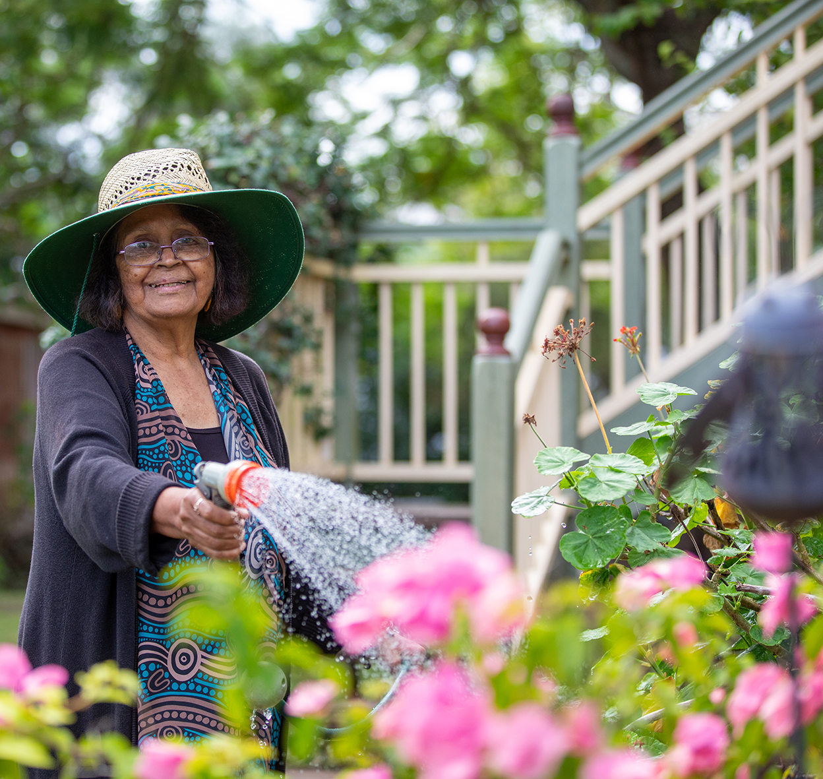
Get the support you need to age well.
Aged care can help you age well and stay connected to family, culture, Country, Island Home and community
Aboriginal and Torres Strait Islander people can apply for government-funded aged care services from age 50.
Registering with My Aged Care is free.
You don’t need to be receiving a pension to access aged care.
Many services are free or low cost. There may be some out-of-pocket costs.
You don’t need to be sick or wait for an emergency to get care.
Start your aged care journey your way, today.
Get the support you need to age well – online, by phone or in person.
Speak with your local health service
or Elder Care Support worker
Visit MyAgedCare.gov.au
Call My Aged Care on 1800 200 422
Visit a Services Australia office

