Slide 1
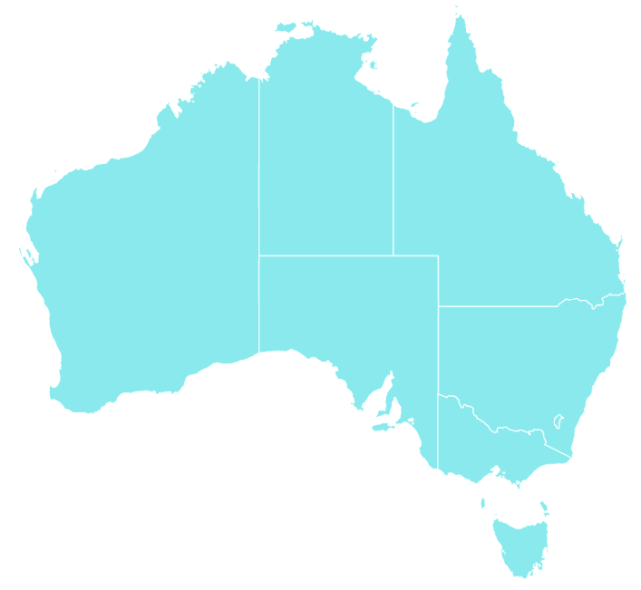
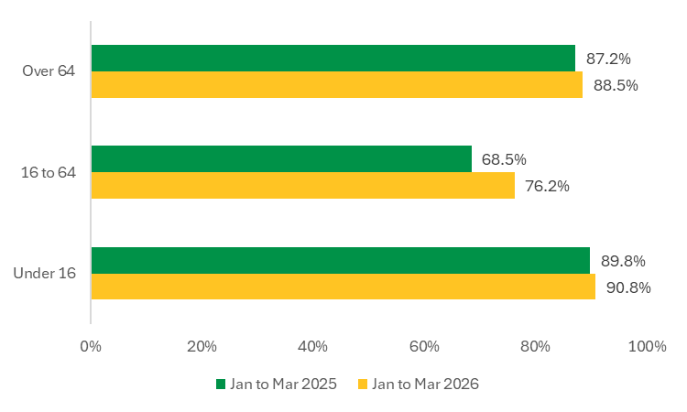
National GP Bulk Billing Snapshot – January to March 2026
Bulk billing refers to services where the GP accepts the Medicare benefit as full payment and the patient does not incur an out-of-pocket cost. Any Medicare-eligible patient can be bulk billed for a GP service under Medicare. This dashboard provides a snapshot of bulk billing for GP non referred attendances (GP NRA) and Medicare Bulk Billing Practices (those registered for the Bulk Billing Practice Incentive Program) for the January to March 2026 reporting quarter.
Medicare Bulk Billing Practices (by State)
National GP NRA Bulk Billing Rate (Jan - Mar 2026)
81.9% (▲4.6pp*)
Number of registered Medicare Bulk Billing Practices nationally
3,638
Approx population living within 20 minutes drive of a registered Medicare Bulk Billing Practice
97%
Previously mixed billing practices now registered as Medicare Bulk Billing Practices
1,358
State | Pre-Nov 2025* | Mar 2026~ | MyMedicare Registered Practices^
NSW | 1,013 | 1,415 | 2,555
VIC | 634 | 995 | 1,954
QLD | 382 | 634 | 1,558
SA | 95 | 203 | 502
WA | 118 | 221 | 737
TAS | 25 | 64 | 148
NT | 68 | 87 | 107
ACT | 10 | 19 | 104
*percentage point difference when compared to same period 12 months prior
GP NRA Bulk Billing Rate January to March 2026 (by State)*
GP NRA Bulk Billing Rate (by Month)
Medicare Bulk Billing Practices (by Remoteness)
89.8%
(▲ 13.7pp)
79.5%
(▲ 4.0pp)
Remoteness | Pre-Nov 2025* | Mar 2026~ | MyMedicare Registered Practices^
MM1 | 1,587 | 2,313 | 5,240
MM2 | 167 | 309 | 680
MM3 | 128 | 240 | 519
MM4 | 89 | 168 | 346
MM5 | 186 | 392 | 594
MM6 | 60 | 80 | 127
MM7 | 128 | 136 | 159
74.0%
(▲ 4.6pp)
80.4%
(▲ 5.9pp)
85.6%
(▲ 4.0pp)
83.7%
(▲ 5.5pp)
54.1%
(▲ 1.4pp)
*also showing percentage point (pp) difference when compared to same period 12 months prior.
78.0%
(▲ 5.7pp)
*GP Practices registered with MyMedicare and that were classified as bulk billing prior to 1 November 2025. ~GP Practices registered for the BBPIP.^GP Practices registered with MyMedicare.
GP NRA Bulk Billing Rate (by Patient Age)
GP NRA Bulk Billing Rate (for Concessional Patients)
Concession | NSW | VIC | QLD | SA | WA | TAS | NT | ACT | National
Jan to Mar 2025 | 92.8% | 92.7% | 91.0% | 91.3% | 91.3% | 87.8% | 96.3% | 75.3% | 91.9%
Jan to Mar 2026 | 93.7% | 93.6% | 91.8% | 92.1% | 92.0% | 88.7% | 97.5% | 75.4% | 92.7%
GP NRA Bulk Billing Rate (for Non-concessional Patients)
Non-concession | NSW | VIC | QLD | SA | WA | TAS | NT | ACT | National
Jan to Mar 2025 | 71.7% | 65.7% | 60.4% | 54.3% | 52.0% | 51.4% | 63.4% | 41.9% | 64.0%
Jan to Mar 2026 | 78.7% | 75.5% | 68.3% | 67.2% | 60.3% | 64.1% | 85.3% | 44.1% | 72.5%

