Slide 1
Designing Better Aged Care Environments

Slide 2
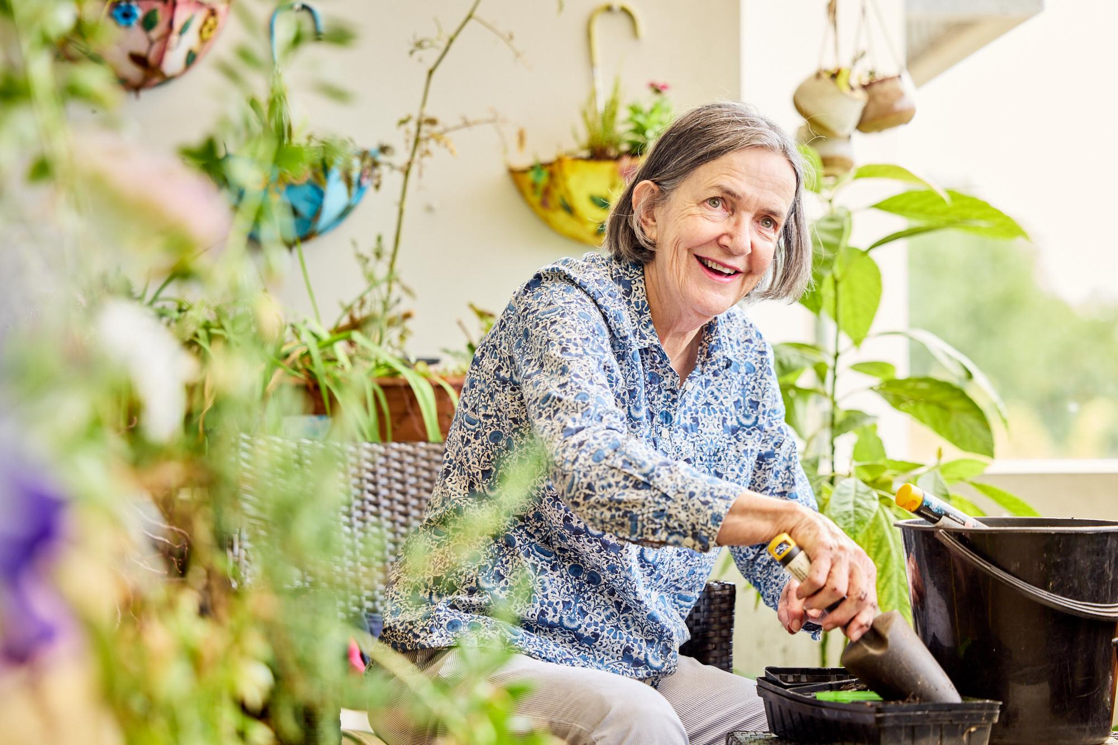
Designing Better Aged Care Environments
Webinar Series: Home Matters - Rethinking Aged Care Design

Slide 3

Acknowledgment of Country
The Department of Health, Disability and Ageing and Dementia Training Australia would like to show our respect and acknowledge the traditional custodians of these lands. We extend this respect to Elders past and present, and to all Aboriginal and Torres Strait Islander people here today.
Artist: Brittney Angus

Slide 4



Housekeeping
Q&A
Participant Audio/Video
Copy of Slides

Slide 5

Overview of Today’s Session
Lived Experience concerns
Environments and Changed Behaviour
National Aged Care Design Principles and Guidelines

Slide 6


Host
Isabelle Meyer Executive Director
Dementia Training Australia

Slide 7
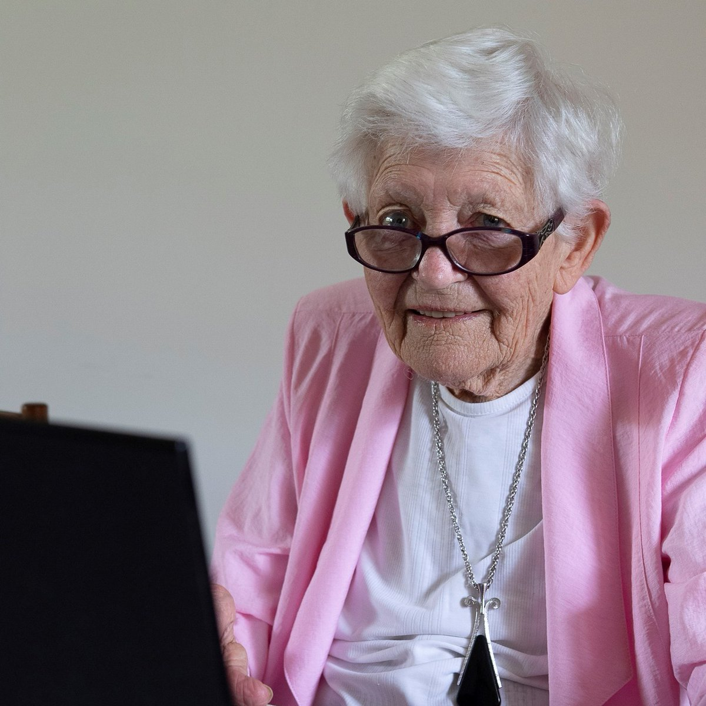


Speakers
Val Fell Dementia Advocate
Volunteer and advocate, leading local initiatives and contributing to national aged-care reform.
Margaret MacAndrew Director Dementia Training Australia (Qld)
Associate Professor, School of Nursing, Queensland University of Technology
Nick Seemann Architect & Environments Specialist Dementia Training Australia
Lead author of the National Aged Care Design Principles and Guidelines.

Slide 8
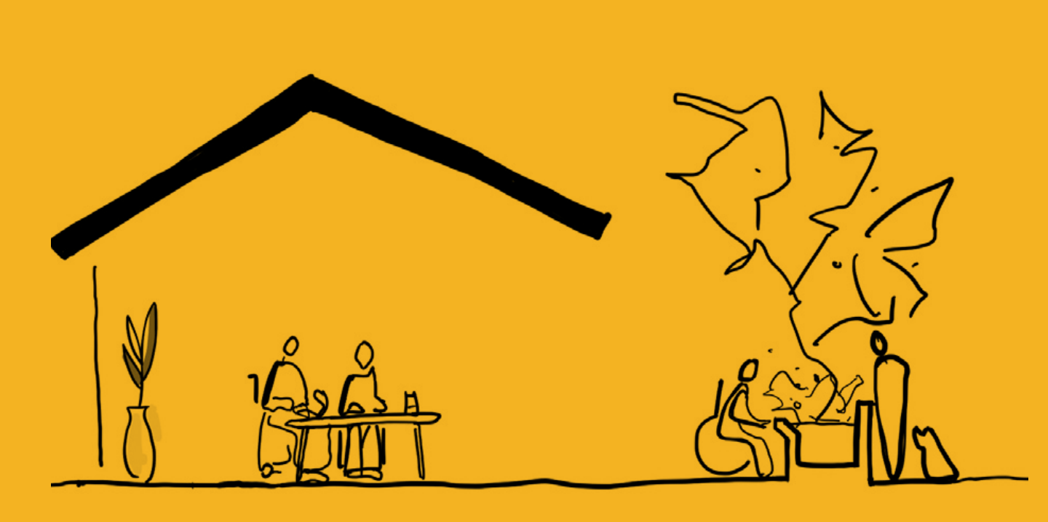
Introduction to the
National Aged Care Design Principles and Guidelines and how they can help improve residents’ lives

Slide 9
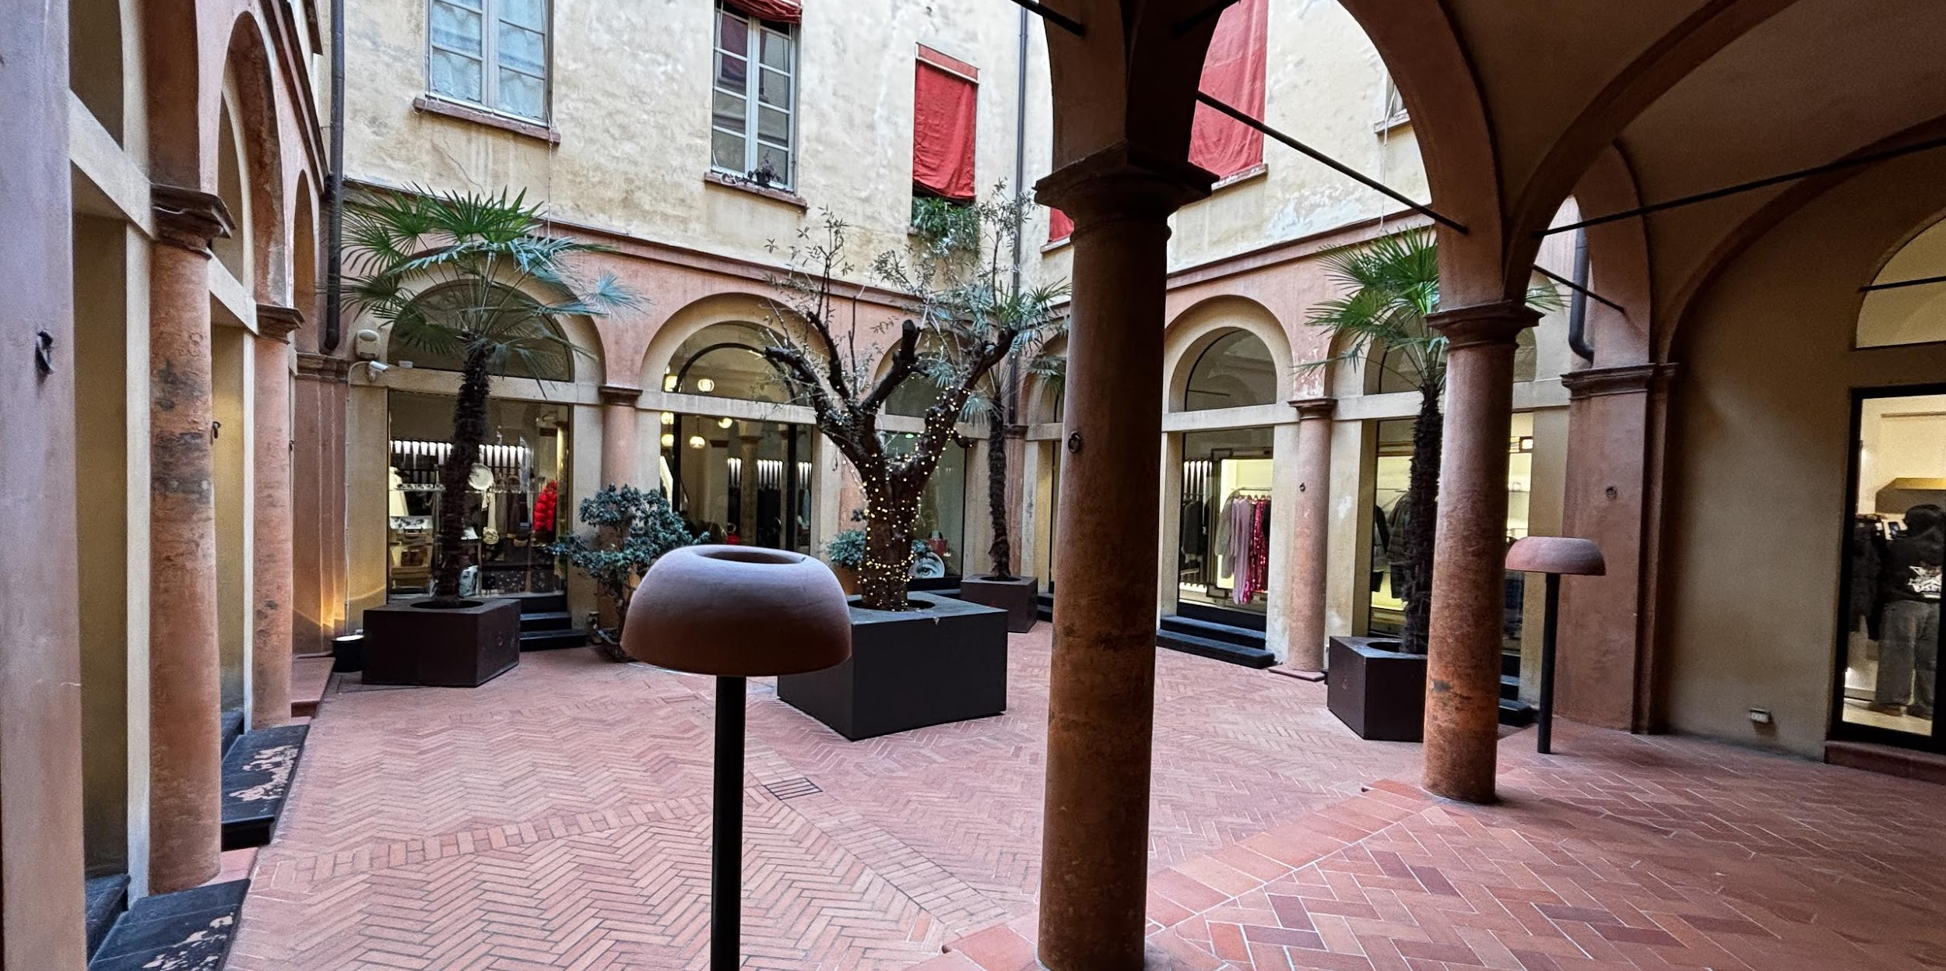

Slide 10
2
Cultivate a Home
Principle 1 - Enable the Person
To support people living in a place that maintains their health, wellbeing and sense of identity.
Principle 2 - Cultivate a Home
To create a familiar environment in which people have privacy, control and feel they belong.
Principle 3 - Access the Outdoors
To support people seeing, accessing and spending time outdoors in contact with nature.
Principle 4 - Connect with Community
To encourage people to connect with family, friends and community, continuing to participate in meaningful activities.
1
Enable the
Person
4
Connect with Community
3
Access the Outdoors
National Aged Care Design Principles and Guidelines. Commonwealth of Australia, Department of Health, Disability & Ageing 2024.

Slide 11
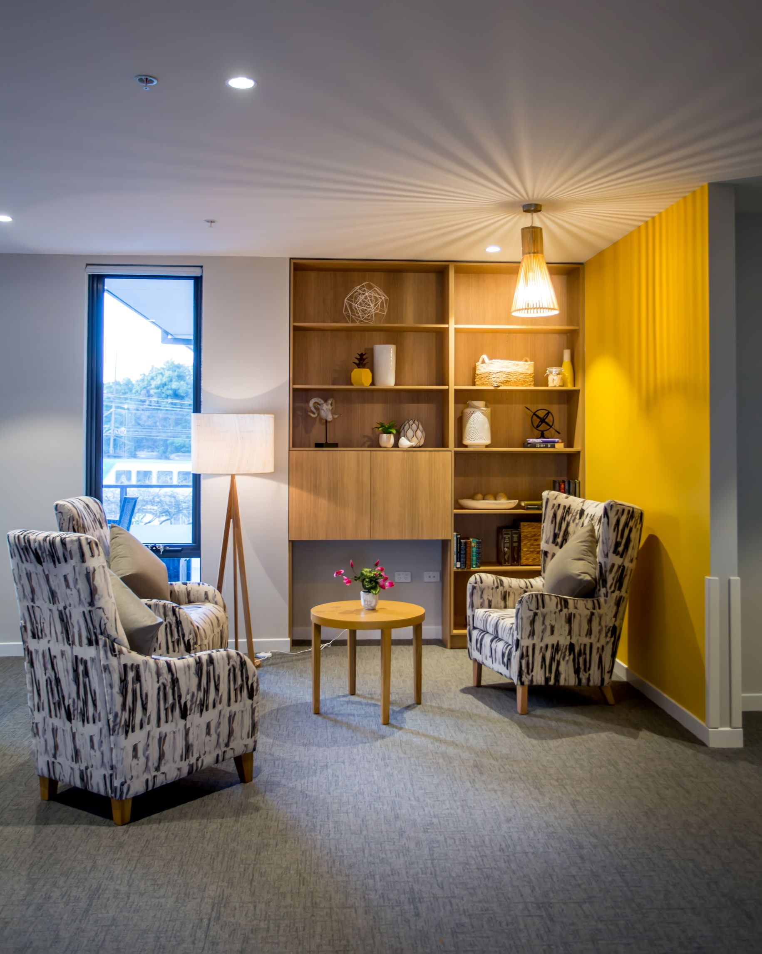
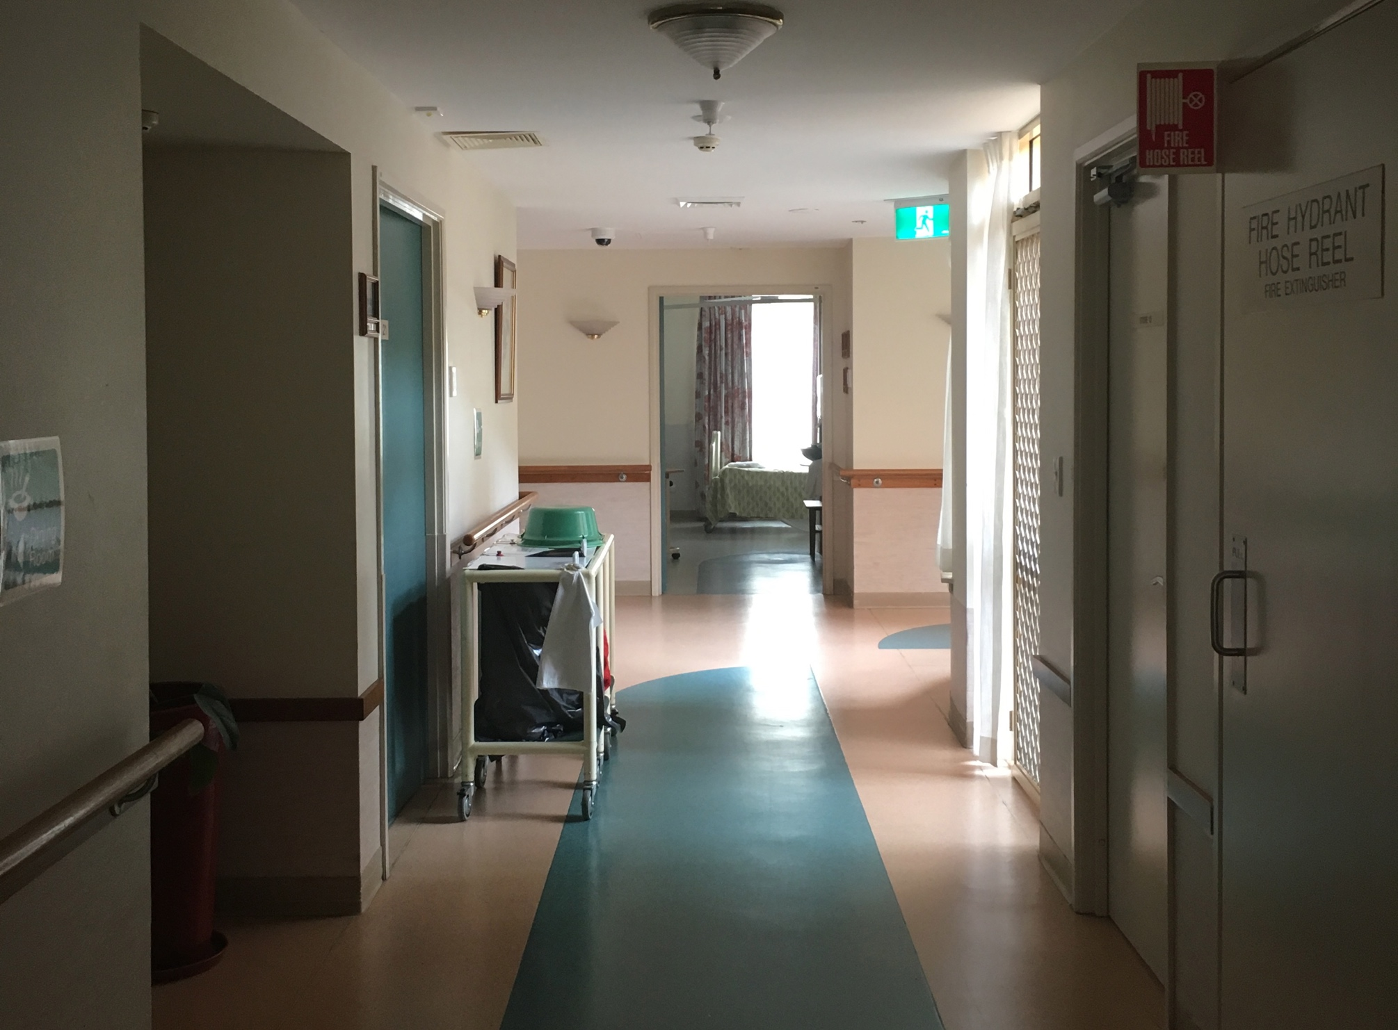

Slide 12
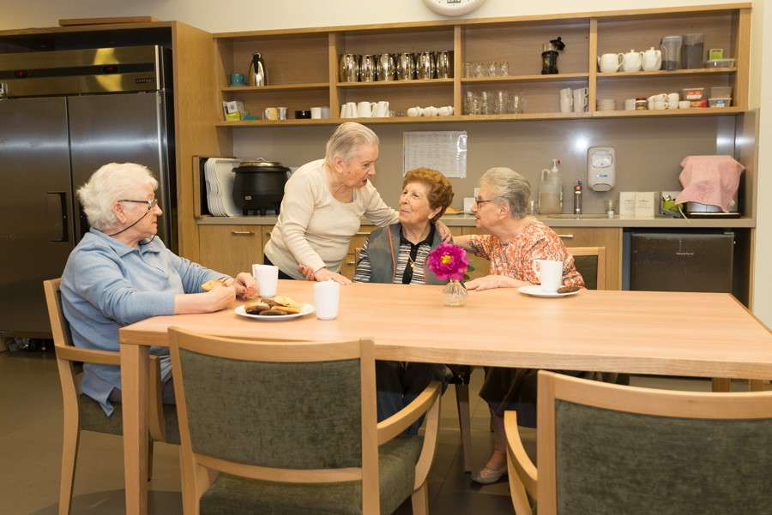

Slide 13
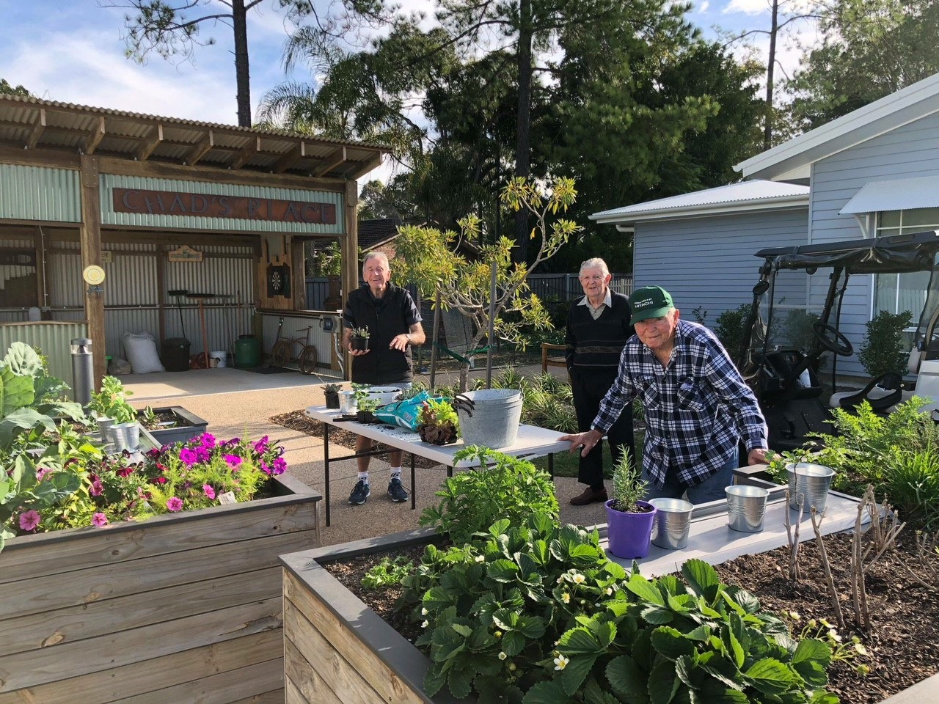

Slide 14
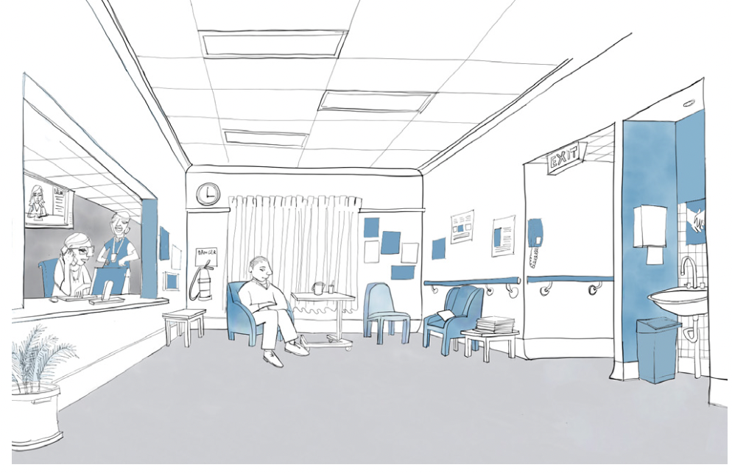
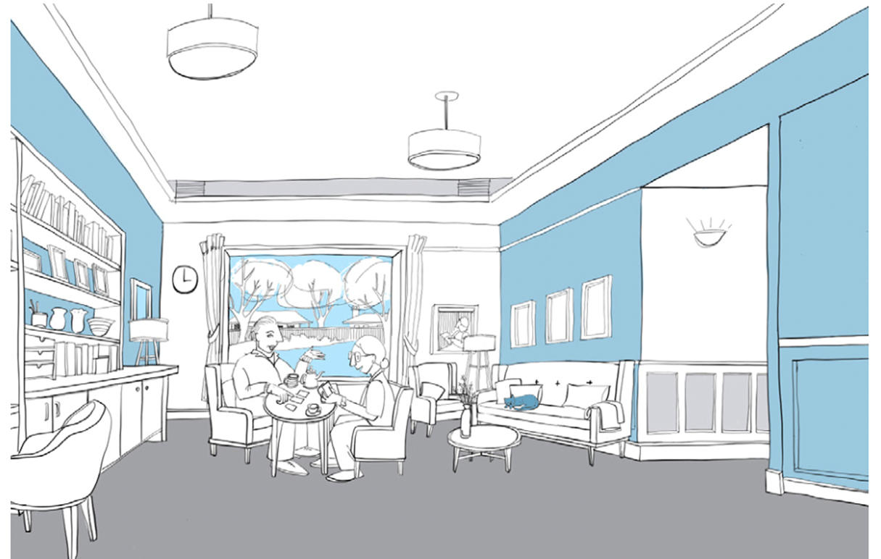
How Do Places Affect Us?
Before
After

Slide 15
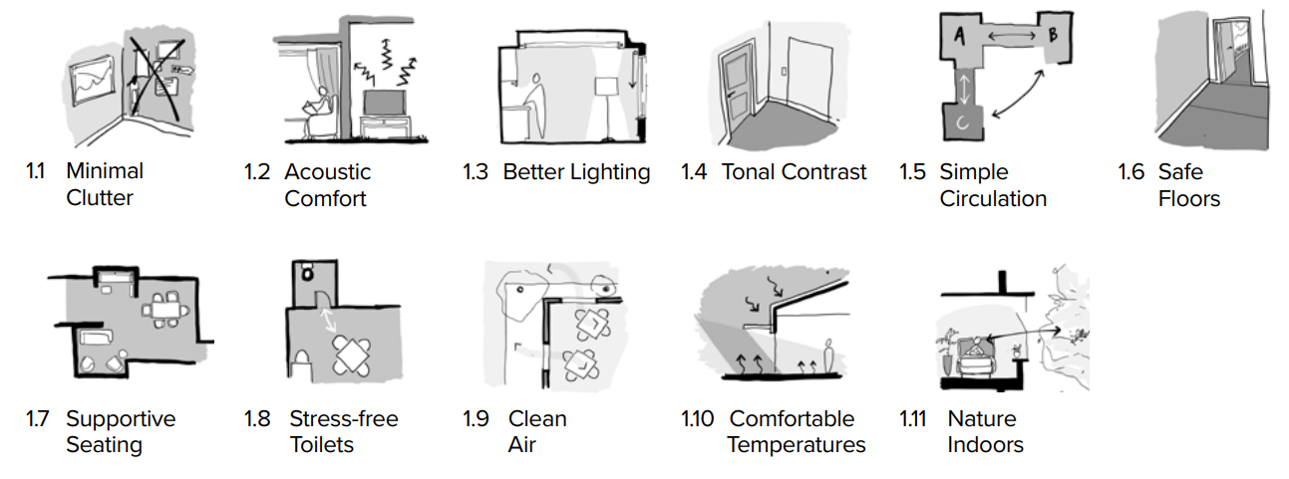
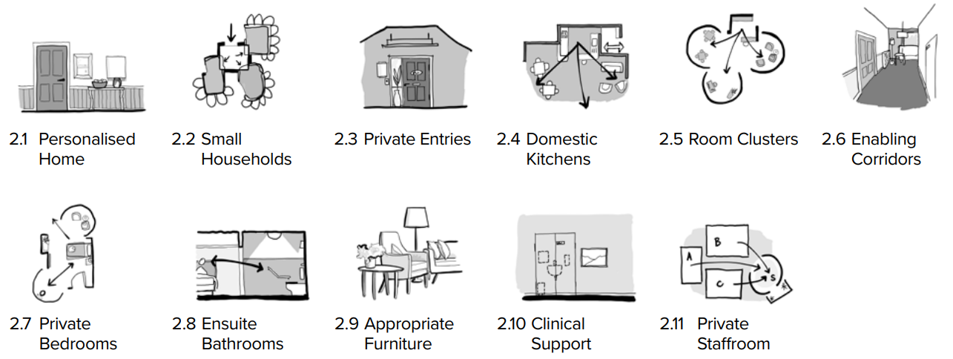
31 Guidelines
Principle 1 - Enable the Person
Principle 2 - Cultivate a Home

Slide 16
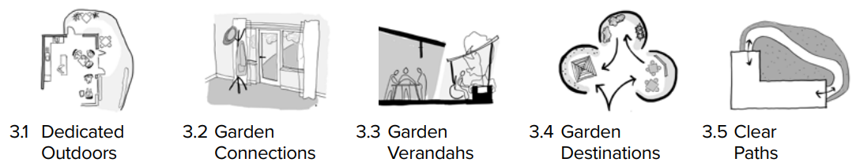
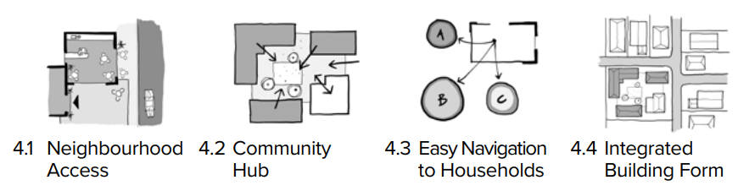
31 Guidelines
Principle 3 - Access the Outdoors
Principle 4 - Connect with Community

Slide 17
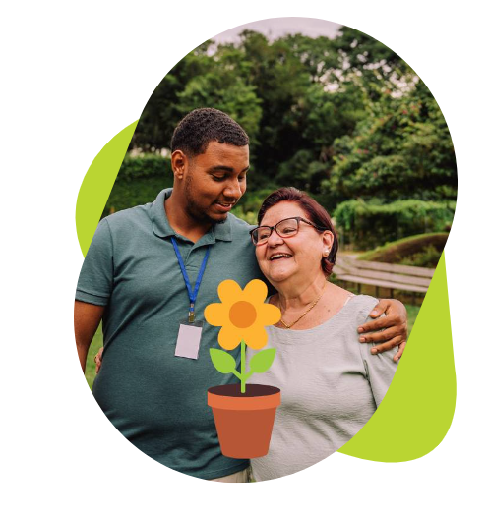
Care Home Assessment Tool (CHAT)
What does it do?
Guides you through the 4 Design Principles
Assesses how well your care home meets each Guideline
Identifies strengths and areas for improvement
Provides a holistic site report (by unit/wing/household)
https://dta.com.au/care-home-assessment-tool-chat/

Slide 18


Environments Hub

Slide 19

Q&A Discussion

