Slide 1
Webinar | Financial reporting ― Aged Care Financial Report 2025–26
Thursday 26 March 2026

Slide 2
Agenda
1. Overview
Kate Stewart – Director, Market Intelligence Branch
2. Support at Home program reporting
Kate Stewart – Director, Market Intelligence Branch
3. Care Minutes Performance Statement
Aden Pulford – Director, Residential Risk and Funding Operations Branch
4. Annual Prudential Compliance Statement
Laura Todorovski – Assistant Director, Aged Care Quality and Safety Commission
5. Residential pricing risk assessment program
Madeleine Hurrell – Assistant Director, Residential Risk and Funding Operations Branch
6. Further information and Q&A session

Slide 3

Overview
Kate Stewart
Market Intelligence Branch

Slide 4
Who needs to complete the Aged Care Financial Report 2025-26?
Registered providers delivering residential aged care and/or the Support at Home program are required to submit an ACFR 2025-26
Registered providers delivering the Multi-Purpose Services Program are only required to complete the Annual Prudential Compliance Statement in the ACFR 2025-26
Providers who delivered the Home Care Packages Program and/or Short-Term Restorative Care (STRC) Programme up until 31 October 2025, are still required to report information in the ACFR 2025-26
Even though the Aged Care Act 1997 and the new Aged Care Act 2024 are both relevant legislation within the 2025-26 financial year, providers will be required to complete only one ACFR, for each Registered Provider
Submit your ACFR via the Forms Administration online portal

Slide 5
Reporting requirements in the ACFR 2025-26
Form Name | Data Collection Level | Residential Aged Care | Home Care Packages / Support at Home | MPS | STRC
Consolidated Segment Report* | Parent Entity or Registered Provider | YES | YES | NO | NO
Registered Provider Reporting (Income and expenditure, balance sheet, cash flow)* | Registered Provider | YES | YES | NO | NO
Movement Schedules* | Registered Provider | YES | NO | NO | NO
Residential Care Reporting (Income and expenditure, balance sheet, Care Minute Performance Statement) | Program level, Approved residential care home level | YES | NO | NO | NO
Home Care Packages / STRC / Support at Home | Program level | NO | YES refer to additional table | NO | YES refer to additional table
Annual Prudential Compliance Statement | Registered Provider | YES | NO | YES | NO
Financial Support Statement* | Parent Entity | YES | NO | NO | NO
Survey of Aged Care Homes (SACH) | Approved residential care home level | YES | NO | NO | NO
Residential Building Activity | Approved residential care home level | YES | NO | NO | NO
General Purpose Financial Statements* | Registered Provider | YES | NO | NO | NO
* except Government providers

Slide 6
Reporting requirements in the ACFR 2025-26 (continued)
For providers who delivered services under the Home Care Packages Program, STRC Programme and/or the Support at Home program there will be three separate Income and Expenditure Statements in the ACFR 2025-26
Income and expenses received or incurred should be attributed to the relevant program
 |  | Pre-1 November 2025 |  | Post-1 November 2025
Section Name | Data Collection Level | Home Care | STRC | Support at Home
Home Care Income and Expenditure Statement | Program Level | YES | NO | NO
STRC Income and Expenditure Statement | Program Level | NO | YES | NO
Support at Home Income and Expenditure Statement | Program Level | NO | NO | YES

Slide 7
What changes will be made to the ACFR 2025-26?
Changes for all providers
Updated terminology and legislative references relating to the new Aged Care Act 2024, for example:
  References to “Approved Provider” have been changed to “Registered Provider”
  The Declaration File has been updated to align with changes under the new Aged Care Act 2024
Changes for Home Care / Support at Home providers only
  “Home Care Income and Expenditure” is to be reported at the program level instead of each Aged Care Planning Region
New “Support at Home Income and Expenditure Statement”
  New “Care Minutes Performance Statement”
  New or amended items in the “Annual Prudential Compliance Statement”
  Amended data items in the “Permitted Uses Reconciliation” and “Survey of Aged Care Homes”
  The removal of data items and references to bed licences and the renaming of “Available Bed Days” to “Operational Bed Days”
  New, removed or amended data items in the “Residential Aged Care Home Income” and “Residential Aged Care Home Expenditure” forms (refer to next slide)
Changes for residential aged care providers only

Slide 8
What changes will be made to the ACFR 2025-26? (continued)
Changes for residential aged care providers only
“Residential Aged Care Home Expenditure” form
New “Staffing retention - travel costs” for non-agency and agency (Other direct care expenses)
New expenses to be reported ‘below the line’ for:
    “Higher Everyday Living/Additional Service/Extra Service – staffing costs (non-agency)”
    “Higher Everyday Living/Additional Service/Extra Service - consumables and contracting”
Labour cost definitions updated to clarify that the labour cost of the time direct care staff spend attending training can now be included in direct care labour cost reporting.
Non-worked hours definition updated to clarify that:
  only direct care worker employees (Registered Nurses, Enrolled Nurses, Personal Care Workers/Assistants in Nursing) are included
  all paid leave hours (such as annual, long service or personal/carer’s leave) and paid training hours for employees are to be included
  agency staff non‑worked hours are to be excluded
“Residential Aged Care Home Income” form
New “Contribution to Hotelling Supplement” (Hotel Services Income)
New “Higher Everyday Living Fee” (Hotel Services Income)
New question on “how many residents were paying Higher Everyday Living Fees/Additional Services Fees/Extra Service Fees as at the end of the financial year”
New “RAD Retention Reduction” (Accommodation Income)

Slide 9
Support at Home program reporting
Kate Stewart
Market Intelligence Branch

Slide 10
Support at Home Income and Expenditure Statement
  Income and expense reporting significantly re-designed and expanded to align with the Support at Home program services and short-term pathways
  The new format aligns with claiming and monthly statements
    Key points:
  Covers the eight months from 1 November 2025 to 30 June 2026
  Income from “Commonwealth Subsidies and Supplements” and “Participant contributions” are to be reported separately under six service categories
  Care labour cost reporting focuses on the service being delivered, then the type of worker delivering the service
Labour hours only need to be reported for employee care staff. You do not need to report labour hours for agency and sub-contracted or brokered client services
Reporting is at the total program level. You do not need to report separately by Aged Care Planning Region

Slide 11
Support at Home income reporting
Income is to be reported for the following six service categories and pathways:
  Clinical Support Services
  Independence Support Services
  Everyday Living Services
  Restorative Care Pathway
  End of Life Pathway, and
  Assistive Technology and Home Modifications Scheme
“Commonwealth subsidies and supplements” are to be reported separately for each of the six categories
“Participant Contributions” are to be reported separately for five of the categories, as there are no contributions for clinical support services
“Care Management” income is to be reported against three line items
There is a separate line item for income from “Participant Top-Ups and private clients”
Grants such as the Support at Home Thin Markets (rural, remote and specialised) are to be reported as Other Income
Income
Clinical Support Services
- Commonwealth Subsidies and Supplements
Independence Services
- Commonwealth Subsidies and Supplements
- Participant Contributions
Everyday Living Services
- Commonwealth Subsidies and Supplements
- Participant Contributions
Care Management - Clinical, Independence & Everyday Living Services
Restorative Care Pathway
- Commonwealth Subsidies and Supplements
- Participant Contributions
- Care Management
End of Life Pathway
- Commonwealth Subsidies and Supplements
- Participant Contributions
- Care Management
Assistive Technology & Home Modification Scheme
- Commonwealth Subsidies and Supplements
- Participant Contributions
- Provider Administration and Co-ordination
Participant Top-Ups and Private Clients
Other Income
Total Income:

Slide 12
Support at Home care expense reporting
Expanded expense categories to align with the Support at Home program services and pathways.
Majority of line items relate to labour costs, however there are also non-labour items e.g. consumables
Labour costs are to be separately reported for:
  employee care staff
  agency staff
  sub-contracted and brokered client services
Labour costs can include:
  staff travel to and from a participant’s residence
  staff time completing administrative tasks/paperwork before and after a participant visit.
Labour costs do not need to include superannuation or other employee on-costs, which can be reported separately under line items in “Administration & Support Expenses”
Care management costs are to be reported separately for:
  Care management - restorative care pathway
  Care management - end of life pathway
  Care management (excluding restorative care pathway and end of life pathway)
Separate expense item under “Other care expenses” for “participant top-ups and private clients” expenses

Slide 13
Support at Home labour cost reporting QFR vs ACFR
How to report in QFR from Quarter 2 2025-26
How to report in ACFR 2025-26
Whilst the previous home care reporting worker type line items remain, you need to refer to the updated definitions which outline which Support at Home service item is to be reported in each line item
Labour cost reporting is categorised by the service delivered, then the type of worker delivering the service
Line item | Service to be reported
Registered nurse | Assessing, treating and monitoring clinical conditions Administration of medications Wound care, continence management (clinical) and management of skin integrity Education Specialist service linkage
Enrolled nurse | Assessing, treating and monitoring clinical conditions Administration of medications Wound care, continence management (clinical) and management of skin integrity Education Specialist service linkage
Personal care worker | Assistance with selfcare and activities of daily living Assistance with the self-administration of medication Continence management (non-clinical)
Allied health | Aboriginal and Torres Strait Islander health practitioner Aboriginal and Torres Strait Islander health worker Allied health therapy assistant Counsellor or psychotherapist Dietitian or nutritionist Exercise physiologist | Music therapist Occupational therapist Physiotherapist Podiatrist Psychologist Social worker Speech pathologist
Other staff (in a direct care role) | Nursing assistant Acupuncturist Chiropractor Diversional therapist Remedial masseuse Art therapist Osteopath Social support and community engagement | Respite Transport Assistive technology and home modifications Home maintenance and repairs Domestic assistance Meals Nutrition
Line item | Service to be reported
Clinical Support Services | Nursing Care Registered Nurse Enrolled Nurse Nursing assistants
 | Allied Health Physiotherapist Occupational Therapist Speech Pathologist Podiatrist Dietic Care Other allied health
 | Nutrition
Independence Services | Personal Care Social Support and Community Engagement Therapeutic Services for Independent Living Respite Transport
Everyday Living Services | Domestic Assistance Home Maintenance and Repairs Meal Delivery Meal Preparation
Restorative Care Pathway
End of Life Pathway Services
Assistive Technology & Home Modification Scheme
Care Management (excluding Restorative Care & End of Life Pathways)

Slide 14
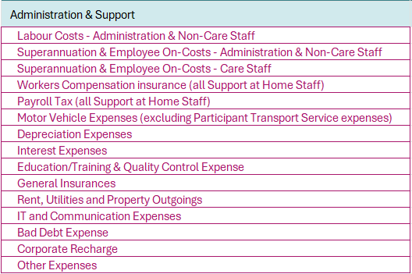
Support at Home administration & support expense reporting
The administration and support expense line items are similar to previous home care reporting.
There are two new line items for “Superannuation and employee on-costs”

Slide 15
Support at Home labour worked hours reporting
  Labour worked hours reporting includes:
  Direct care
  Care management
  Administration and support
  Non-worked hours
  Direct care labour worked hours only need to be reported for employee care staff and are reported against the service being provided. e.g. clinical care, personal care, social support and community engagement, domestic assistance etc. You do not have to report direct care labour worked hours for agency staff or sub-contracted and brokered client services.
  Care management labour worked hours are reported separately for clinical and non-clinical staff.
  Non-worked hours reporting is for employee direct care staff only - RN, EN, PCW and other employee staff employed in a direct care role. Non-worked hours includes all staff paid leave and paid training hours.
  Note that labour worked hours are only reported in the ACFR. They are no longer reported in the QFR.

Slide 16
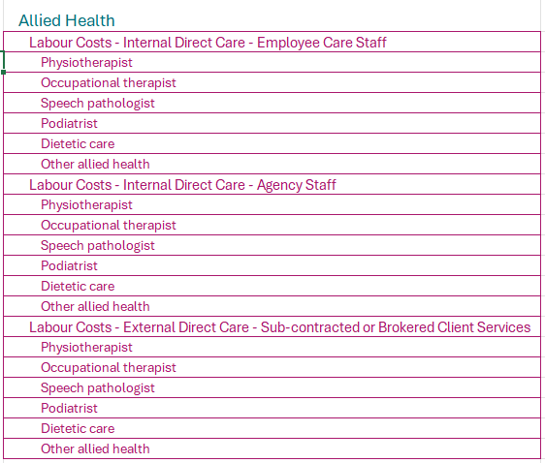
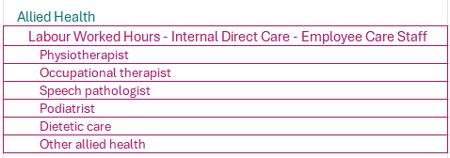
Support at Home allied health reporting
Allied health labour costs and worked hours are to be reported against the following six categories:
  Physiotherapist
  Occupational therapist
  Speech pathologist
  Podiatrist
  Dietetic care, and
  Other allied health.
Labour costs are required to be further sub-categorised by whether the allied health worker is an employee, agency or sub-contracted / brokered
Worked hours are only required for employees

Slide 17
Care Minutes Performance Statement
Aden Pulford
Residential Risk and Funding Operations Branch

Slide 18

Introducing the Care Minutes Performance Statement
A Care Minutes Performance Statement must be completed and audited by an external auditor annually
The Care Minutes Performance Statement has been introduced to protect the integrity of reporting against the Care Minutes and 24/7 Registered Nurse Obligations.
This will in turn protect the Care Minutes Supplement, and the 24/7 RN Supplement.
The audited Care Minutes Performance Statement and the Aged Care Financial Report (ACFR) is due by 31 October 2026

Slide 19
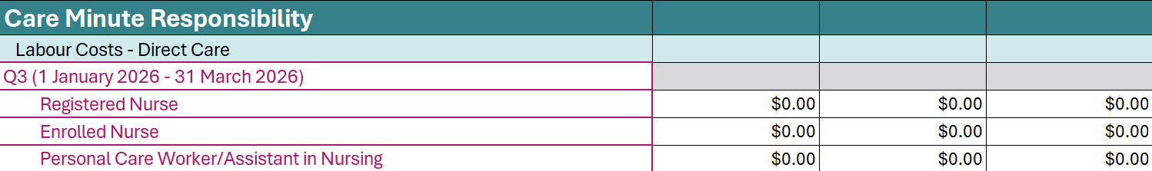
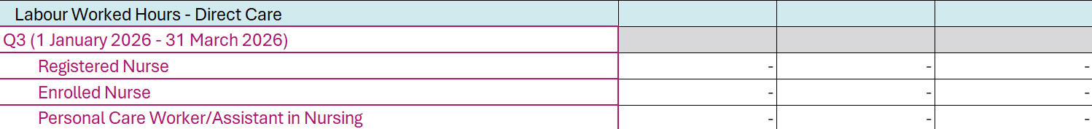
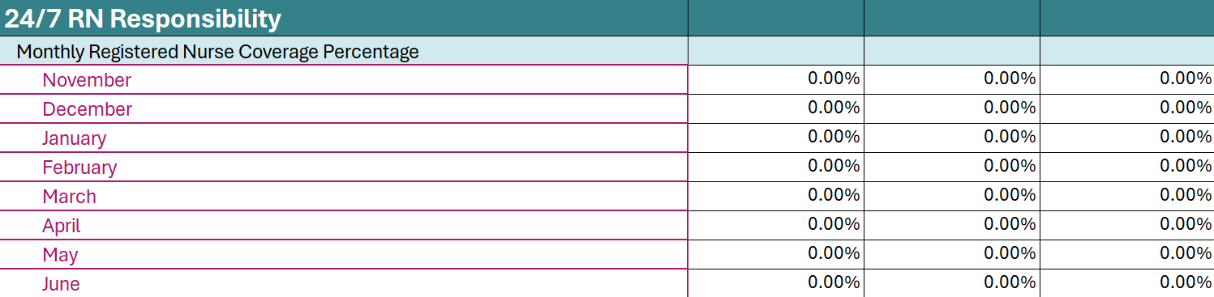
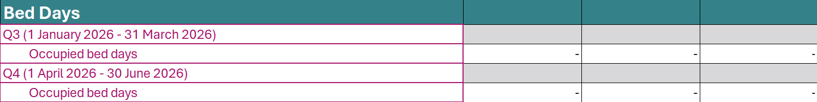
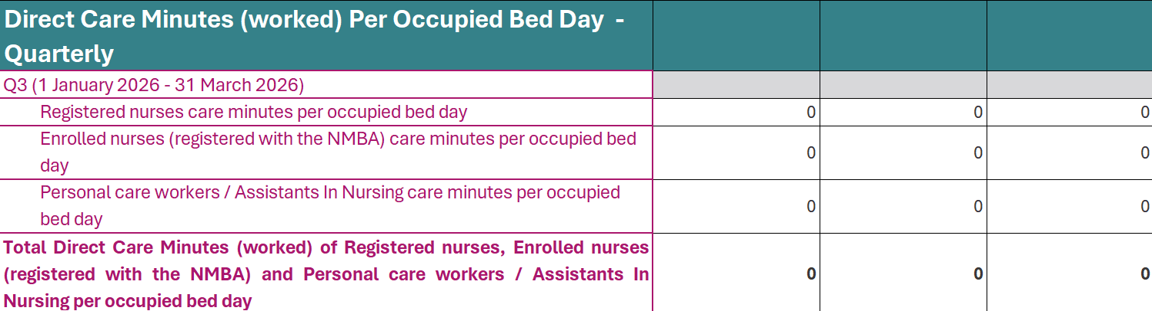
New Care Minutes Performance Statement
All registered aged care providers will be required to submit a Care Minutes Performance Statement annually
Care Minute Responsibility
MM1 providers' payments will be updated based on their Care Minutes Performance Statement
24/7 RN Responsibility
The first Care Minutes Performance Statement will only cover Q3 and Q4 of 2025-26.
Bed Days
Direct Care Minutes (worked) Per Occupied Bed Day - Quarterly
The Quarterly Financial Reports will be reconciled against the Care Minutes Performance Statement
26 March 2026

Slide 20
Engaging with the audit process
What is required?
Residential aged care providers are required to engage an external auditor to provide a reasonable assurance opinion, directed to the department, that their Care Minutes Performance Statement reflects the actual care minutes delivered.
Audit expectation
The external auditor must perform the audit under the assurance standard ASAE 3000.
What is the ASAE 3000?
The ASAE 3000 standards are issued by the Auditing and Assurance Standards Board. This standard relates to Assurance Engagements Other than Audits or Reviews of Historical Financial Information. It is separate to the audit that is already completed for the annual financial statement.
26 March 2026

Slide 21
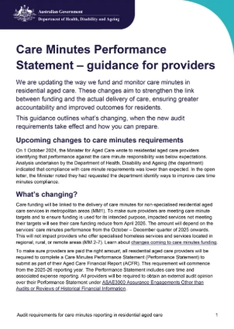
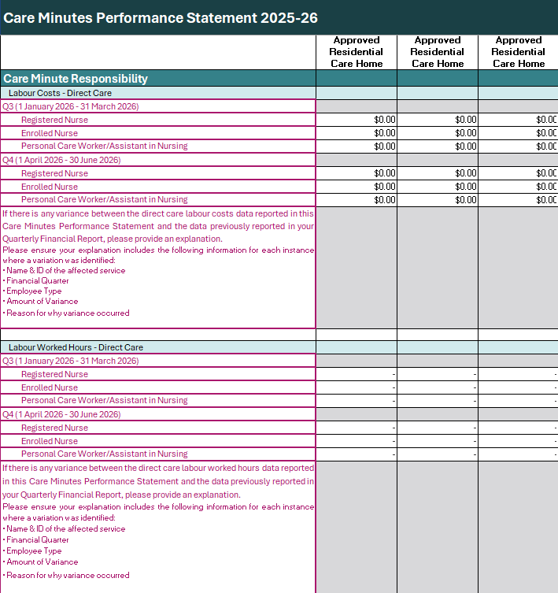
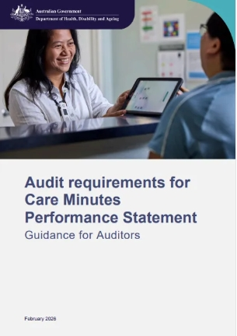
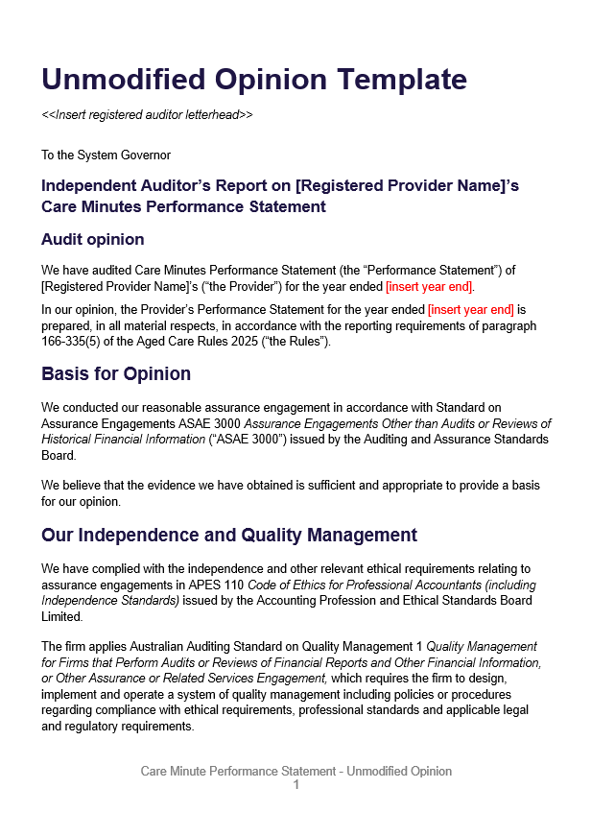


Resources
Guidance for providers
Care Minutes Performance Statement template
Guidance for auditors
Audit report templates
For questions on the statement contact:
ACFRQFRQueries@Health.gov.au
Scan the QR code to access our resources
26 March 2026

Slide 22
Annual Prudential Compliance Statement
Laura Todorovski
Aged Care Quality and Safety Commission

Slide 23
Annual Prudential Compliance Statement (APCS)
What is the APCS?
Which providers have to submit an APCS?
The role of the Aged Care Quality and Safety Commission
25/26 reporting period – the 'hybrid' year
Resources available

Slide 24
What is the APCS?
The Annual Prudential Compliance Statement (APCS) collects information relating
to a provider's compliance with its financial and prudential obligations
The APCS contains questions about the number and value of the refundable deposits, accommodation bonds and entry contributions held by a provider at the end of its reporting period, the way these funds were managed and expended and whether refunds
were paid on time
It is submitted as part of the broader Aged Care Financial Report due annually, within
four months after the end of the provider's reporting period. For most providers this
is 31 October.

Slide 25
Which providers have to submit an APCS?
Under the Aged Care Act 2024 and Aged Care Rules 2025, only Category 6 residential care providers are required to submit an APCS where they hold refundable deposits, accommodation bonds or entry contributions.
Registered providers in Categories 1 to 5 are not required to submit an APCS as they do not hold refundable amounts.

Slide 26
The role of the Aged Care Quality and Safety Commission
The role of the Aged Care Quality and Safety Commission (the Commission) is to review and assess APCS responses, determine compliance, provide education and where non-compliance is identified, ensure appropriate remediation and regulatory follow-up.
Providers may be asked to substantiate their claims
Information from the APCS may inform other activities like Prudential and Targeted Reviews
Providers may be required to take corrective action where non-compliance is observed
Outcomes contribute to the Commission’s ongoing risk monitoring and regulatory engagement.

Slide 27

What changes will be made to the APCS 2025-26?
APCS reporting spans two legislative frameworks

Slide 28
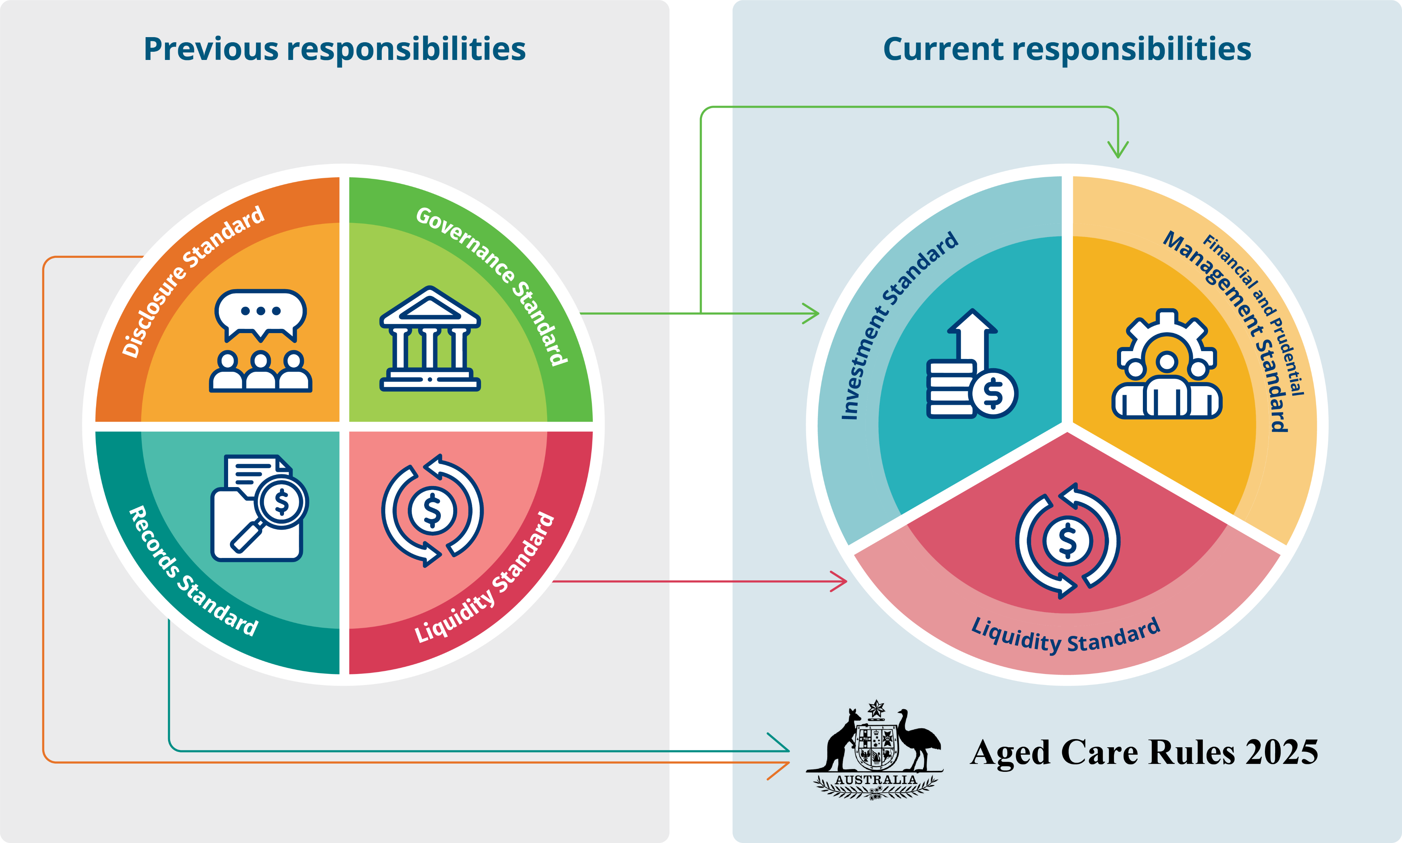
What changes will be made to the
APCS 2025-26?
Prudential Standards, set out in the Fees and Payments Principles 2024 (No.2)
Aged Care Financial and Prudential Standards 2025, Aged Care Rules 2025

Slide 29
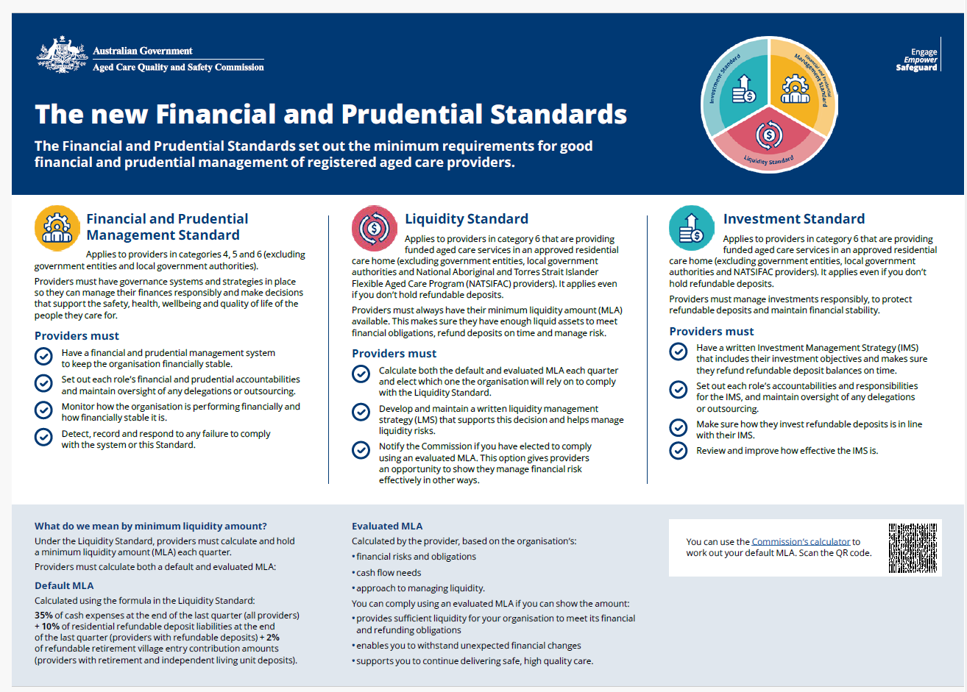
New questions to look out for in the APCS
Questions relating to the new Financial and Prudential Standards:
  Liquidity Standard – has the same name under both legislative frameworks but the requirements are different
  Investment Standard – now applies to all providers, even those not investing
  Financial and Prudential Management Standard – is an overarching principle ensuring organisations are financially sound and viable to ensure the delivery of quality care.

Slide 30
New questions to look out for in the APCS
Compliance with rules around charging accommodation payments and contributions
  Questions specifically relating to action taken when overcharging has been identified
  Record keeping and being able to demonstrate day-to-day operational activities relating to charging and refunding is key.

Slide 31
Resources available
Resources available now
  2025-26 APCS guidelines
  Aged Care Financial Report resources | Australian Government Department of Health, Disability and Ageing
  Fact sheets relating to the new Financial and Prudential Management Standards – they include checklists, tips for demonstrating compliance and information about best practice
Financial & Prudential Standards | Aged Care Quality and Safety Commission
Resources coming soon
  Audit guidelines – coming soon
  Audit opinion templates – coming soon
For all other APCS related enquiries please
contact the Prudential Supervision team via prudential@agedcarequality.gov

Slide 32
Residential pricing risk assessment program
Madeleine Hurrell
Residential Risk and Funding Operations Branch

Slide 33
Introducing the Pricing Risk Assessment Program
What is it?
From Quarter 4 (April to June 2026), we will start ongoing pricing risk assessments to examine the impact of misreporting on residential aged care pricing and policy.
The department will examine a sample of providers’ reporting, to measure the impact of errors or different reporting practices on the reported cost of delivering care.
Why are we doing it?
Residential aged care funding is based on the Independent Health and Aged Care Pricing Authority’s (IHACPA) pricing advice​
Inaccurate or inconsistent reporting can impact the pricing advice, leading to inaccurate funding

Slide 34
How the Pricing Risk Assessment Program Works
Select a Sample of Services
Gather Information
Review Calculation Basis
Informing Pricing and Policy
Sample of residential care homes annually
Perform a walkthrough
Review the assumptions made to allocate costs
Review the measurement bases applied
Provide outputs to IHACPA, to support pricing and inform funding policy decision-making
ACFR line items
Request further information

Slide 35
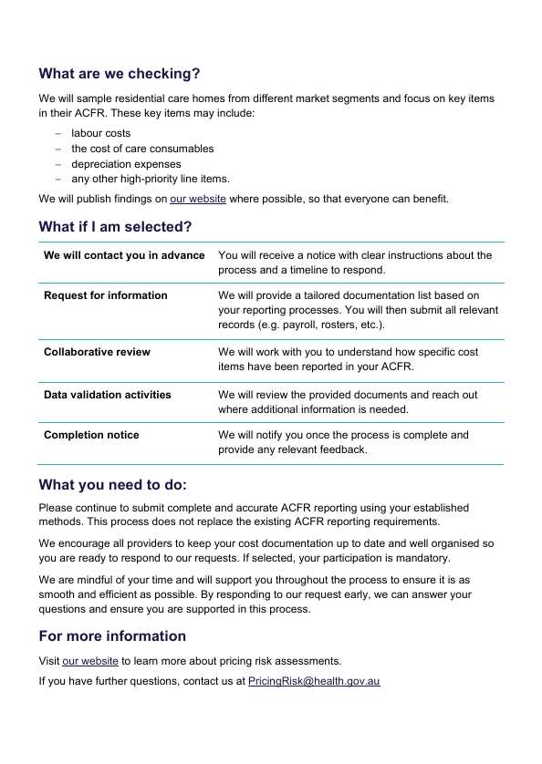
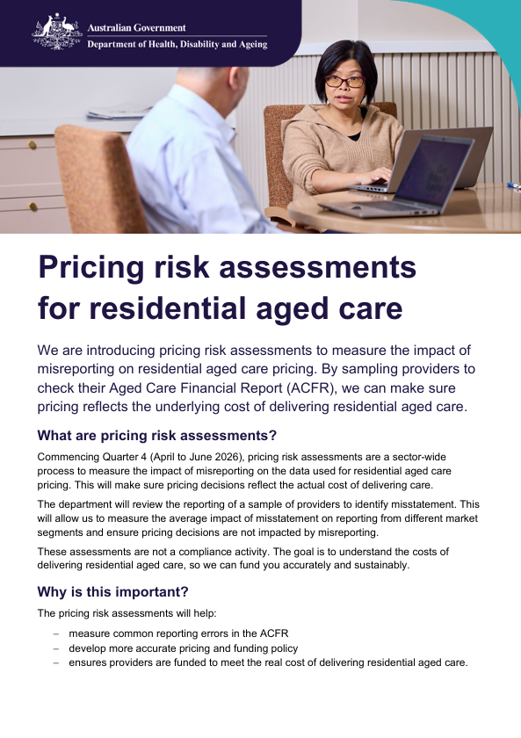
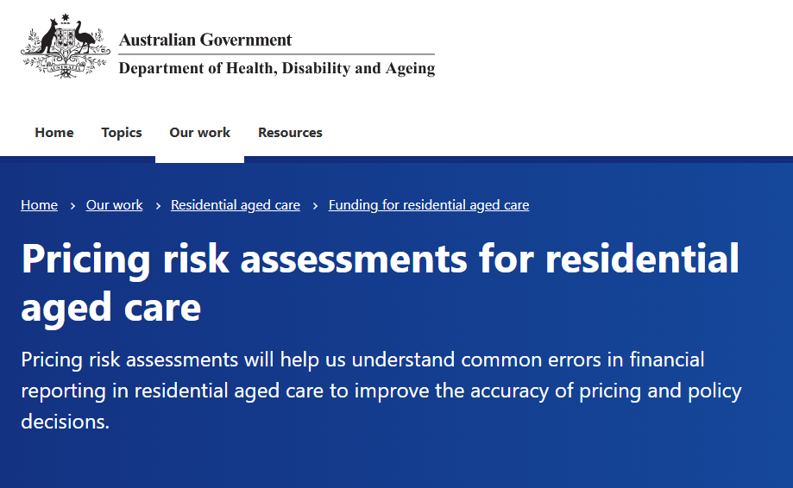

Resources
Pricing Risk Assessments webpage
Pricing Risk Assessments factsheet
For questions and feedback on the program contact:
PricingRisk@Health.gov.au
Scan the QR code to access our webpage and resources

Slide 36
Further information and available support
Anna Morison
Acting Assistant Secretary
Market Intelligence Branch

Slide 37

Financial Reporting Help Desks for Aged Care Providers
Aged Care Financial Report
Resources regarding the ACFR are available on the department’s website to support providers with their submissions.
ACFR Resources
Quarterly Financial Report
Resources regarding the QFR are available on the department’s website to support providers with their submissions.
QFR Resources
Completing ACFR & QFR | Forms Administration Help Desk | Submission related questions Re-opening the poral for resubmissions General reporting queries | health@formsadministration.com.au (02) 4403 0640
Specific financial reporting data | Financial Reporting Operations Team Help Desk | Submission related questions Support at Home financial reporting questions Changes to reporting from 1 November 2025 | ACFRQFRQueries@Health.gov.au
Residential direct care reporting and data quality checks | Residential Care QFR & ACFR Help Desk | Residential Labour Costs & Hours reporting questions Care Minutes reporting questions Residential Labour Costs and Hours data quality checks | QFRACFRHelp@health.gov.au
Annual Prudential Compliance Statement reporting | Aged Care Quality and Safety Commission-Prudential Supervision | Annual Prudential Compliance Statement related questions Understanding your obligations when overcharging is identified Changes to reporting 1 November 2025 | prudential@agedcarequality.gov.au
Care Minutes Performance Statement reporting | Residential Risk & Funding Policy Team | Understanding your reporting obligations How this reporting will affect your Care Minutes funding | ACFRQFRQueries@health.gov.au
Technical IT questions about GPMS, or the QFR application | My Aged Care Service Provider Assessor Helpline | Assigning user access Logging into GPMS Accessing the QFR application in GPMS | 1800 836 799

Slide 38






Business advice and capability support
Business and Workforce Advisory Service (BWAS)
Registered aged care providers can apply for free, independent and confidential advice to improve their operations.
Rapid, strategic, tailored and designed to help providers review their operations
Provides advice on business management, financial strategies, workforce challenges, and aged care reform transition/implementation.
Service Development Assistance Panel (SDAP)
SDAP provides free professional support to aged care service providers located in rural and remote (MM4-7) areas or who provide care to First Nations peoples.
Panel members – qualified and experienced professionals – work with your service to improve the way you deliver and administer aged care to
To address challenges including financial management, business planning, governance and reform transition/implementation

Slide 39
Questions
Aged Care Wages

Slide 40

Please complete this short survey
Thank you for attending

