Slide 1


National Lung Cancer Screening Program
Healthcare Provider Program Overview

Slide 2

Key Program elements
Use of existing Low-Dose CT infrastructure and mobile screening
Screening and Assessment Pathway and supporting resources
Two new bulk-billed MBS items for low-dose CT scans
Integration with the National Cancer Screening Register (NCSR)
National Communications and Engagement

Slide 3

Key Program elements
Use of existing Low-Dose CT infrastructure and mobile screening
Screening and Assessment Pathway and supporting resources
Two new bulk-billed MBS items for low-dose CT scans
Integration with the National Cancer Screening Register (NCSR)
National Communications and Engagement

Slide 4
Key Program elements
Use of existing Low-Dose CT infrastructure and mobile screening
Screening and Assessment Pathway and supporting resources
Two new bulk-billed MBS items for low-dose CT scans
Integration with the National Cancer Screening Register (NCSR)
National Communications and Engagement

Slide 5
Key Program elements
Use of existing Low-Dose CT infrastructure and mobile screening
Screening and Assessment Pathway and supporting resources
Two new bulk-billed MBS items for low-dose CT scans
Integration with the National Cancer Screening Register (NCSR)
National Communications and Engagement

Slide 6
Key Program elements
Use of existing Low-Dose CT infrastructure and mobile screening
Screening and Assessment Pathway and supporting resources
Two new bulk-billed MBS items for low-dose CT scans
Integration with the National Cancer Screening Register (NCSR)
National Communications and Engagement

Slide 7
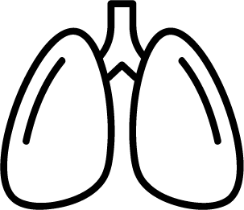


The importance of lung cancer screening
Lung cancer is Australia’s leading cause of cancer-related death¹
But if found early, over 65% of lung cancers can be successfully treated²
In 2024, estimated 15,000 new cases and 9,000 deaths from lung cancer in Australia³

Slide 8
The importance of lung cancer screening
Lung cancer is Australia’s leading cause of cancer-related death¹
20% reduction in mortality from early detection
But if found early, over 65% of lung cancers can be successfully treated²
70% of lung cancers can be detected via a CT scan in the early stages
In 2024, estimated 15,000 new cases and 9,000 deaths from lung cancer in Australia³
100s of lives could be saved each year

Slide 9
Priority populations
There are disparities in incidence and mortality rates for some communities, including:
Aboriginal and Torres Strait Islander peoples
people living in rural and remote areas
people from culturally and linguistically diverse (CALD) backgrounds
people with disability
people with mental illness
people from the LGBTIQA+ communities.

Slide 10





Who is eligible for lung cancer screening?
The National Lung Cancer Screening Program is designed for those most at risk of lung cancer.
Biennial Screening
50 – 70 years
Person who smokes/person with smoking history
(10 years or less since cessation)
30 pack-year smoking history
Asymptomatic (no signs or symptoms of lung cancer)
and
and
and

Slide 11
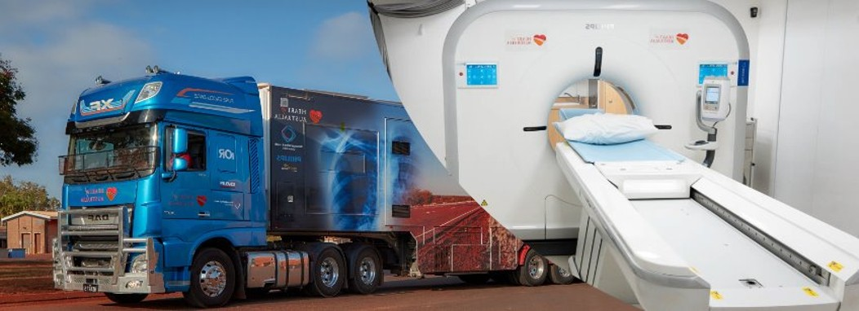
LOW-DOSE CT INFRASTRUCTURE & MOBILE SCREENING
Existing CT Infrastructure will be used where possible
People living in rural and remote locations (one of the NLCSP priority populations) have poorer health outcomes than those in metropolitan areas
Five mobile screening trucks are being manufactured to deliver mobile screening services in some rural and remote communities
Work, including the truck routes, is being co-designed with NACCHO, their Affiliates and Members and jurisdictional health departments

Slide 12
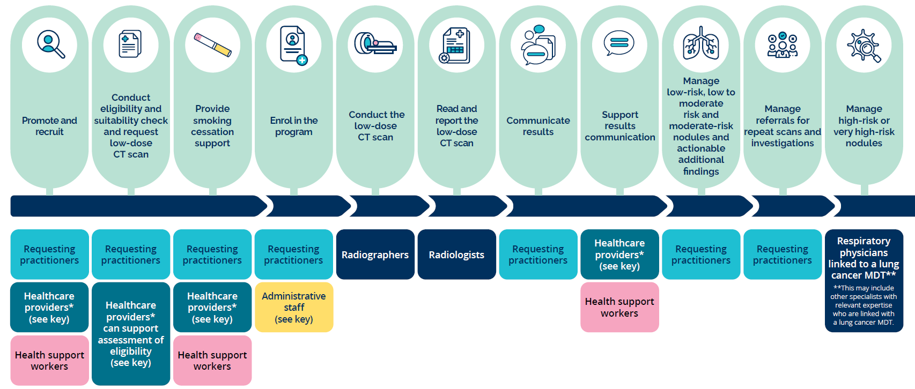
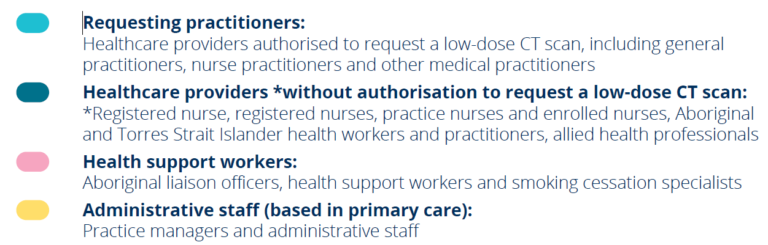
Health workforce roles & responsibilities

Slide 13
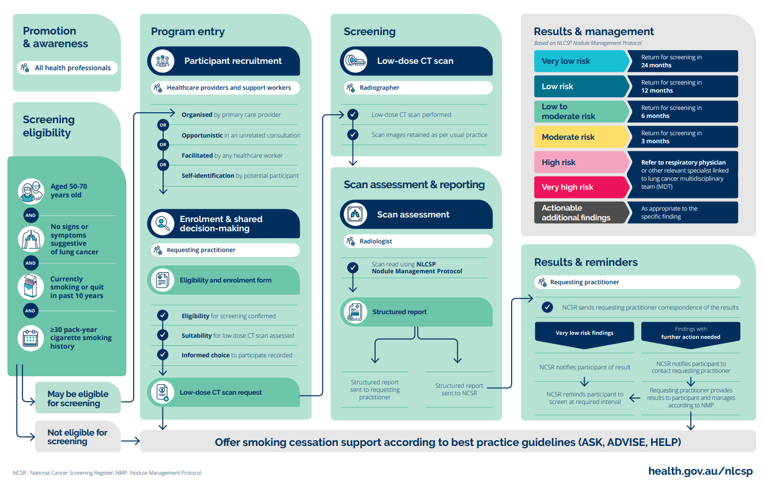
Screening & assessment pathway

Slide 14

Screening & assessment pathway: Promotion & screening

Slide 15

Screening & assessment pathway: entry and enrolment

Slide 16
Screening & assessment pathway: screening & reporting

Slide 17


Screening & assessment pathway: screening & results

Slide 18
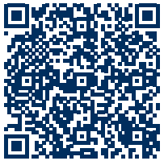

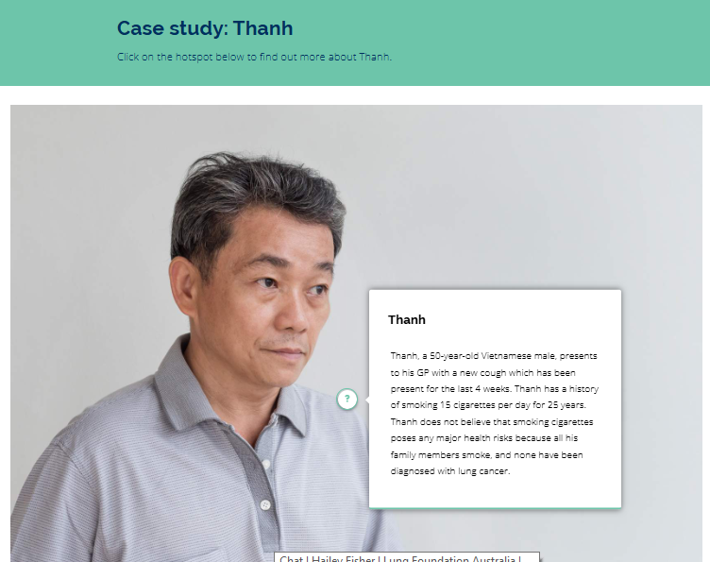
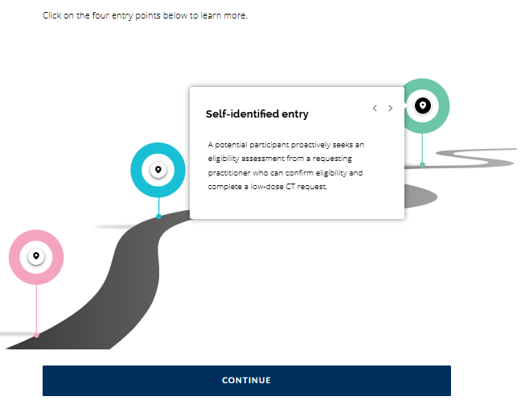

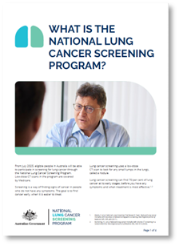
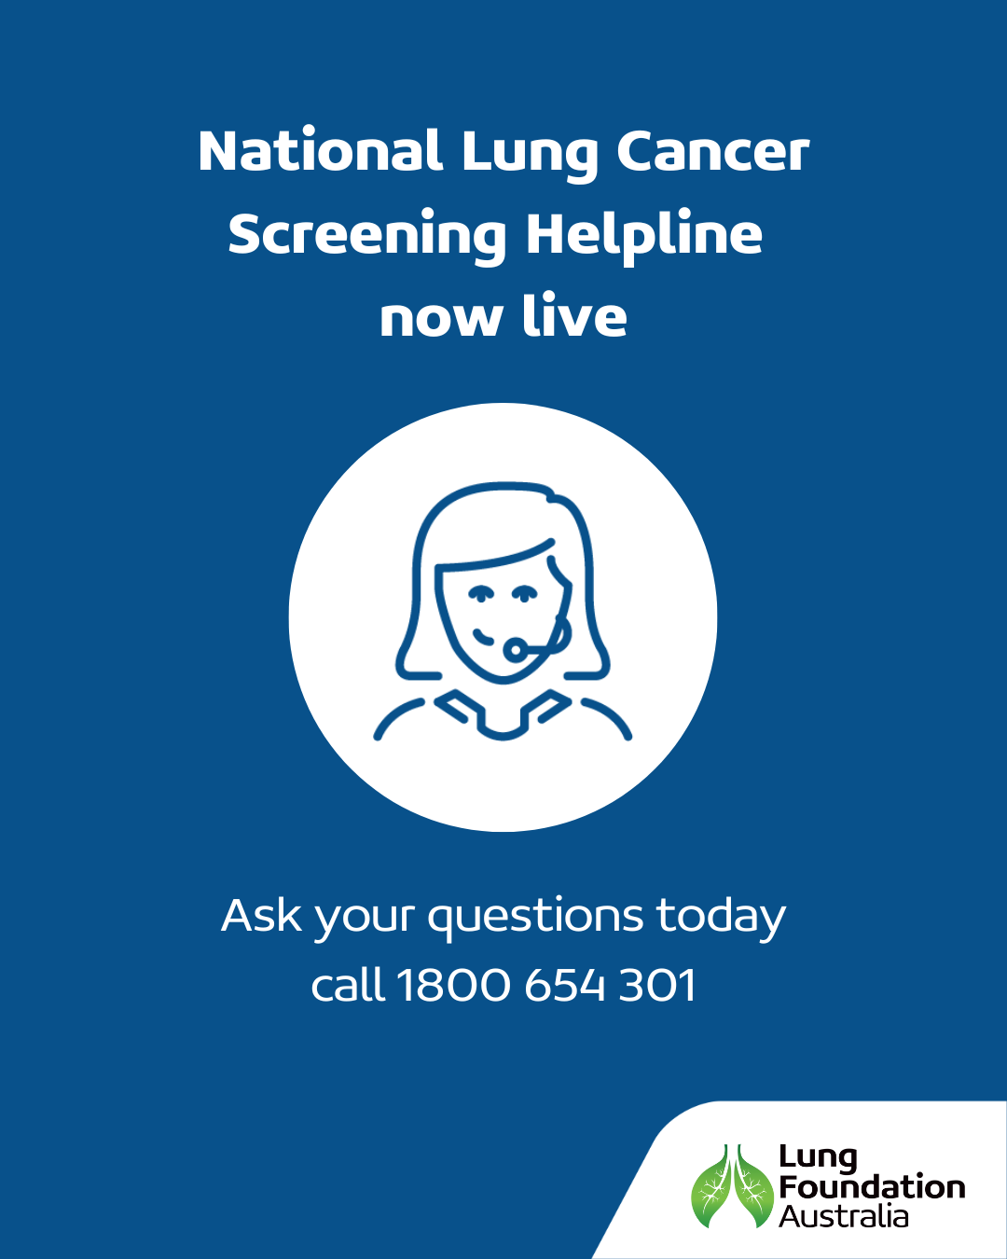
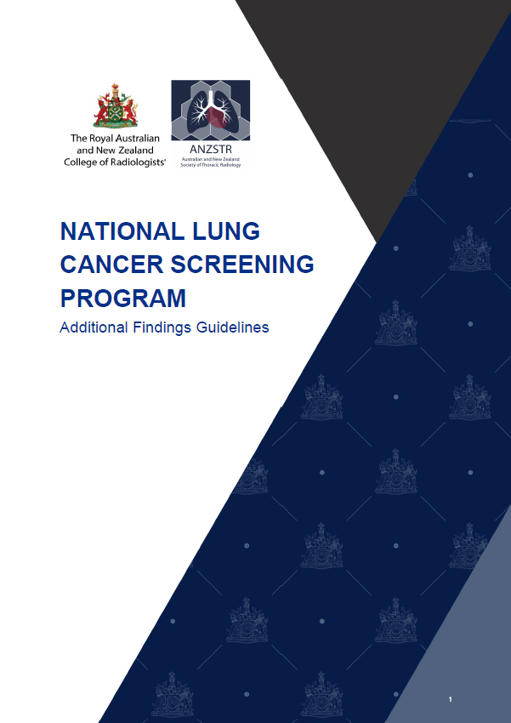
NLCSP materials and resources
Digital Healthcare Provider Toolkit
Scan the QR code for access
Program Guidelines
Healthcare providers
Resources
Healthcare providers and participants
eLearning Modules
CPD accredited for healthcare providers
Support Centre Helpline
Freecall 1800 654 301
M-F 8am – 4.30pm
Guidance, education and training
Radiology sector specific

Slide 19
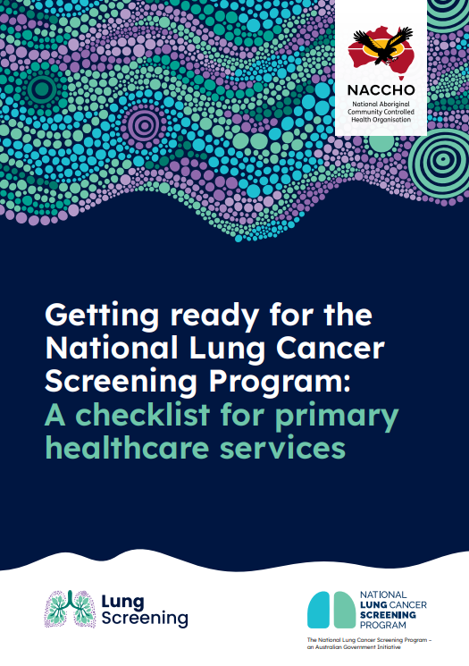

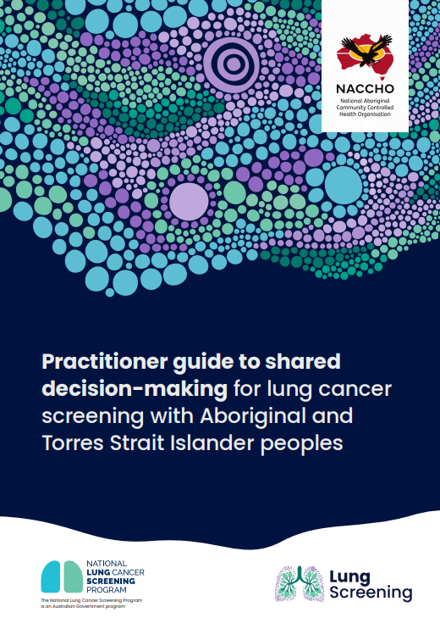

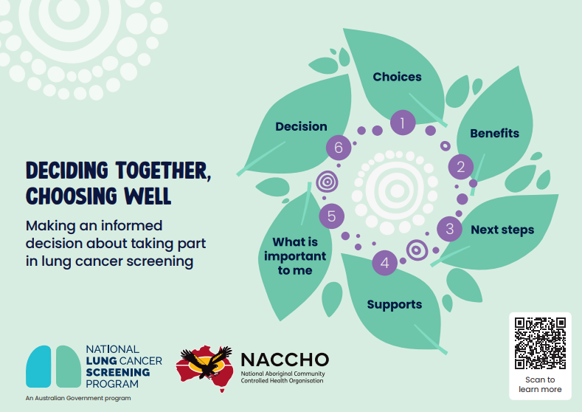
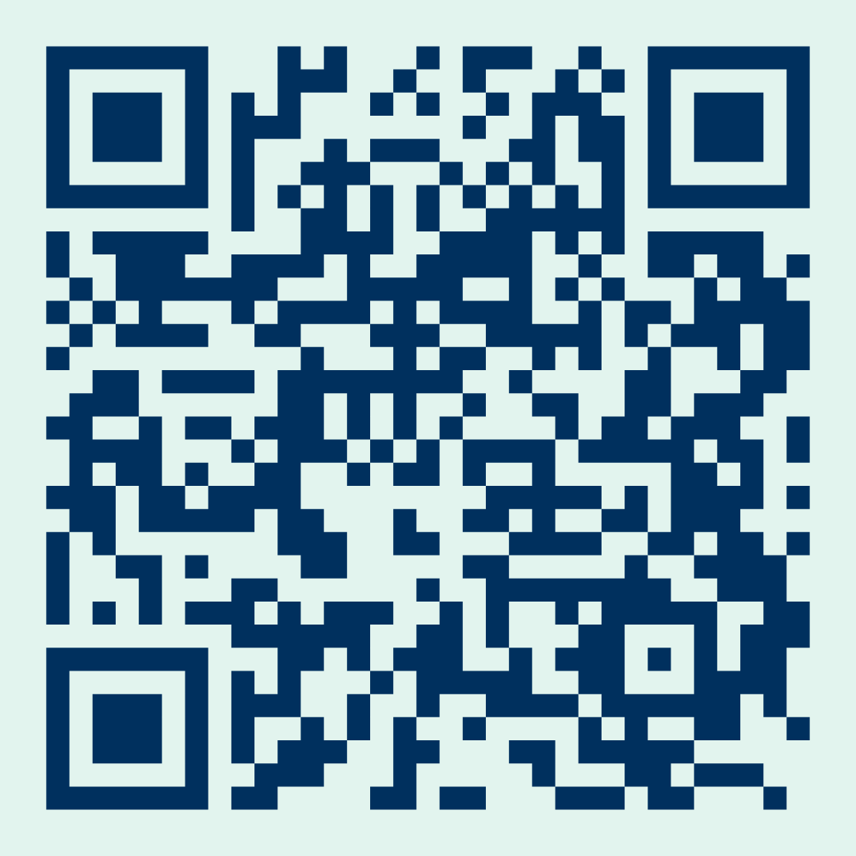
RESOURCES FOR ABORIGINAL AND TORRES STRAIT ISLANDER PEOPLE AND COMMUNITIES
NACCHO National Lung Cancer Screening Program Webpage
Scan the QR code for access or visit www.naccho.org.au/cancer/lung-cancer/

Slide 20



Mbs items
Mandatory bulk billing Medicare Benefit Schedule items for low-dose CT scans, with item parameters and criteria were set by MSAC
Screening low-dose CT scan: undertaken approximately every 2 years when they participate in the Program
Interval low-dose CT scan: follow-up management of a participant with a previously detected low, low-to moderate or moderate risk of lung cancer (to be used for any follow-up regardless of interval)

Slide 21










National cancer screening register
National Cancer Screening Register
MAXIMISE PARTICIPATION
INFORMATION EXCHANGE
SECURE ONLINE ACCESS
DATA AND REPORTING
CONNECTED DIGITAL HEALTH EXPERIENCE
NCSR Website
Scan the QR code for access or visit www.ncsr.gov.au

Slide 22
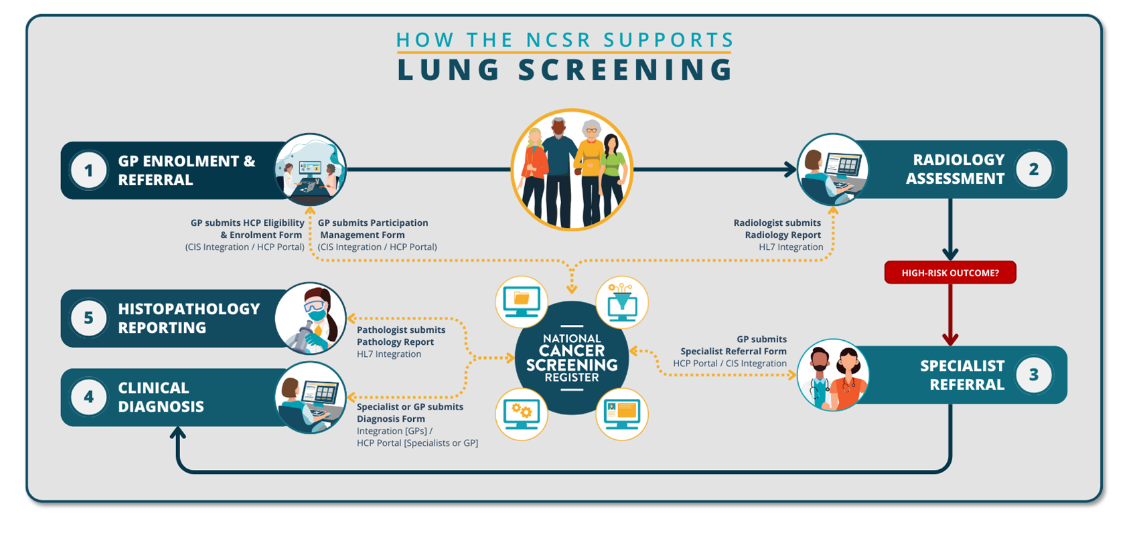
NCSR solution overview

Slide 23
Communication and engagement
Health Sector
Education and information resources
National Communications Campaign
Commencing mid-2025 to raise awareness and promote participation
Priority Populations
Tailored communications and community-led activities to support participation
NLCSP Webpage
Regularly updated as design and implementation progresses
Stakeholder Engagement
Continued consultation with health care providers, states and territories, consumers, and people from priority populations

Slide 24

How can you support?
Through these simple actions, you could save hundreds of lives each year
Familiarise yourself with the Program Guidelines. ​
Complete the online education (continuous professional development (CPD) accredited eLearning modules). ​
Register and integrate with the National Cancer Screening Register, which is essential for enrolments, supporting clinical follow up and reporting. ​
Ensure your team has undertaken formal cultural safety training, which may assist in fostering and providing culturally safe care to Aboriginal and/or Torres Strait Islander peoples.​
Download or order Program resources. ​
Promote the Program using the Communications Toolkit. ​
Identify and invite eligible participants.

Slide 25
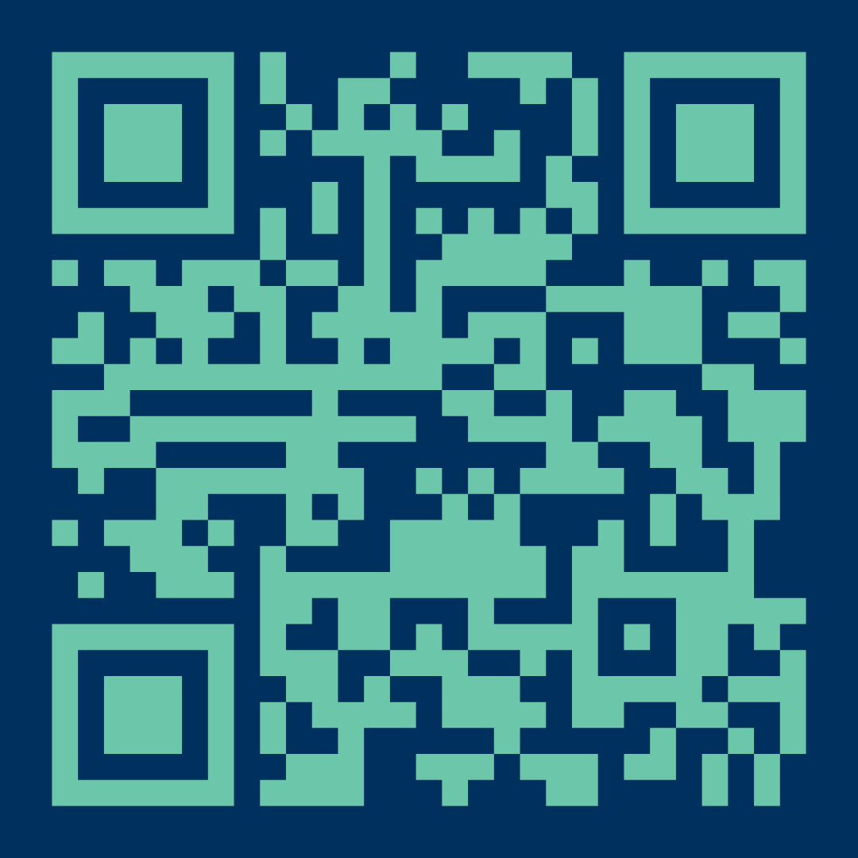
More information
National Lung Cancer Screening Program webpage:
Scan the QR code for access or visit www.health.gov.au/nlcsp.
Contact us:
lungcancerscreening@health.gov.au
Lung Foundation Australia Information & Support Centre:
Free and confidential service is available Mon−Fri 8am−4.30pm (AEST)
Email: lungscreening@lungfoundation.com.au Phone: 1800 654 301

Slide 26
references
Australian Institute of Health and Welfare. Australia’s health 2024: in brief, catalogue number 249. AIHW, Australian Government; 2024 [cited 2024 Aug 8]. Available from: www.aihw.gov.au/reports/australias-health/australias-health-2024-in-brief/formats.
Australian Institute of Health and Welfare (2024) Cancer data in Australia, AIHW, Australian Government, accessed 05 May 2025
Australian Institute of Health and Welfare. Cancer data in Australia, catalogue number CAN 122. Australian Government; 2024 Aug [cited 2024 Aug 27]. Available from: www.aihw.gov.au/reports/cancer/cancer-data-in-australia/contents/about.
Australian Institute of Health and Welfare (2024) Cancer data in Australia, AIHW, Australian Government, accessed 10 July 2025.
Aberle, D. et al. National Lung Screening Trial Research Team. Reduced lung-cancer mortality with low-dose computed tomographic screening. New England Journal of Medicine 365, 395–409 (2011)

