Slide 1









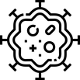
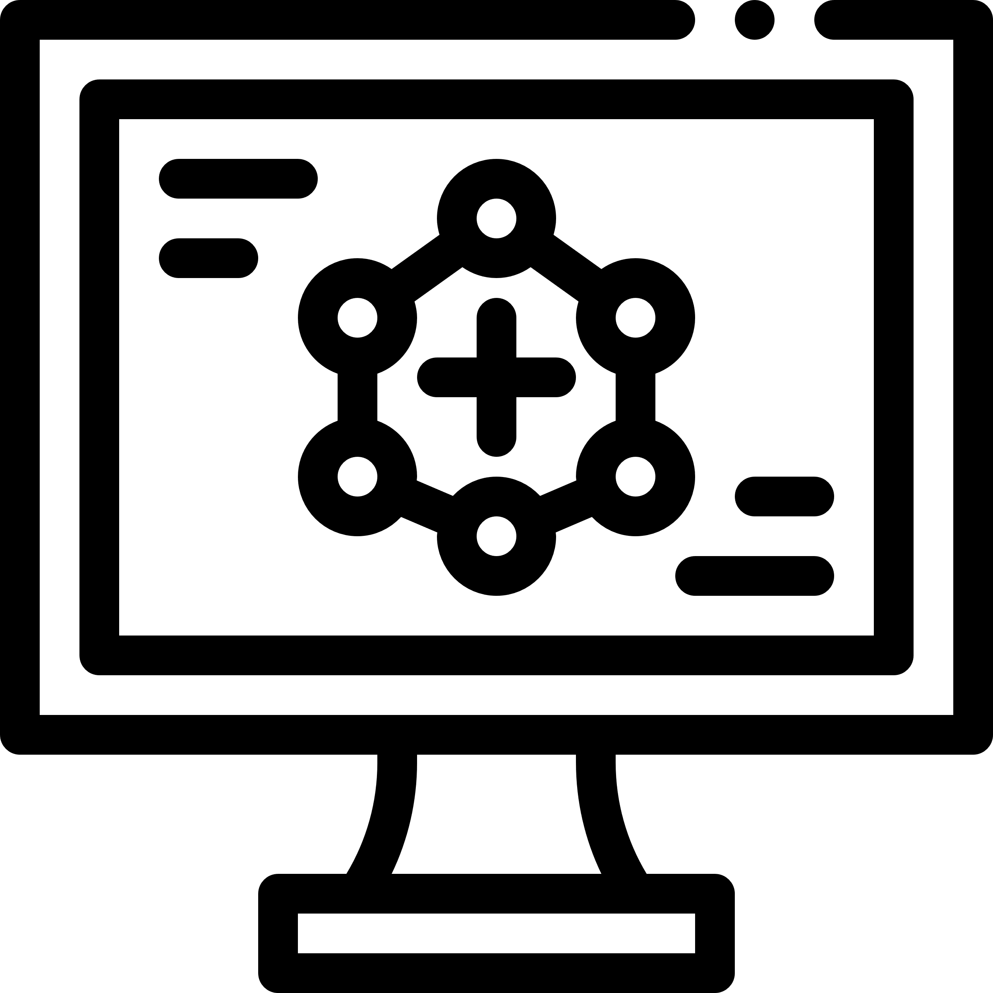



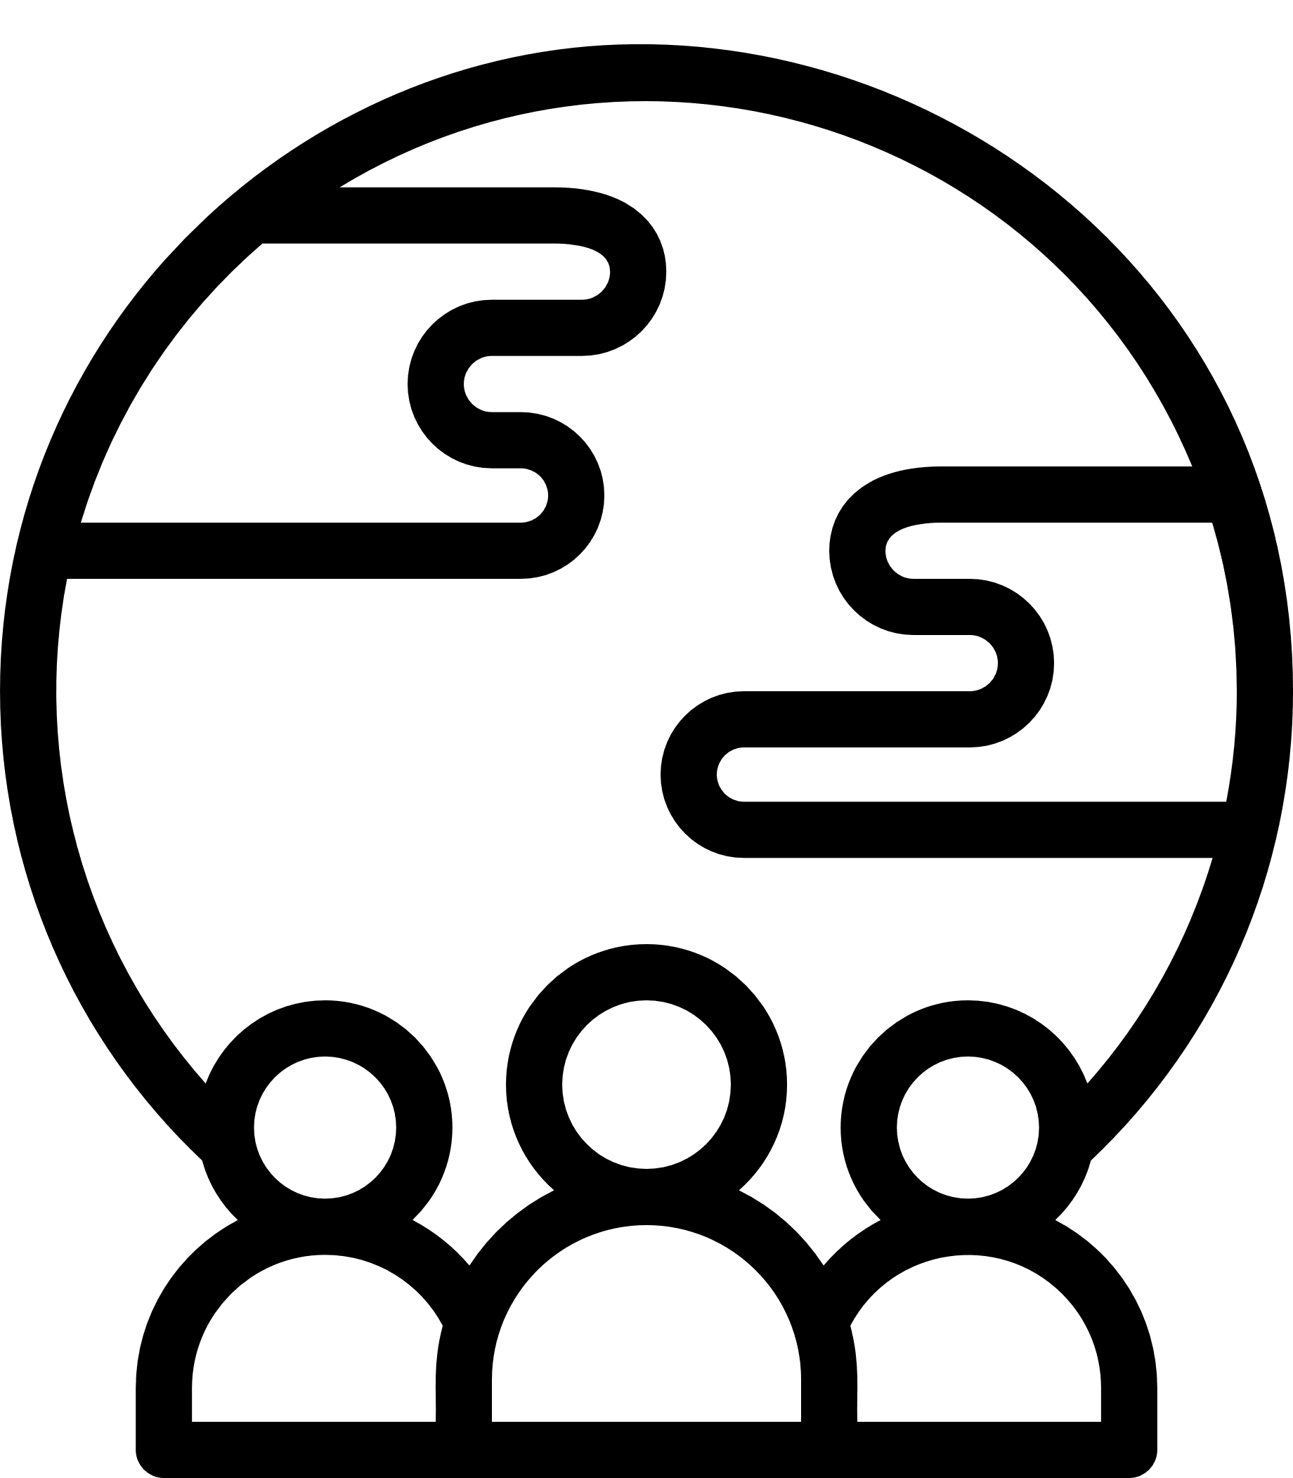
Breast Density GP Guidance
Key Messages
1
Breast density refers to the amount of fibroglandular tissue in the breast and is measured on a mammogram. Both breast density and cancers appear white on a mammogram, making cancers harder to see (known as the masking effect). This could lead to a false negative screening result (getting an all clear when cancer is present). Breast density cannot be assessed by physical examination.
2
The sensitivity of screening mammography (that is, the percentage of women with cancer who attend screening and are correctly identified as having cancer) is approximately 90% for women with low breast density (classified as BI-RADS a or b), 84% for women with dense breasts (BI-RADS c) and
64% for women with extremely dense breasts (BI-RADS d).
3
As well as the masking effect of density, women with dense breasts (BI-RADS c or d) have a slightly increased risk of breast cancer.
As a group, women with BI-RADS category a have around half the risk for breast cancer than women with BI-RADS category b, while those with BI-RADS
category c and d have 1.6-fold and 2.6-fold higher risk, respectively, than women with BI-RADS category b, who represent the general population risk.
4
Risk associated with high breast density needs to be considered in the context of a patient’s overall risk of breast cancer. Other risk factors for breast cancer include age, family history, genetic predisposition, previous invasive breast cancer, DCIS or other high-risk lesions*, use of menopausal hormone therapy (MHT), BMI, parity and breastfeeding, and lifestyle factors, including smoking and alcohol consumption.
5
There is currently uncertainty regarding the optimal supplemental screening methods for women with high breast density, with clinical evidence developing. When discussing any decision about supplemental screening with women who have high breast density, GPs should be clear that a recommendation for further screening does not mean that the woman has breast cancer or has been recalled because of abnormalities suggesting cancer.
6
Shared decision-making about supplemental screening is key. A woman’s decision to have supplemental screening should be fully informed and made in the context of the patient’s breast cancer risk factors, personal circumstances and preferences. After receiving this information, a woman with high breast density may choose not to have any supplemental screening.
7
2D mammography used in breast screening detects the majority of cancers and remains the imaging modality for population-based screening for women of all breast densities. Routine mammographic screening through BreastScreen Australia is recommended for asymptomatic women aged 50-74 years and is available for women 40-49 years and over 74 years if they choose to screen.
This Guidance is intended to inform discussions between healthcare providers and patients who have been found to have high breast density through the BreastScreen Australia program. This Guidance is designed to guide patient-provider discussions and should be considered in the context of each individual patient’s breast cancer risk factors, personal circumstances and preferences. The information in this Guidance is general in nature, based on multidisciplinary discussions and expert consensus as of November 2025. This Guidance may be updated as new medical evidence emerges.
Further information and clinical advice can be found in BreastScreen Australia’s 2024 Position Statement on Breast Density and Screening. The opinions, comments, recommendations, and/or analysis expressed in this Guidance are those of the authors and relevant third parties and do not necessarily reflect the views of the Australian Government including the Department of Health, Disability and Ageing, and cannot be taken in any way as an endorsement or a commitment to a particular course of action, including any future development or implementation. The Department of Health, Disability and Ageing, its employees and advisers disclaim all liability, including liability for negligence and for any loss, damage, injury, expense or cost incurred by any person as a result of accessing, using or relying on any of the information or data in this Guidance to the maximum extent permitted by law.
BreastScreen Australia acknowledges staff at the Cancer in Primary Care Research Group at the University of Melbourne for their support and collaboration in the development of this guidance.
1

Slide 2



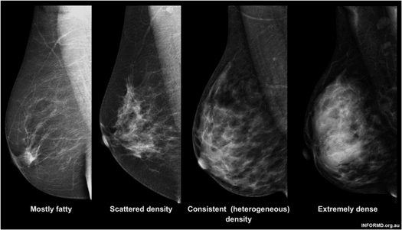
Breast Density GP Guidance
Key Messages
8
For women with BI-RADS d breast density and an average familial risk (as defined in the RACGP Red Book), supplemental imaging, i.e. with CEM or MRI, should be discussed. DBT or US can be considered where CEM and MRI are unavailable, but these tests are less sensitive and have higher false positive rates. Additional imaging will usually incur out-of-pocket costs, regardless of the referrer.
9
For women with BI-RADS c or d breast density and a moderate familial risk (as defined in the RACGP Red Book), overall breast cancer risk should be calculated using a validated breast cancer risk assessment tool such as iPrevent or Tyrer-Cuzick, which incorporates breast density as part of the risk assessment, to determine eligibility for Medical Benefits Scheme (MBS)-funded magnetic resonance imaging (MRI) (Item 63464**). For those women who do not qualify for an MBS-funded MRI but have BI-RADS c or d density, consider self-funded contrast-enhanced mammography (CEM) or MRI. Digital breast tomosynthesis (DBT) or ultrasound (US) may be considered where CEM and MRI are unavailable but are less sensitive.
10
Women with a potentially high genetic risk of cancer (as defined by the RACGP Red Book), should be referred to a breast surgeon or family cancer clinic in accordance with the eviQ GP Referral Guidelines. These Guidelines outline criteria for referral and include a comprehensive list of genetic services by state and territory.
* High risk lesions include Lobular carcinoma in situ (LCIS), Atypical ductal hyperplasia (ADH) and atypical lobular hyperplasia (ALH).
** Patient may be eligible for a Medicare rebate for breast MRI (Item 63464), if they are younger than 60 years of age and have a lifetime risk greater than 30% or a 10 year absolute risk greater than 5% using a clinically relevant risk evaluation algorithm; and this requires referral from a specialist.
Category a:
Mostly fatty
Category b:
Scattered density
Category c:
Heterogeneously dense
Category d:
Extremely dense
BI-RADS
Breast density categories
The following mammogram images show normal breasts with varying amounts of dense breast tissue
(courtesy of InforMD)
2

Slide 3




Breast Density GP Guidance FAQ
1
2
Why do I need to know this?
BreastScreen services in several states are now providing information to women about their breast density in their mammogram result letter. Women with high breast density (categorised as BI-RADS c and d) are advised to consult their GP to discuss concerns about their breast density and breast cancer risk after their breast imaging at BreastScreen.
What do the BI-RADS categories mean?
The Breast Imaging Reporting and Data System (BI-RADS) for mammography (fifth edition) is used to describe four categories of density:
BI-RADS category a: the breasts are almost entirely fatty.
BI-RADS category b: there are scattered areas of fibroglandular density.
BI-RADS category c: the breasts are heterogeneously dense, which may obscure small masses.
BI-RADS category d: the breasts are extremely dense, which lowers the sensitivity of mammography.
3
What do I do if my patient has dense breasts?
In a woman at high risk of breast cancer, refer to familial cancer service.
In a woman at moderate risk of breast cancer due to family history, calculate the woman’s risk using an online breast cancer risk assessment tool. This will determine if her breast cancer risk is high enough to be eligible for an MBS-funded MRI (Note that to receive an MBS rebate for breast MRI the woman must be aged under 60 years and the referral must be made by a specialist).
For women with dense breasts (BI-RADS c or d) who do not qualify for an MBS-funded MRI, consider self-funded additional imaging with contrast enhanced mammography (CEM) or MRI where available. Digital breast tomosynthesis (DBT) and or Ultrasound (US) may be used if CEM and MRI are contraindicated or unavailable (based on location and accessibility) but are less sensitive and have higher false positive rates.
4
What risk assessment tools are available?
Validated breast cancer risk assessment tools (e.g. iPrevent or Tyrer-Cuzick) can be used to calculate the woman’s risk of developing breast cancer. They include an assessment of family history, genetic risk and lifestyle risks. These risk tools are useful to determine eligibility for an MBS-funded MRI, particularly for women at moderate risk due to family history and BI-RADS c or d.
3

Slide 4
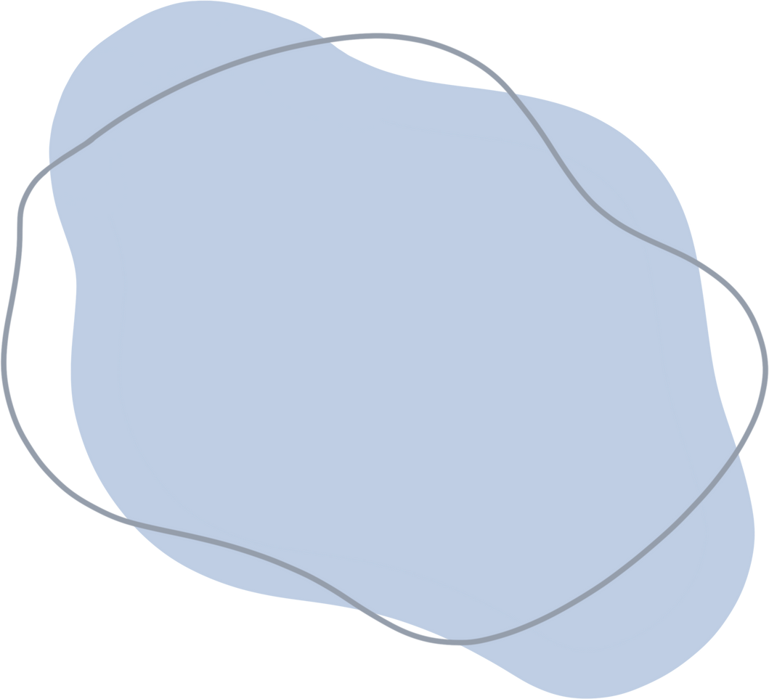
Supplemental Imaging Options
Additional Cancers Detected
Issues to Consider
Cost
MBS Eligibility Requirements
Magnetic Resonance Imaging
(MRI)
~ Additional 16 cancers per 1000 women screened
Accessibility
Out-of-pocket costs
High false positives
Patient acceptability, including claustrophobia
Gadolinium contrast required
$$$
MBS Item 63464: High breast cancer risk, calculated by risk assessment tool; aged <60 years old, referral from specialist required.
Contrast Enhanced Mammography (CEM)
~ Additional 16 cancers per 1000 women screened
Accessibility
Out-of-pocket costs
High false positives
Additional radiation
Iodine-containing contrast required
$$
No MBS item number for supplemental imaging following screening.
~ Additional 4 cancers per 1000 women screened
Widely available
Lower out-of-pocket costs
Higher false positives
Lower cost
Operator dependant
$
MBS Item 55076: If clinically indicated where mammography results are inconclusive due to breast density.
Ultrasound
Digital Breast Tomosynthesis (DBT)*
~ Additional 1.7 cancers per 1000 women screened
Widely available
Potential out-of-pocket cost
Lower cost
Additional radiation
$
MBS Item 59302: For patients with significant family history or clinical indications of breast malignancy.
Magnetic resonance imaging (MRI), Contrast enhanced mammography (CEM), Digital breast tomosynthesis (DBT), Ultrasound (US).
MRI and CEM are the most sensitive imaging tests to detect breast cancers that may be masked when using mammography due to breast density. However, they are not universally available in Australia. DBT and US are less sensitive and US has a higher false positive rate. Supplemental imaging may incur out-of-pocket costs for the patient. Women at high risk, calculated using a breast cancer risk assessment tool, and aged under 60 are eligible for a breast MRI under MBS Item 63464, noting that this requires referral from a specialist.
CEM is not currently covered under the MBS. US is covered under the MBS with referral.
*The inclusion of DBT in the above table offers the full suite of supplemental imaging technologies for women to make an informed decision. Some screening technologies may be unavailable based on location and accessibility.
4

Slide 5





Screening Options for Discussion
Breast Density Category
RACGP Family History Risk Category
Screening Options for Discussion
* Additional imaging screening tests are associated with an increase in false positive results and may incur out of pocket costs.
** Patient may be eligible for a Medicare rebate (Item 63464) if <60 years old, but this requires referral from a specialist, which may incur additional out of pocket costs.
*** Refer to eviQ General Practitioner Referral Guidelines for cancer genetics assessment, which includes a list of Genetic Services by state and type of service.
BI-RADS a or b
Average Risk
Recommend mammography screening every 2 years
Moderate Risk
Recommend mammography screening yearly or every 2 years
High Risk
Refer to familial cancer services ***
BI-RADS c
Average Risk
Recommend mammography screening every 2 years
Moderate Risk
Recommend mammography screening yearly or every 2 years (following risk-informed discussion) at the interval recommended in your jurisdiction
Review additional risk factors and consider using a risk assessment tool (e.g. iPrevent or Tyrer-Cuzick) to determine eligibility for MBS-funded MRI (Item 63464)**
Consider supplemental imaging* with CEM or MRI where available (consider DBT or US if MRI and CEM are contraindicated or unavailable)
High Risk
Refer to familial cancer services ***
BI-RADS d
Average Risk
Recommend mammography screening every 2 years (following risk-informed discussion)
Consider alternative/additional imaging* with CEM or MRI where available (DBT or US if MRI and CEM are contraindicated or unavailable)
Moderate Risk
Recommend mammography screening yearly or every 2 years (following risk-informed discussion) at the interval recommended in your jurisdiction
Calculate breast cancer risk using a risk assessment tool (e.g. iPrevent or Tyrer-Cuzick).
If lifetime risk estimation >30% (or a 10-year absolute risk estimation >5%), offer additional MBS-funded MRI**
If lifetime risk estimation <30% (or a 10-year absolute risk estimation <5%), offer additional imaging* with CEM or MRI where available (DBT or US if MRI/ CEM are contraindicated or unavailable)
High Risk
Refer to familial cancer services ***
5

