Slide 1
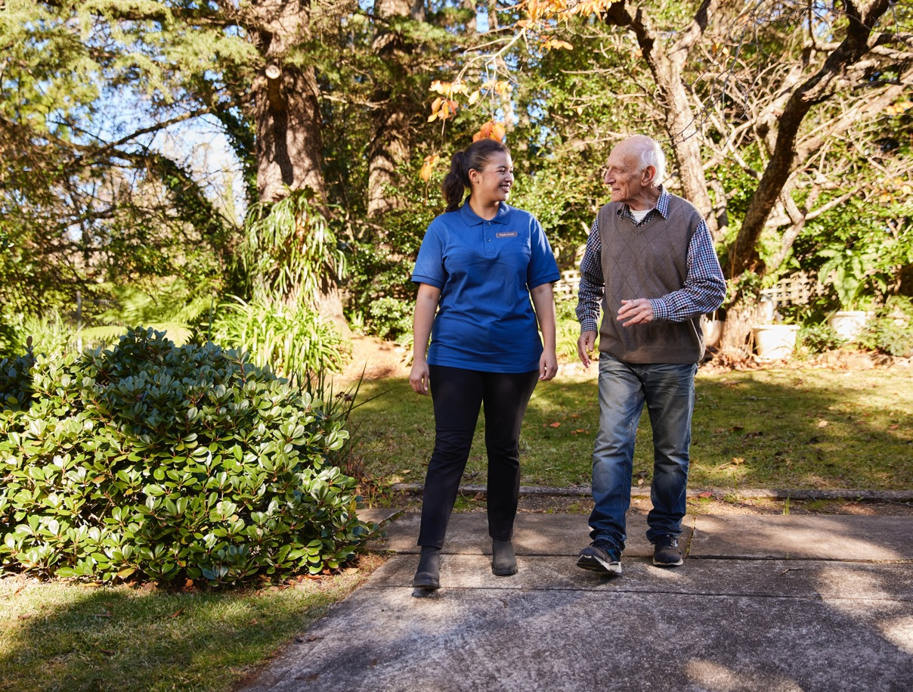
The General Practice in Aged Care Incentive
Better health care for residential aged care home residents
Pull quote
An introduction for residential aged care staff
www.health.gov.au

Slide 2
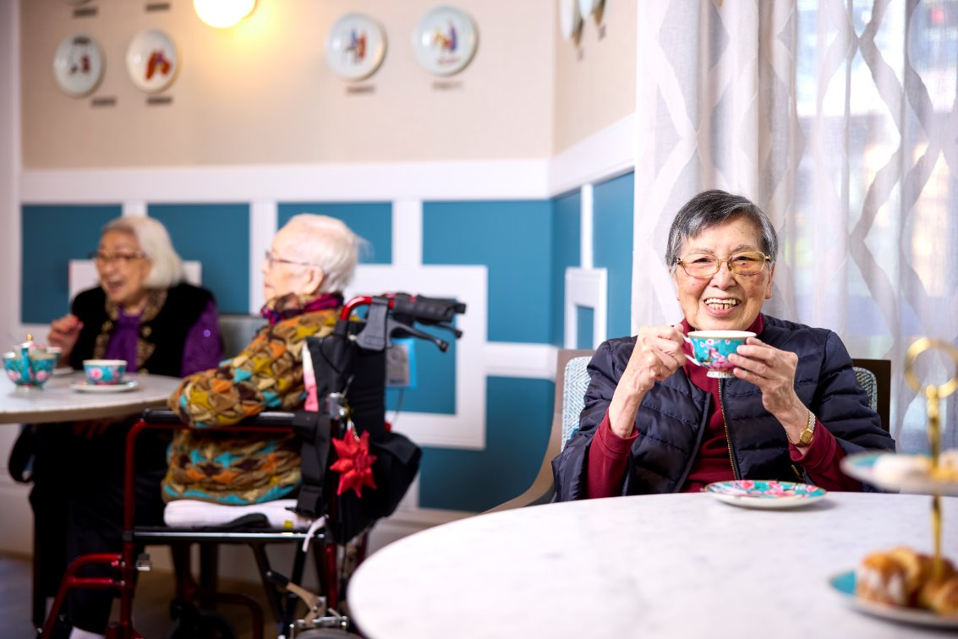
Purpose
The purpose of today’s session is to provide information on:
the General Practice in Aged Care Incentive
how the incentive works
eligibility and service requirements
staff roles
benefits
Pull quote
Further information on all these points is contained in the accompanying information kit for residential aged care providers: Understanding, communicating and supporting the General Practice in Aged Care Incentive.

Slide 3
What are the challenges residents in aged care homes (and us) experience when trying to access a GP and general practice care?
Pull quote
www.health.gov.au
Notes:
​Facilitate a discussion regarding current challenges.

Slide 4
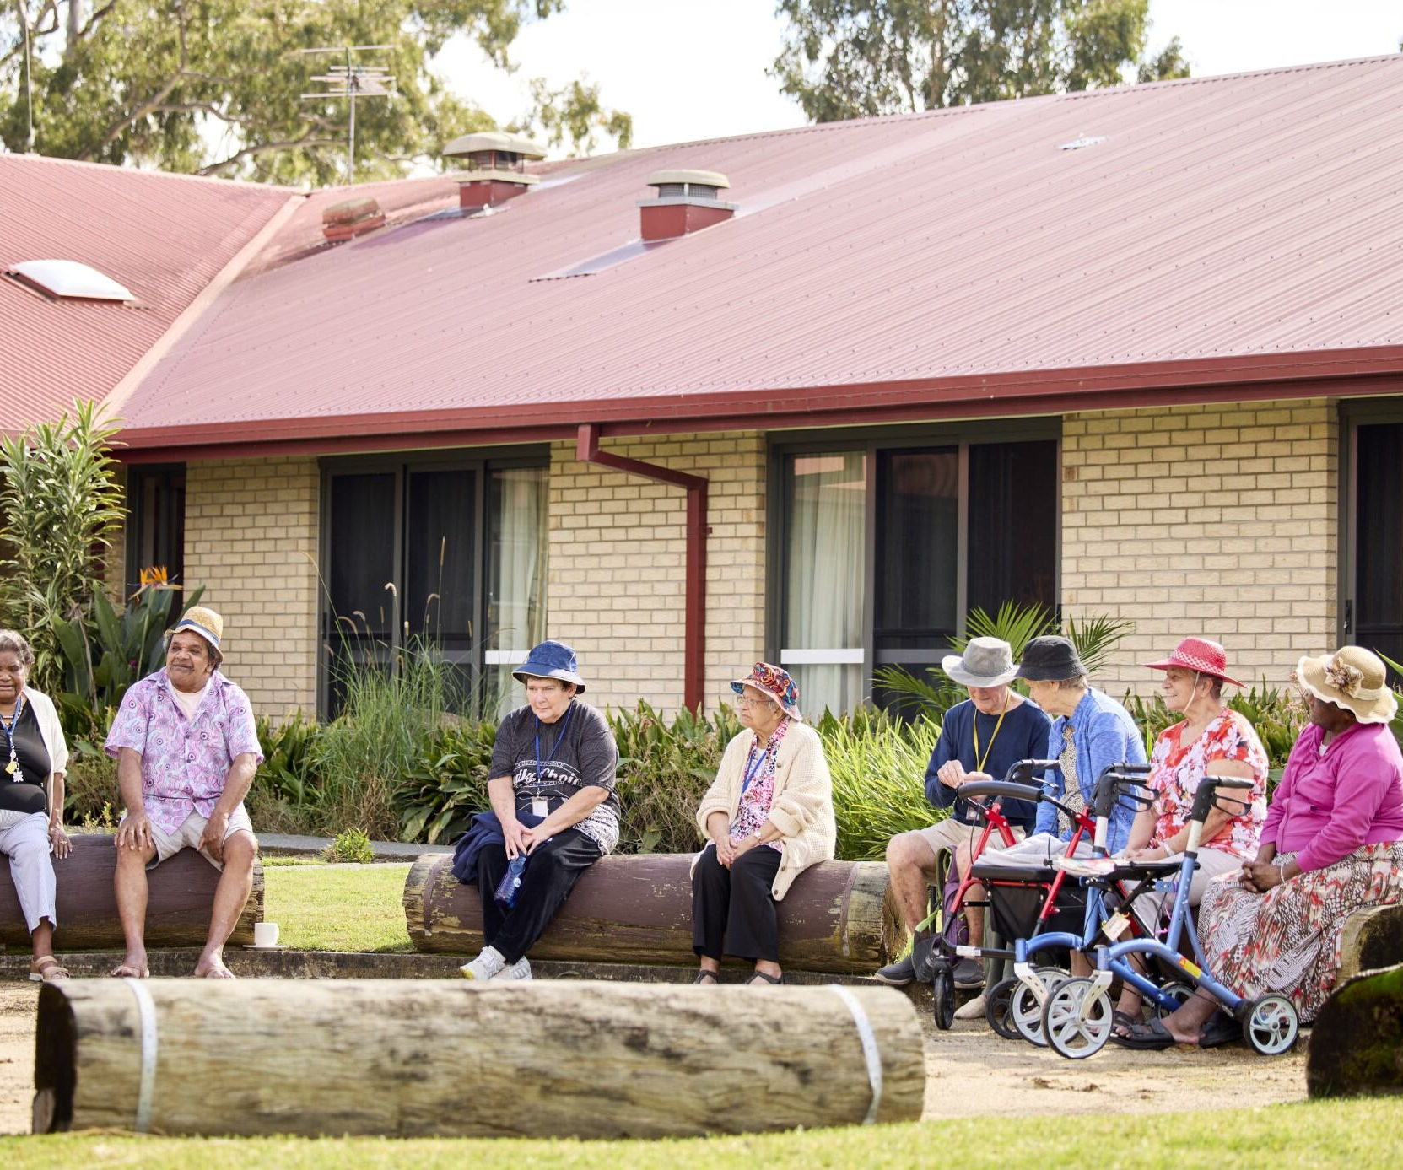
What is the current experience?
Access to GPs is challenging and untimely
Patients have trouble establishing a relationship with a GP
GPs of choice don't always attend aged care homes​
Transport barriers to accessing community-based health services​
Assumptions that aged care providers can provide health care​
Structural discrimination ​
Positive experiences with in-house solutions for example, mobile dental services, GP clinics, telehealth, pharmacists
Pull quote
Notes:
The slide provides an outline of the resident's experience in residential aged care up to now.

Slide 5
What does quality primary health care look like for residents in our residential aged care home?
Pull quote
www.health.gov.au
Notes:
Facilitate a discussion on what high quality primary health care looks like for our residents.​
​
Call out key words/themes such as:​
Responsive​
Timely​
Accessible​
Relational (person, GP and practice and aged care home)​
Planned​
Comprehensive​
Coordinated​
Reviewed and actively managed​
Supporting your residents to register for MyMedicare and facilitating GPs visiting residents may help you meet your Aged Care Quality Standards responsibilities by ensuring your residents can access safe and effective clinical care.
What else would you add to the list?

Slide 6
What is the General Practice in Aged Care Incentive?
The incentive:
commenced on 1 July 2024
aims to enhance the delivery of coordinated quality health care in residential aged care homes
responds to the Royal Commission into Aged Care Quality and Safety and Strengthening Medicare Taskforce
Pull quote
Notes:
1. The General Practice in Aged Care Incentive started on 1 July 2024​​
2. The incentive is all about delivering coordinated quality health care in residential aged care homes right around the country. ​​
​
3. Under the incentive, GPs and practices will receive incentive payments for providing their patients in residential aged care homes with:​​
Proactive face-to-face visits for health assessment and other services​​
Regular planned reviews​​
Coordinated care planning ​​
4. There are some conditions that need to be met for GPs and patients to be eligible – we will cover those in a moment​​
​
5. The incentive is an important response to the Royal Commission into Aged Care Quality and Safety which found that many residents in aged care homes currently receive substandard primary health care – that is, from GPs and others that work in general practices​​
​
6. We know that there are many reasons for this such as a lack of available GPs, long wait times and poor access to after-hours services when they are needed​
​
7. The incentive is also an important part of Strengthening Medicare to ensure it is more equitable and responsive to the needs of all people living in Australia – particularly those with the greatest health care needs

Slide 7
Why is the incentive important?
Residents living in aged care homes have:
complex health care needs
a risk of avoidable hospital visits
equal rights to health care
experiences of substandard health care.
Regular general practice care results in better health outcomes
Pull quote
Notes:
For residents living in our aged care home this means:​
The GP and their practice staff are able to get to know the person, their health conditions and care needs, and their personal preferences better ​
The GP will have access to all the information they need to ensure they better manage the resident’s health conditions and can coordinate care with you for their benefit​
The GP and the practice staff will then be able to work with the person, their family, friends and carers and our care home staff to better manage their conditions​
For example, making sure they receive regular health checks so that new issues can be identified quickly and plans put in place to better manage care; preventative care is provided - such as health screening, immunisations and vaccinations; medications are monitored regularly and so on...​
We know that some residents don’t have a regular GP and, for those that do, it is often difficult for you to get to see them at their clinic – this incentive is designed to overcome some of these challenges.
​

Slide 8
How does the incentive work?
Eligible GPs and practices will receive incentive payments for visiting and providing services to their patients who permanently live in a residential aged care home
Residents can be actively involved in selecting a preferred GP
Eligible GPs and patients must be registered in MyMedicare
Primary Health Network partners will support
Notes:
From 1 July 2024 eligible GPs and primary care practices can receive extra payments for conducting regular appointments, health checks and care planning with residents in aged care homes – at their residential aged care home. ​​
Most importantly, both eligible GPs and practices as well as patients must be registered with MyMedicare to benefit from the incentive​​
MyMedicare is all about formally linking a GP and practice to the patient​
Primary Health Networks are very valuable partners. Not all aged care homes are in locations well served by the GP workforce. Shortages are a reality. In these instances, PHNs have been given funding by the government to find other ways to work with us to find solutions. They will also facilitate improved processes between GPs and practices and residential aged care homes to ensure the provision of practice, planned and continuous care​

Slide 9
To access this package of care, residential aged care residents must:
1. Be a permanent resident of an aged care home
There are no age restrictions to be eligible for the General Practice in Aged Care Incentive package of care
2. Be registered with an eligible* preferred GP in MyMedicare
This voluntary patient registration model formalises the relationship between patients and primary care teams. It is voluntary and free to register with a Medicare Card or DVA Veterans Card
*the GP and practice must be registered for the incentive and then enrol the patient in the incentive.
www.health.gov.au
Notes:
There are 2 main eligibility criteria for residents for the General Practice in Aged Care Incentive: ​
- they must be a permanent resident of an aged care home ​
- they must select a preferred provider and register in MyMedicare. The preferred provider and their practice then must accept them into the General Practice in Aged Care Incentive and commit to providing the expected package of care ​
​
The provider and practice must be registered for the incentive, and then enrol the residential aged care home resident

Slide 10
Incentive service requirements include
8 regular visits
At least 2 eligible regular services per quarter, totalling 8 regular visits per year
Delivered in separate calendar months.
An alternative care team member to the GP (for example, a nurse) can provide 1 eligible service per quarter
and
2 care planning services
At least 2 eligible care planning services per year including:
comprehensive medical assessment ​
contribution to, or review of, multidisciplinary care plan ​
multidisciplinary case conference
residential Medication Management Review. ​
Notes:
​
This slide provides an overview of the eligibility criteria and the service requirements​.​
​
The GP and practice care team will be required to deliver 8 regular visits and 2 care planning services within a 12-month period.​
​
The GP and practice may charge a fee for such services ​
​
It is important that people, family and carers talk to their GP and practice about their charging policies.

Slide 11
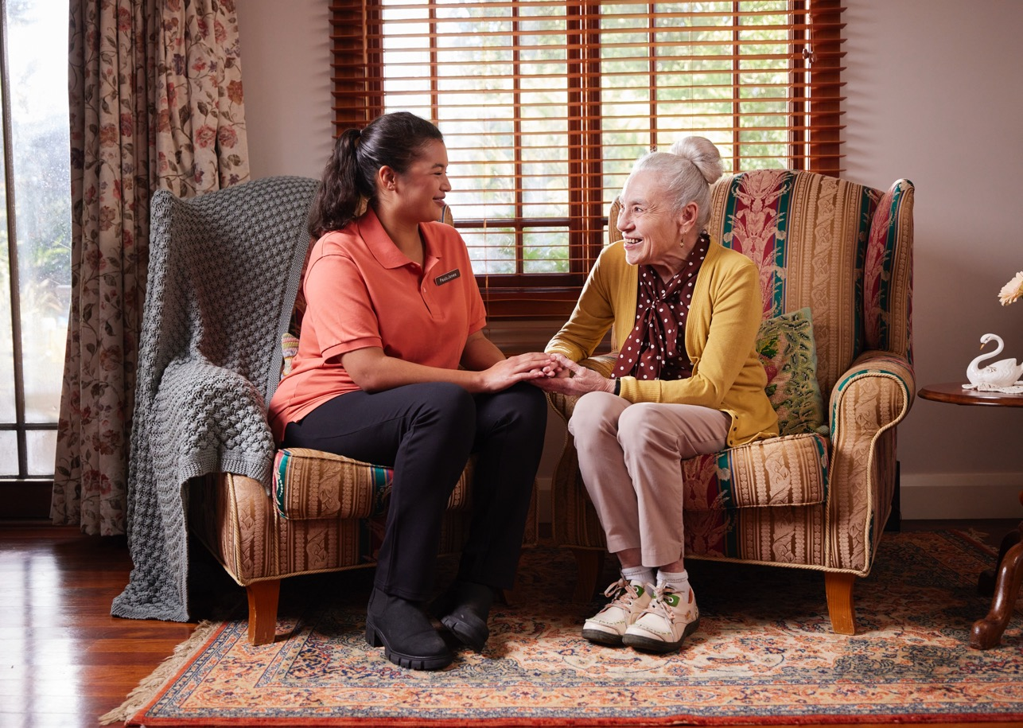
Patient primary care journey example
Mavis’ primary care journey over a year
Pull quote
Notes:
The following slide details an example of a patient story.

Slide 12
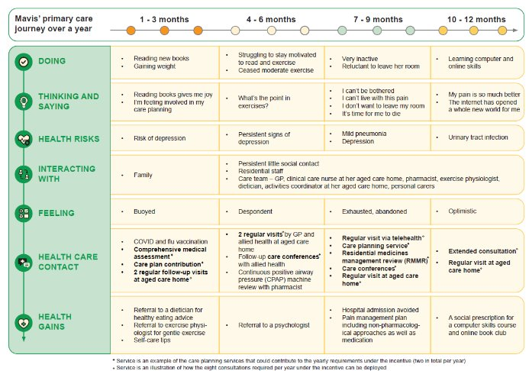
Patient story
Notes:
Patient story - What could good look like?​
​
Mavis is an 89-year longstanding resident of an aged care home in a regional area of NSW. She is widowed and has two adult children, one of whom lives nearby. Both children are busy with their careers and family commitments. Mavis does not socialise much with other residents. She is well educated and had a career in school administration before she retired. She has a long-standing GP who has regularly visited her in the aged care home over the past three years. ​
​
Mavis has chronic obstructive pulmonary disease (COPD), is oxygen-dependent and lives with other conditions including sleep apnoea, congestive heart failure, and arthritis – a source of chronic pain. She experiences recurrent urinary tract infections. Mavis is on seven different medications including medication for chronic pain. Her mobility is good across short distances, and she has no history of falls. She becomes very breathless and often requires a wheelchair. ​
​
Mavis understands how her condition impacts on her ability to conduct day to day functions and is keen to stay well. She has some confidence in her own ability to manage her condition with the support of staff at her aged care home but recently has experienced frequent trips to hospital. She is seeing a physiotherapist to assist with her lung health and mobility. While she is keen to avoid any further trips to hospital, she is resistant to the physio’s suggested exercises. What matters to Mavis at this stage of her life is quality time with her family. She has lost some capacity to do the reading she used to enjoy but she still gets to it when she can. While not diagnosed, Mavis is likely to be depressed​
​
​
Talk through the patient story.​
​
Does this resonate:​
How many Mavis’s are you aware of? People in similar circumstances?​
What's different between the usual care received and this illustration?​

Slide 13
What do you think the benefits of the incentive are for aged care residents?
Pull quote
www.health.gov.au
Notes:
Facilitate a discussion on the benefits of incentive.​
​
It is likely that staff will jump to challenges of implementation:​
Document these e.g., on a flipchart or whiteboard (to ensure they haven’t been ignored)​
​

Slide 14
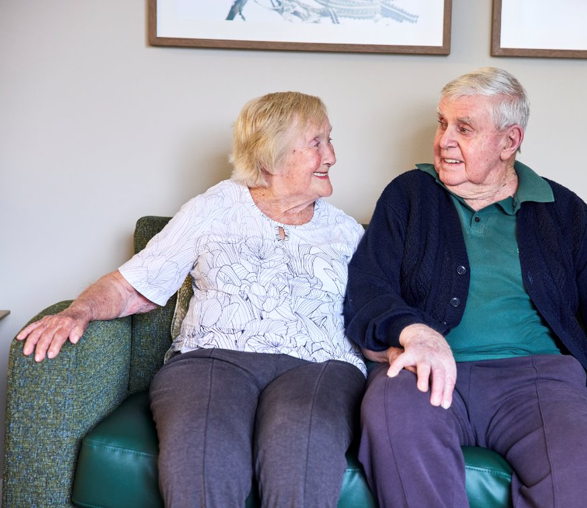
What are the potential benefits to residential aged care home residents?
More proactive and regular access to primary care services delivered in residential aged care homes
More regular care planning services, including health assessments and development of care plans
Greater regularity of primary care services delivered to people in aged care
Formal establishment of relationships between patient, GP, practice and other healthcare professionals
Residents have improved health and wellbeing outcomes ​
Fewer preventable hospitalisations for residents, especially during the after-hours period
Increased continuity of care
Pull quote
Notes:
This slide outlines the benefits to people living in aged care:​
More proactive, timely care​
More regular visits​
Better planning and co-ordination​
Minimise avoidable hospitalisations​

Slide 15
What do you think the benefits of the incentive are for residential aged care home staff?
Pull quote
www.health.gov.au
Notes:
Facilitate a discussion on the benefits of incentive to aged care home staff.​
​
Again, it is likely that staff will jump to challenges of implementation:​
Document these e.g., on a flipchart or whiteboard ​

Slide 16
What are the benefits for aged care home staff?
Knowing that people in their care are getting regular and coordinated primary health care​
Assurance that care plans will be reviewed as needs change​
The opportunity for more residents to have a regular GP​
Feeling supported as part of the extended healthcare team
Pull quote
Notes:
This slide outlines some of the intended benefits to staff.​
​
Under the Quality Standards aged care homes must deliver safe and effective clinical care in accordance with a person’s needs, goals and preferences to optimise health and wellbeing. A partnership approach to care planning and coordination with local providers and practices can contribute to the achievement of this standard. ​
​
This approach will be enhanced by the incentive. ​

Slide 17
What should we do to support residents to gain access to a regular GP and help them receive the benefits of the General Practice in Aged Care Incentive?
Pull quote
www.health.gov.au
Notes:
See next slide... ​

Slide 18
What can ‘We’ do to support residents?
Understanding the incentive, its benefits and roles ​
Providing information for residents and their families and carers
Residential aged care home staff can support the implementation of the General Practice in Aged Care Incentive by:
Developing processes to support implementation
Notes:
Aged care staff have 3 main roles in supporting the implementation of the General Practice in Aged Care Incentive. ​
​
Discuss these roles as a team. ​
​
What local approaches can you implement for each of these roles? ​
​
Some suggested approaches are detailed in the associated information kit. ​
​
Extend the conversation by:​
​
Reviewing the implementation challenges you have recorded.​
​
Discuss how staff (or others) could overcome these – where there's a will there's a way!​
​
2. Identifying what are the top three priorities​
​
3. Who will take the lead on each of these​
​
​
This may help you develop a communication and support plan.​
​

Slide 19
For more information:
Information kit for residential aged care providers: Understanding, communicating and supporting the General Practice in Aged Care Incentive​​
Department of Health and Aged Care fact sheets​
MyMedicare website
Pull quote

