Slide 1
The General Practice in Aged Care Incentive
Better health care for residential aged care home residents
Pull quote
An introduction for aged care residents, their families and carers.
www.health.gov.au

Slide 2
Presentation overview
What is the General Practice in Aged Care Incentive?
What difference will it make to health care for residential aged care home residents?
What do I need to do to get the benefits?
Where can I find out more?
Pull quote
Notes:
1. This presentation will take you through what you need to know about the new General Practice in Aged Care Incentive.​
​2. We will cover how the incentive will benefit your healthcare and what you need to do to get involved.​
​3. There’s plenty of information available that you can refer to after this session. ​
​4. We have an aged care resident information booklet available if you would like read-up on some of the detail later.

Slide 3
What is the General Practice in Aged Care Incentive?
The incentive:
commenced on 1 July 2024
aims to enhance the delivery of coordinated quality health care in residential aged care homes
responds to the Royal Commission into Aged Care Quality and Safety and Strengthening Medicare Taskforce
Pull quote
Notes:
1. The General Practice in Aged Care Incentive commenced on 1 July 2024​.
2. The incentive is all about delivering coordinated quality health care in residential aged care homes around the country.
3. Under the incentive, GPs and practices will receive incentive payments for providing their patients in residential aged care homes with:​
Proactive face-to-face visits for health assessment and other services​
Regular planned reviews​
Coordinated care planning.
4. There are some conditions that need to be met for GPs and patients to be eligible – we will cover those in a moment​.
5. The incentive is an important response to the Royal Commission into Aged Care Quality and Safety which found that many residents living in aged care homes currently receive substandard primary health care – that is, from GPs and others that work in general practices​.
6. We know that there are many reasons for this such as a lack of available GPs, long wait times and poor access to after-hours services when they are needed.​
7. The incentive is also an important part of Strengthening Medicare to ensure it is more equitable and responsive to the needs of all people living in Australia – particularly those with the greatest health care needs.

Slide 4
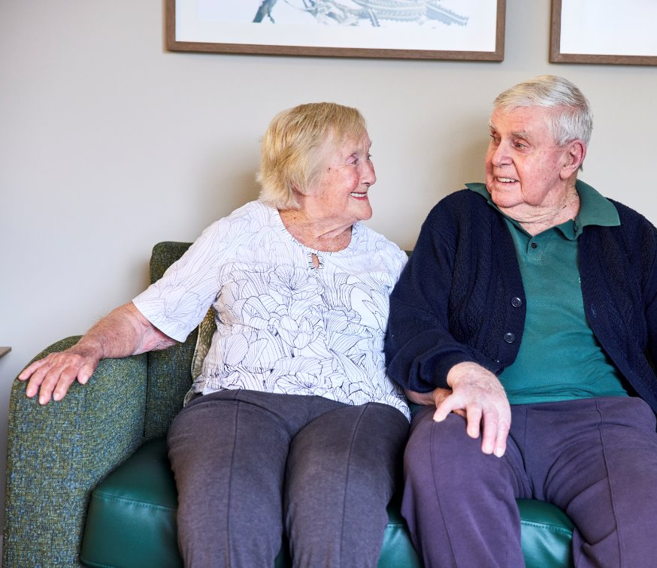
What are the potential benefits for me?
Your GP and their practice:​
Has a chance to really get to know your health needs ​
Can see you regularly, not just when you are sick​
Can help keep you in good health, which might mean fewer hospital visits​
Will have dedicated time to coordinate and review your care​
Can bring along other health professionals who can help you ​
Can include your family or advocates if that is helpful to you.
Pull quote
Notes:
This slide summarises the health benefits of the General Practice In Aged Care Incentive that you will experience through more proactive face-to-face visits, regular planned reviews and coordinated care planning.​
In summary, the benefits of improved continuity of care, more regular monitoring of your conditions and medications, earlier identification of issues and less likelihood of going to hospital all flow from having a regular GP and clinic who come to see you where you live more frequently.

Slide 5
What do I need to do to get the benefits?
Choose your preferred GP and the practice they work in
Discuss your choices and eligibility for the incentive with them
Complete the MyMedicare registration form if you haven't already done so
Notes:
The critical step you need to take is to register with MyMedicare – this is voluntary and entirely your choice​.
In addition, you will first need to have a regular GP and practice who are also registered with MyMedicare​.
Your preferred GP might be: a GP you are already seeing at their practice; a GP who is already visiting you in your aged care home; or someone new​.
There is clear and detailed information about these steps – and your options – in the aged care resident information booklet available here and online​.
We also have experts in the room [name them] who can go over any questions you have in the Q&A session.

Slide 6
For more information:
Aged care resident information booklet​
Department of Health and Aged Care fact sheets ​
Ask your provider​
Ask a member of the team at your residential aged care home
Pull quote

