Slide 1
The General Practice in Aged Care Incentive
Better health care for residential aged care home residents
Pull quote
An introduction for members and partners
www.health.gov.au

Slide 2
Presentation overview
What is the current experience?​
What is the General Practice in Aged Care Incentive?​
Why is the incentive important?​
How does the incentive work?​
What are the roles and benefits?​
What do GPs and practices need to do to participate?​
Where can I find out more?
Pull quote
Notes:
1. This presentation will take you through what you need to know about the new General Practice in Aged Care Incentive​​
​​
2. We will cover why the incentive is important, how it will work, what the benefits are and how to participate ​
​​
3. There’s plenty of information available that you can refer to after this session. ​​
​

Slide 3
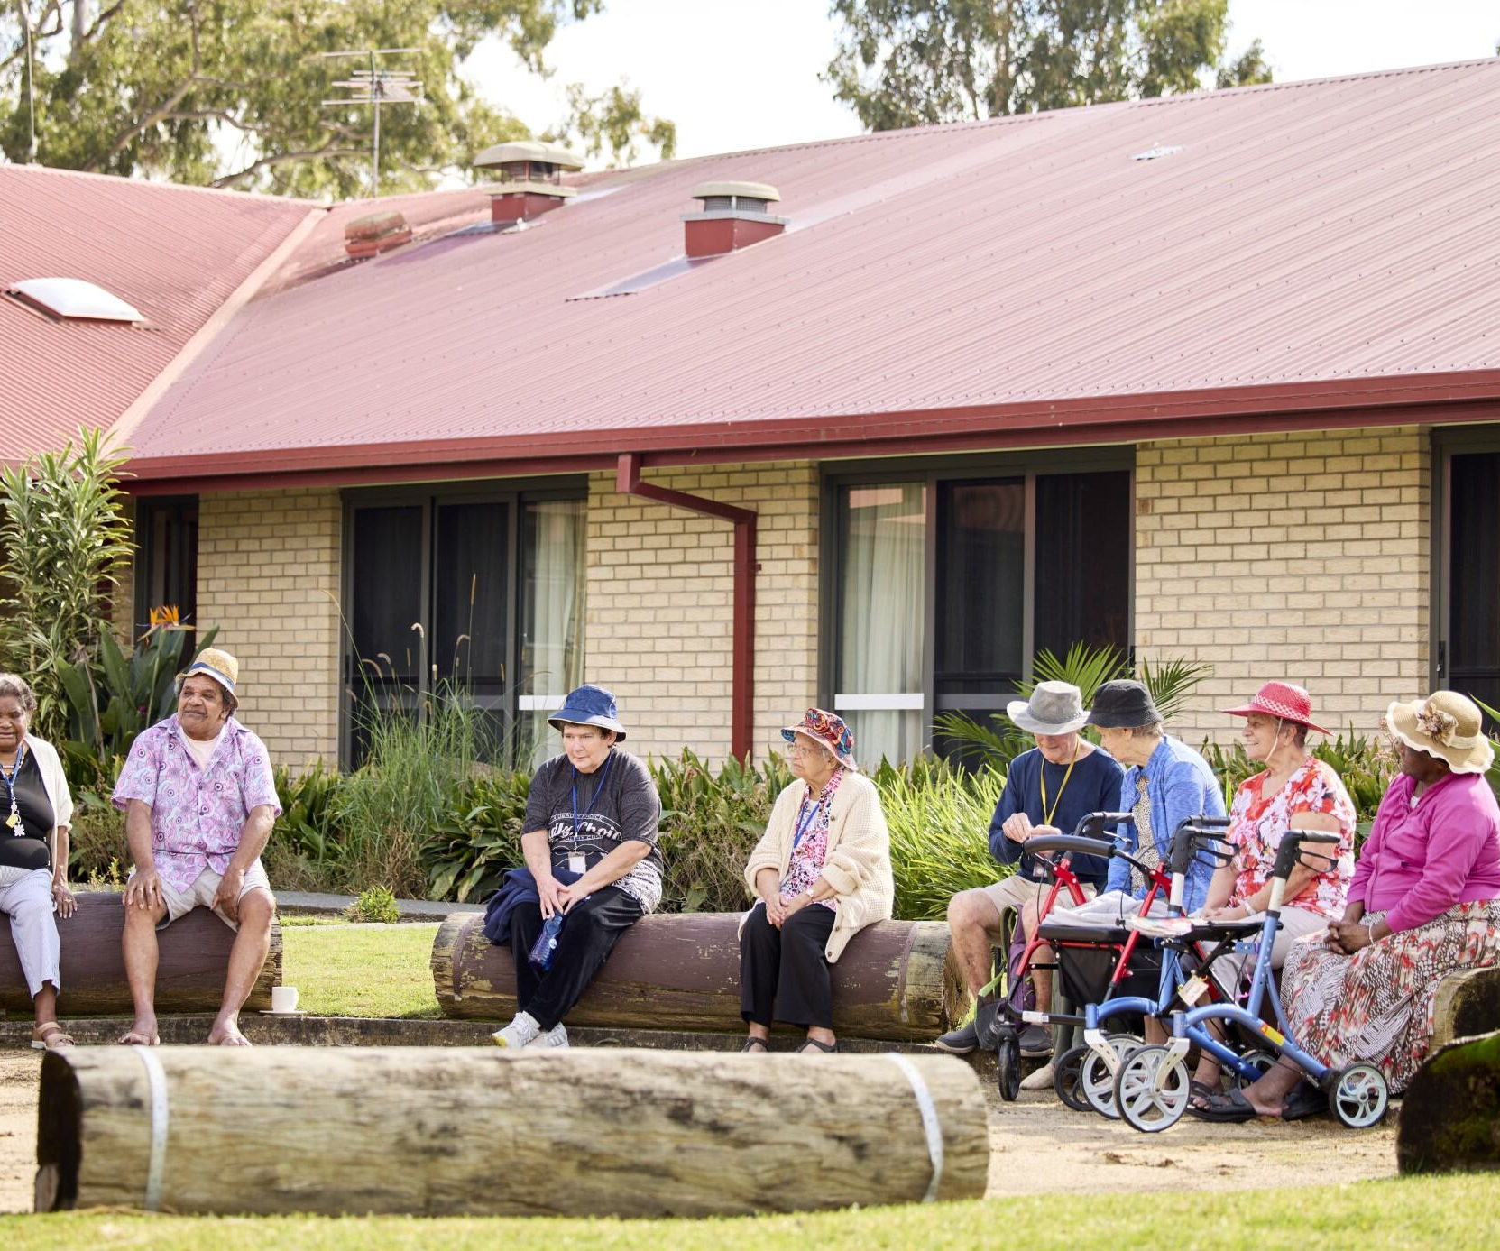
What is the current experience?
Access to GPs is challenging and untimely
Patients have trouble establishing a relationship with a GP
GPs of choice don't always attend aged care homes​
Transport barriers to accessing community-based health services​
Assumptions that aged care providers can provide health care​
Structural discrimination ​
Positive experiences with in-house solutions for example, mobile dental services, GP clinics, telehealth, pharmacists
Pull quote
Notes:
This slide is a summary of what the consumer experience in aged care has been up to now as reported to the Royal Commission in Aged Care Quality and Safety.

Slide 4
A recommendation for change
Recommended the development of a new model of primary care to encourage the provision of holistic, coordinated and proactive health care for the growing complexity of the needs of people receiving aged care.
Recommendation 56. Final Report: Care, Dignity and Respect.
Royal Commission into Aged Care Quality and Safety. 2021
https://www.royalcommission.gov.au/system/files/2021-03/final-report-recommendations.pdf
Pull quote
www.health.gov.au
Notes:
Currently, people living in residential aged care predominantly receive time-based, reactive primary care services rather than preventative and proactive care. People living in residential aged care homes also experience little continuity of care, and many do not have a regular General Practitioner (GP) delivering services, especially in rural and remote areas. Low continuity of primary care in aged care settings is associated with higher risk of mortality. Changing GPs may also impact the management of an individual's health conditions, wellbeing and personal resilience. General practices and practitioners have indicated that there is a barrier to providing care in aged care homes due to the current cost structure of remuneration and the inconvenience of delivering services within the RACH. The Royal Commission into Aged Care Quality and Safety (Royal Commission) also recognised that a lack of compensation for administrative demands limited the effectiveness of existing funding models. ​
​
The Royal Commission has recommended the development of a new model of primary care to 'encourage the provision of holistic, coordinated and proactive health care for the growing complexity of the needs of people receiving aged care' (Recommendation 56). ​
​

Slide 5
What is the General Practice in Aged Care Incentive
The incentive:
commenced on 1 July 2024
aims to enhance the delivery of coordinated quality health care in residential aged care homes
responds to the Royal Commission into Aged Care Quality and Safety and Strengthening Medicare Taskforce
Pull quote
Notes:
In response the recommendation 56 of the Royal Commission the General Practice in Aged Care Incentive will be available to eligible GPs from 1 July 2024.​
​
The General Practice in Aged Care Incentive also forms part of the Australian Government's Strengthening Medicare Reforms which lays the foundations for a stronger Medicare. These reforms respond to the recommendations of the Strengthening Medicare Taskforce and aim to meet the urgent healthcare needs of today while building a stronger Medicare for future generations. ​
​
1. The General Practice in Aged Care Incentive started on 1 July 2024​​
2. The incentive is all about delivering coordinated quality health care in residential aged care homes around the country ​
3. Under the incentive, GPs and practices will receive incentive payments for providing their patients in residential aged care homes with:​​
Proactive face-to-face visits for health assessment and other services​​
Regular planned reviews​​
Coordinated care planning ​​
4. There are some conditions that need to be met for GPs and patients to be eligible – we will cover those in a moment​​
5. The incentive is an important response to the Royal Commission into Aged Care Quality and Safety which found that many residents in residential aged care homes currently receive substandard primary health care – that is, from GPs and others that work in general practices​​
6. We know that there are many reasons for this such as a lack of available GPs, long wait times and poor access to after-hours services when they are needed.​​
7. The incentive is also an important part of Strengthening Medicare to ensure it is more equitable and responsive to the needs of all Australians – particularly those with the greatest health care needs​
​

Slide 6
Why is the incentive important?
Residents living in aged care homes have:
complex health care needs
a risk of avoidable hospital visits
equal rights to health care
experiences of substandard health care.
Regular general practice care results in better health outcomes
Pull quote
Notes:
As people get older, their health needs become more complicated, and they are often at greater risk of avoidable hospital visits​​
2. The incentive is important because it is designed to meet the specific needs of people who live in residential aged care homes so they can enjoy access to care that meets their needs; in their home, coordinated with clinicians in their residential aged care home - largely facilitated through face-to-face visits. ​
A key part of Strengthening Medicare and the opportunity to voluntarily register with a GP and practice of choice is the recognition that having regular general practice care results in better health outcomes – conditions and medications are monitored regularly, and more regular health checks can get onto any new issues more quickly ​​
We know that some residents don’t have a regular GP and, for those that do, it is often difficult to get seen at their clinic – this incentive is designed to overcome some of these challenges. ​
​

Slide 7
How does the incentive work?
Eligible GPs and practices will receive incentive payments for visiting and providing services to their patients who permanently live in a residential aged care home
Residents can be actively involved in selecting a preferred GP
Eligible GPs and patients must be registered in MyMedicare
Primary Health Network partners will support
Notes:
Since 1 July 2024, eligible GPs and practices receive extra payments for conducting regular appointments, health checks and care planning with people in residential aged care homes – at their residential aged care home. ​
Most importantly, both eligible GPs and practices as well as patients must be registered with MyMedicare to benefit from the incentive​
MyMedicare is all about formally linking a GP and practice to the patient
Primary Health Networks are very valuable partners. Not all residential aged care homes are in locations well served by the GP workforce. Shortages are a reality. In these instances, PHNs have been given funding by the government to find other ways to work with us to find solutions

Slide 8
Registering for MyMedicare and the incentive
The practice must be registered in the Services Australia systems for the following:
Provider Digital Access (PRODA)
Health Professional Online Services (HPOS)
the Organisation Register
eligible GPs need to be linked to the Organisational Register
practices must first be registered for MyMedicare and add their banking details to then register for the incentive.
Once the incentive is live, practices will register through the Organisation Register tile in HPOS. Further guidance on this will be provided by Services Australia and will be available online on the Services Australia website to guide practices through the registration process.
Notes:
This slide provides an overview of My Medicare registration for practices and providers​.

Slide 9
Program eligibility
Practices must:
meet eligibility criteria (including registration with Services Australia systems and accreditation against the National General Practice Accreditation Scheme*) and be registered in MyMedicare
have banking details registered in MyMedicare
be registered for the General Practice in Aged Care Incentive in MyMedicare
intend to deliver General Practice in Aged Care Incentive services to registered patients.
Responsible providers must:
hold an incentive eligible provider speciality code
be linked to the practice in the Organisation Register
intend to be responsible for the delivery of services to incentive patients.
Pull quote
Notes:
This slide provides an overview of the eligibility criteria. ​
​
It should be noted that if providers want to receive payment they also need to add their MyMedicare banking details in HPOS.

Slide 10
Service requirements
Eligible providers and practices must meet the servicing requirements to be eligible for incentive payments, including delivering:
2 eligible care planning services over a 12-month period; AND
2 eligible regular visits per quarter, each in a separate calendar month, delivering at least 8 regular services in a 12-month period.
At least one of the regular visits within the quarter must be provided by the responsible provider. A second visit within the quarter can be delivered by another care team member, including:
an alternate provider within the same practice
GP registrar
nurse practitioner
Aboriginal and Torres Strait Islander health practitioner or health worker.
Pull quote
Notes:
This slide provides an overview service requirements​
​
Practices in Modified Monash Model regions 4-7 will be able to provide 4 regular quarterly visits per 12-month period by eligible telehealth MBS items where they are unable to attend a face-to-face service. ​
​
Responsible providers can utilise/claim regular MBS telehealth items.​
These are outlined further in the General Practice in Aged Care Incentive guidelines.

Slide 11
Patient primary care journey example
Mavis’ primary care journey over a year
Pull quote
Notes:
The following slide details an example of a patient story.

Slide 12
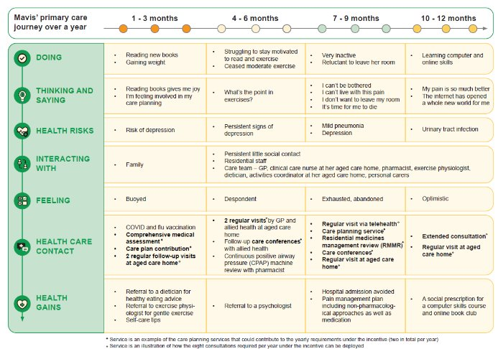
Mavis’ primary care journey over a year
Notes:
Patient story - What could good look like in residential aged care homes?​
​
Mavis is an 89-year longstanding resident of a residential aged care home in a regional area of NSW. She is widowed and has two adult children, one of whom lives nearby. Both children are busy with their careers and family commitments. Mavis does not socialise much with other residents. She is well educated and had a career in school administration before she retired. She has a long-standing GP who has regularly visited her in the residential aged care home over the past three years. ​
​
Mavis has chronic obstructive pulmonary disease (COPD), is oxygen-dependent and lives with other conditions including sleep apnoea, congestive heart failure, and arthritis – a source of chronic pain. She experiences recurrent urinary tract infections. Mavis is on seven different medications including medication for chronic pain. Her mobility is good across short distances, and she has no history of falls. She becomes very breathless and often requires a wheelchair. ​
​
Mavis understands how her condition impacts on her ability to conduct day to day functions and is keen to stay well. She has some confidence in her own ability to manage her condition with the support of staff at her residential aged care home but recently has experienced frequent trips to hospital. She is seeing a physiotherapist to assist with her lung health and mobility. While she is keen to avoid any further trips to hospital, she is resistant to the physio’s suggested exercises. What matters to Mavis at this stage of her life is quality time with her family. She has lost some capacity to do the reading she used to enjoy but she still gets to it when she can. While not diagnosed, Mavis is likely to be depressed​
​
​
Talk through the patient story.​
​
Does this resonate? ​
Point out the regular visits and the care planning services​
​

Slide 13
How is this incentive different to previous incentives?
The General Practice in Aged Care Incentive is a fundamentally different incentive structure
The incentive payments are:
$300 per patient, per year, paid to the responsible provider, and;
$130 per patient, per year, paid to the practice.
The payments will be quarterly, in addition to existing Medicare Benefits Scheme (MBS) and Department of Veterans’ Affairs (DVA) rebates for services delivered.
Key differences include:
there is no cap (the current Aged Care Access Incentive is capped at $10,000 per year)
additional benefits under MyMedicare – including rural loadings and triple bulk billing
it signals a shift away from volume-based incentive to one that incentivises proactive, planned and continuous care
it signals a team-based approach to care as some services provided by practice team members will be eligible as long as the majority are provided by the GP (the responsible provider) that the patient registers.
www.health.gov.au
Notes:
This slide outlines the incentive payment and explains the difference from previous incentives such as no​
No Cap​
Focus on planned proactive care rather than volume​
Providing a multidisciplinary GP led team-based approach

Slide 14
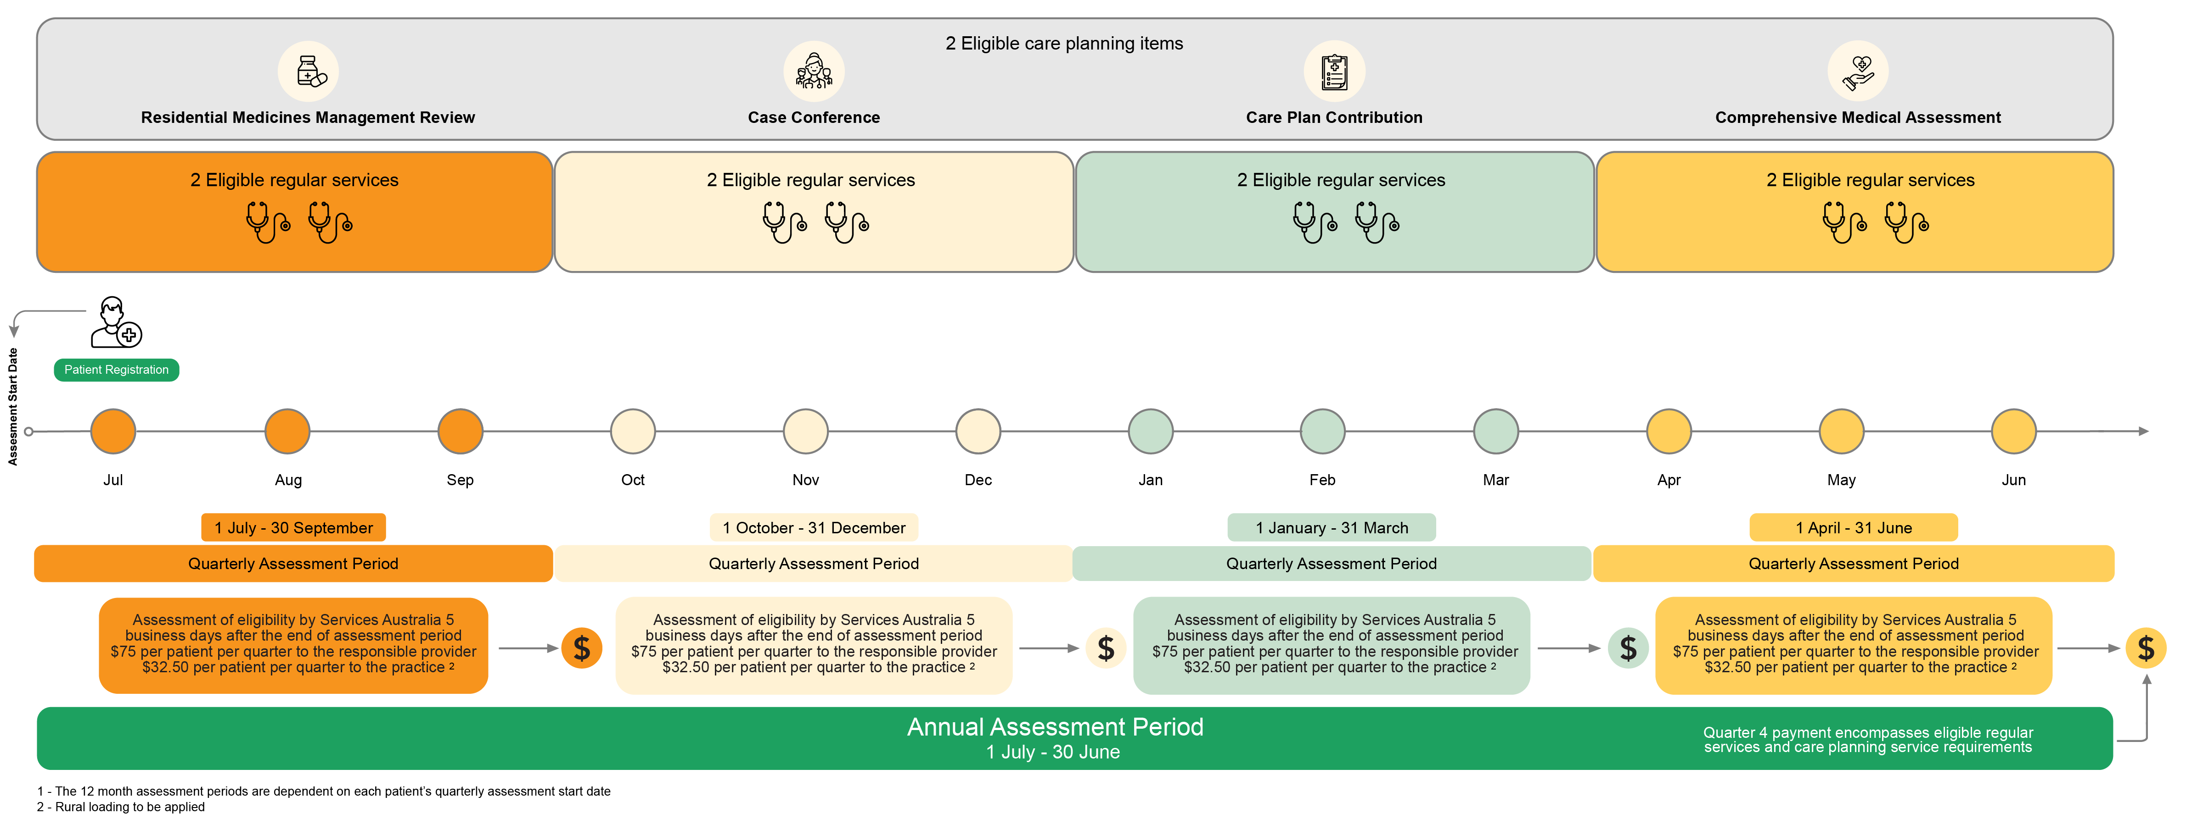
Structure and process
Notes:
This slide outlines the servicing requirements, assessment periods and payment schedule of the incentive. ​
​
Eligible providers and practices must meet the servicing requirements to be eligible for incentive payments. This includes delivering:​
Two eligible care planning services over a 12-month period; AND ​
Two eligible regular visits per quarter, each in a separate calendar month, delivering at least eight regular services in a 12-month period. ​
​
Assessment of eligibility by Services Australia occurs 5 business after the end of the quarterly assessment period. Quarter four payment encompasses eligible regular services and the care planning service requirements. ​
​
Further details are provided in the General Practice in Aged Care guidelines available on the department website. ​
​
Please note that the dates/months in this slide are indicative and different patients will start their 12-month assessment period at different times (i.e. patients won't always begin their assessment period from July to June).

Slide 15
Roles and responsibilities of GPs and the care team
The role of GPs, nurses and allied health practitioners is to provide a more coordinated, multidisciplinary, and integrated service for people living in aged care homes.
To participate in the incentive and receive the payments, GPs are responsible for:
meeting the MyMedicare eligibility criteria and ensuring that they have been registered as a responsible provider MyMedicare
delivery of eligible services to the patient including coordinating services provided by the care team.
Pull quote
Notes:
This slide provides an overview of the roles and responsibilities of GPs and care team members. ​ ​ Please note that generally practice staff will be responsible for registering GPs in the system.

Slide 16
Roles and responsibilities of practices
To participate and receive the payment, practices are responsible for:
understanding the eligibility criteria for becoming an accredited practice under MyMedicare, and seeking accreditation if necessary​
registering for MyMedicare in the Organisation Register ​
adding the practices bank details in MyMedicare ​
supporting eligible GPs to register with MyMedicare​
supporting GPs and other members of a practice to deliver eligible services​
developing systems that provide administrative support to the incentive including payment triggers and MBS item numbers​
adding the incentive indicator to the patients MyMedicare profile​
linking a GPACI responsible provider to a patient.
Pull quote
Notes:
This slide provides an overview of the roles and responsibilities of practices​.

Slide 17
Other stakeholder input that supports the incentive
People at the centre
Residents wishing to receive services under the incentive need to register with MyMedicare
PHNs
Communicating with GPs and practices, promoting the incentive and encouraging uptake
Supporting interested or participating GPs and practices, implement the incentive
Facilitating improved care processes between GPs and practices and aged care homes to ensure the provision of proactive, planned and continuous care
Pull quote
Notes:
Residents and PHNs also have roles in the General Practice in Aged Care Incentive. Residents must register in MyMedicare and can only register once their preferred practice and GP have also registered.​ ​
PHNs will have a role in communicating with GPs and practices, promoting the incentive and encouraging uptake. ​ ​
Supporting interested or participating GPs and practices implement the incentive. ​ ​
Facilitating improved care processes between GPs and practices and residential aged care homes to ensure the provision of proactive, planned and continuous care.

Slide 18
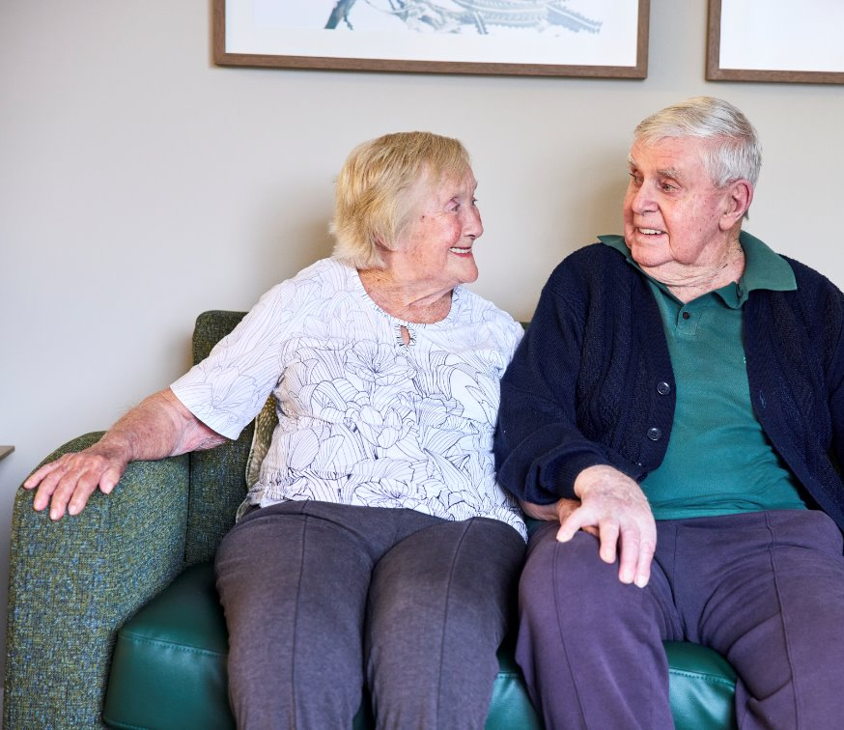
What are the potential benefits to residential aged care home residents?
More proactive and regular access to primary care services delivered in aged care homes
More regular care planning services, including health assessments and development of care plans
Greater regularity of primary care services delivered to people in aged care
Formal establishment of relationships between patient, GP, practice and other healthcare professionals
Increased continuity of care
Pull quote
Notes:
This slide outlines the benefits to people living in aged care:​
More proactive, timely care​
More regular visits​
Better planning and co-ordination​
Minimise avoidable hospitalisations​

Slide 19
What are the benefits for GPs and practices?
Payments for reviewing their patients in an aged care home, rather than at their practice
Establishment of formal relationships between patient, GP, practice and other members of a patient's care team
Pull quote
Notes:
This slide outlines the benefits of GP and practice participation​
​
Enhancing Patient Care: Participating GPs may access additional resources and support that enhance their ability to manage complex health issues more effectively. This leads to improved patient outcomes, higher patient satisfaction, and potentially, a more rewarding practice experience​
Financial Incentive that recognises the financial barriers/opportunity costs to GPs and the enabling role and additional administrative costs of practices when caring for people in residential aged care homes​
Ability to provide a multi-disciplinary approach​
Professional Development: Participation offers an opportunity to develop and evolve a skill set focused on older people. Additional training in this area may help fulfil continuous professional development requirements. Implementing the GP Aged Care Incentive and taking a quality improvement approach will further support continuous professional development requirements​
Building a better practice environment: Participation incentivise the responsible provider and practice. This may assist in improving practice infrastructure and capabilities, workflow, enhanced team collaboration, and overall, a more efficient practice for providing services into residential aged care.​
Meeting patient expectations: The program is designed to address the recommendation of the Royal Commission into Aged Care Quality and Safety in line with person centred care

Slide 20
Considerations before participation
Evaluate whether the benefits align with the practice’s goals and capabilities.
Consider the specific requirements and commitments:
need for additional training​
challenges to practice workflow​
impact on current patient services
Participation is an opportunity to lead in healthcare innovation, fostering a more dynamic and responsive healthcare environment.
Notes:
Practices and providers need to carefully weigh up the challenges as well as the benefits before participating. It’s a choice.

Slide 21
In summary
The General Practice in Aged Care Incentive:
responds to shortfalls in healthcare for people living in aged care homes
delivers coordinated, quality health care at the person’s home
meets the specific needs of older people and those living in an aged care home
benefits everyone, not only patients, but the workforce too
makes extra payments to GPs and practices to provide regular, proactive services
is easy to register for
is supported by aged care providers and Primary Health Networks.

Slide 22
Questions?
Pull quote

Slide 23
For more information:
Information kit for primary care practices and GPs
Department of Health and Aged Care fact sheets
MyMedicare website
Services Australia webpage and helpline
Pull quote

