Slide 1
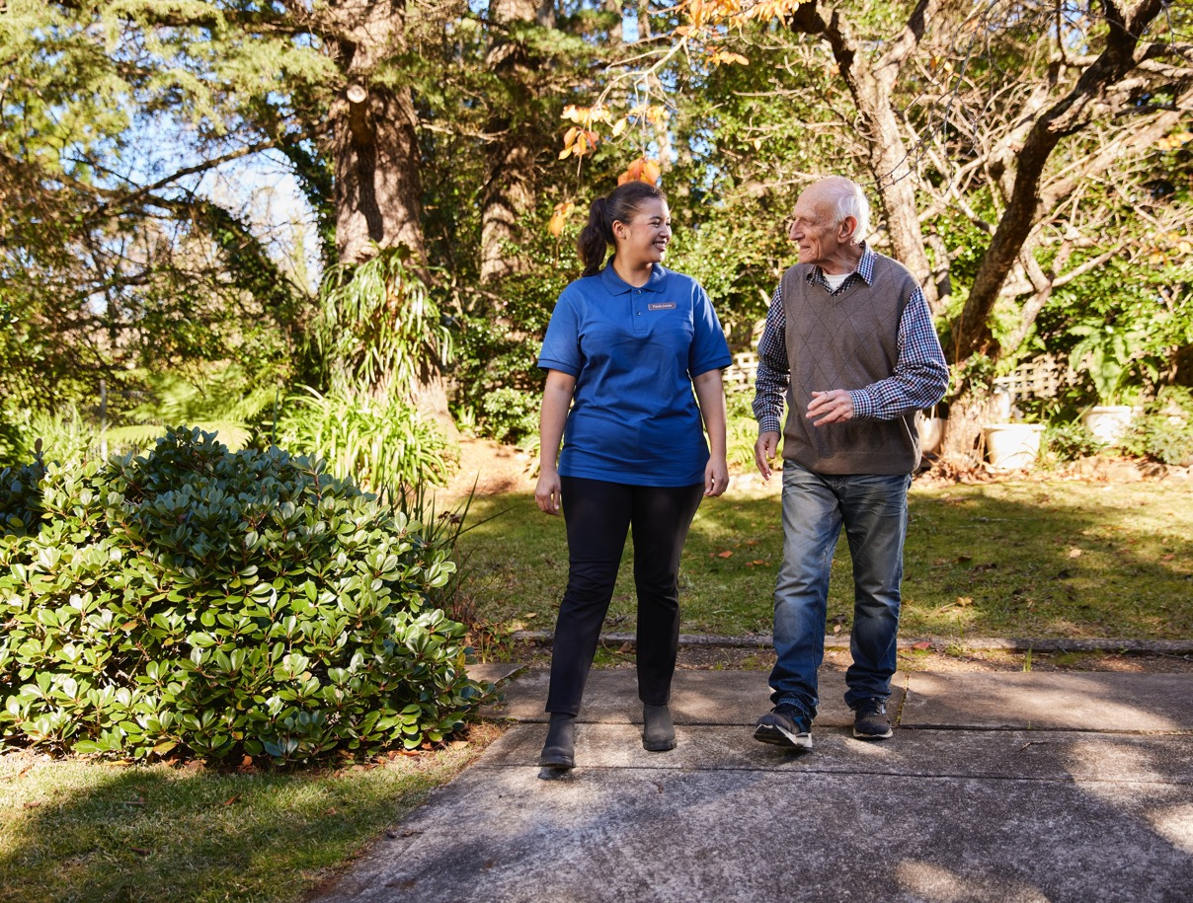
The General Practice in Aged Care Incentive
Better health care for residential aged care home residents
Pull quote
An introduction for members and partners
www.health.gov.au

Slide 2
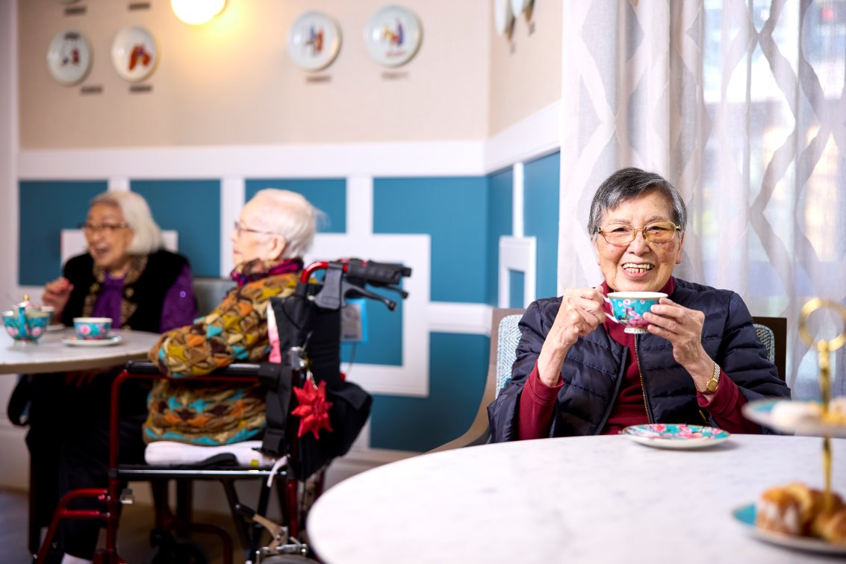
Presentation overview
What is the current experience?
What is the General Practice in Aged Care Incentive?
Why is the incentive important?
How does the incentive work?
What are the benefits?
What do residential aged care residents need to do to participate?
What are the alternatives and patient rights?
Where can I find out more?
Pull quote
Notes:
1. This presentation will take you through what you need to know about the new General Practice in Aged Care Incentive​​.​​
2. We will cover why the incentive is important, how it will work, how it will benefit healthcare and what people need to do to get involved​​.​​
3. There’s plenty of information available that you can refer to after this session. ​​​
4. We have an information booklet available if you would like read-up on some of the detail later.

Slide 3
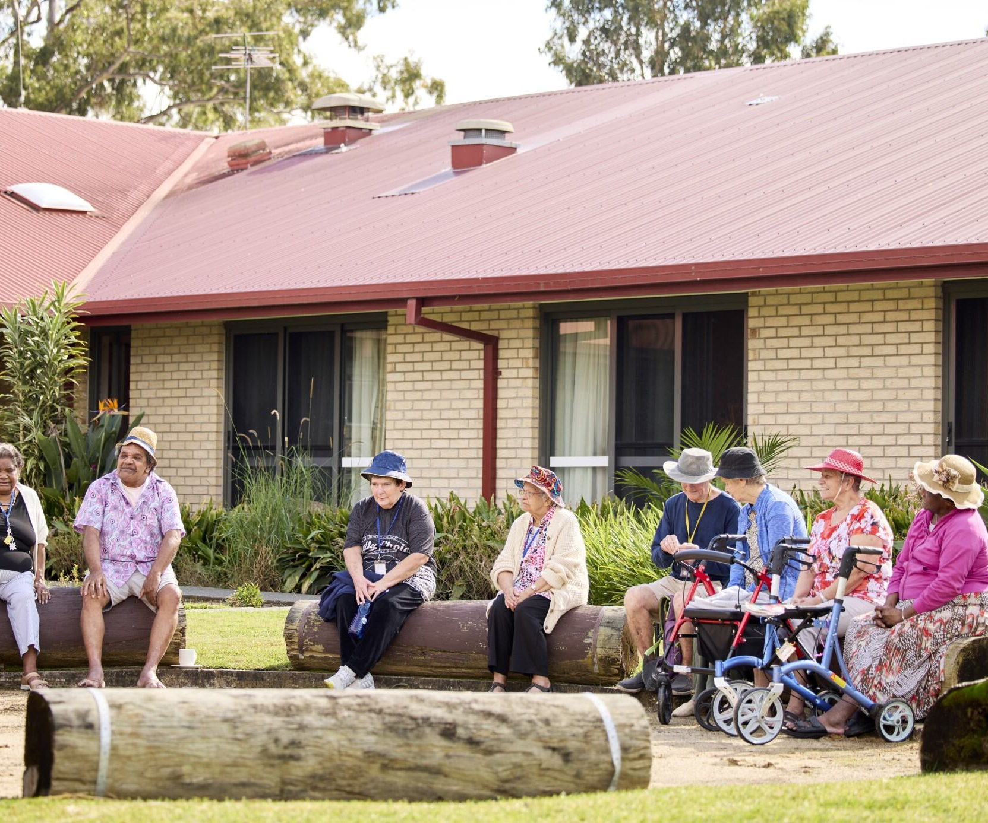
What is the current experience?
Access to GPs is challenging and untimely
Patients have trouble establishing a relationship with a GP
GPs of choice don't always attend aged care homes​
Transport barriers to accessing community-based health services​
Assumptions that aged care providers can provide health care​
Structural discrimination ​
Positive experiences with in-house solutions for example, mobile dental services, GP clinics, telehealth, pharmacists
Pull quote
Notes:
This slide is a summary of what the typical experience of primary health care in residential aged care has been up to now.

Slide 4
What is the General Practice in Aged Care Incentive?
The incentive:
commenced on 1 July 2024
aims to enhance the delivery of coordinated quality health care in residential aged care homes
responds to the Royal Commission into Aged Care Quality and Safety and Strengthening Medicare Taskforce
Pull quote
Notes:
1. The General Practice in Aged Care Incentive started on 1 July 2024​​.
​2. The incentive is all about delivering proactive, planned and continuous primary care in residential aged care homes around Australia.
​3. Under the incentive, GPs and practices will receive incentive payments for providing their patients in residential aged care homes with:​​
Proactive face-to-face visits for health assessment and other services​​
Regular planned reviews​​
Coordinated care planning.
4. There are some conditions that need to be met for GPs and patients to be eligible – we will cover those in a moment​​.
​5. The incentive is an important response to the Royal Commission into Aged Care Quality and Safety which found that many people living in residential aged care homes currently receive substandard primary health care – that is, from GPs and others that work in general practices​​.
6. We know that there are many reasons for this such as a lack of available GPs, long wait times and poor access to after-hours services when they are needed​.
​7. The incentive is also an important part of Strengthening Medicare to ensure it is more equitable and responsive to the needs of all Australians – particularly those with the greatest health care needs.

Slide 5
Why is the incentive important?
Aged care residents have:
complex health care needs
a risk of avoidable hospital visits
equal rights to health care
experiences of substandard health care
Regular general practice care results in better health outcomes
Pull quote
Notes:
As we get older, our health needs become more complicated, and we are often at greater risk of avoidable hospital visits​​.
The incentive is important because it is designed to meet the specific needs of people who live in residential aged care homes so they can enjoy the same access to healthcare as others in the community.
We know that having a GP who knows you and your conditions well, and who visits you often, provides more regular health checks, coordinates and monitors your care and identifies any new or changed issues quickly, results in better health outcomes.
A key part of Strengthening Medicare is the introduction of MyMedicare which allows people (including those in residential aged care homes) the opportunity to voluntarily register with a GP and practice of their choice, subject to that GP and practice accepting you as a registered patient.​
We also know that some people in residential aged care homes don’t have a regular GP and, for those that do, it is often difficult for them to get to see their GP at the general practice.​
The General Practice in Aged Care Incentive is designed to overcome some of these challenges.

Slide 6
How does the incentive work?
Eligible GPs and practices will receive incentive payments for visiting and providing services to their patients who permanently live in a residential aged care home
Residents can be actively involved in selecting a preferred GP
Eligible GPs and patients must be registered in MyMedicare
Primary Health Network partners will support
Notes:
From 1 July 2024 eligible GPs and practices receive extra payments for conducting regular appointments, health checks and care planning with older people in residential aged care homes – at their residential aged care home. This means you won’t have to visit the GP at their clinic, they will come to you​.
Without going into the detail of the payments, in summary, under the incentive GPs will have to deliver at least 10 eligible services over the 12-month period.​
The 10 services must include 8 consultations at regular intervals during the year delivered by the responsible provider or a colleague from their clinic, such as a nurse practitioner; as well as 2 care planning services.​
Examples of care planning services include medical assessments, contributing to or reviewing a care plan, a case conference and a medication review.​
Most importantly, both eligible GPs and clinics as well as patients must be registered with MyMedicare to benefit from the incentive​.
MyMedicare is all about formally linking people to a GP and practice of your choice.
If people already have a GP who has registered with MyMedicare, and if they also choose to register, then they can get the benefits of the General Practice in Aged Care Incentive relatively easily and quickly. ​
But not everyone has a regular GP or has a provider that, for a range of reasons, is not in a position to provide care onsite.​
There are fact sheets, online information and a patient information booklet that guides people through their options and choices here.
Primary Health Networks are valuable partners for the incentive. Not all residential aged care homes are in locations well served by the GP workforce. Shortages are a reality. In these instances, PHNs have been given funding by the government to find other ways to work with us to find solutions to your health care needs. They will also facilitate improved processes between GPs and practices and residential aged care homes to ensure the provision of practice, planned and continuous care.

Slide 7
To access this package of care, residential aged care home residents must:
1. Be a permanent resident of an aged care home
There are no age restrictions to be eligible for the General Practice in Aged Care Incentive package of care
2. Be registered with an eligible* preferred GP in MyMedicare
This voluntary patient registration model formalises the relationship between patients and primary care teams. It is voluntary and free to register with a Medicare Card or DVA Veterans Card
*the GP and practice must be registered for the incentive and then enroll the patient in the incentive.
www.health.gov.au
Notes:
There are 2 main eligibility criteria for residents for the General Practice in Aged Care Incentive: ​
they must be a permanent resident of a residential aged care home ​
they must select a preferred GP and register in MyMedicare. The GP and their practice then must accept them into the General Practice in Aged Care Incentive and commit to providing the expected package of care​.
If these requirements have been met​
​AND​
​The GP and their practice are participating in the General Practice Aged Care Incentive …. (OVERPAGE)

Slide 8
Incentive service requirements include
8 regular visits
At least 2 eligible regular services per quarter, totalling 8 regular visits per year
Delivered in separate calendar months
An alternative care team member to the GP (for example, a nurse) can provide 1 eligible service per quarter
and
2 care planning services
At least 2 eligible care planning services per year including:
comprehensive medical assessment ​
contribution to, or review of, multidisciplinary care plan ​
multidisciplinary case conference
residential Medication Management Review
Notes:
​This slide provides an overview of the eligibility criteria and the service requirements​.​
​The GP and practice care team will be required to deliver 8 regular visits and 2 care planning services within a 12-month period.​
​The GP and practice may charge a fee for such services. ​
​It is important that people, family and carers talk to their responsible provider and practice about their charging policies.

Slide 9
Patient primary care journey example
Mavis’ primary care journey over a year
Pull quote
Notes:
The following slide details an example of a patient story.

Slide 10
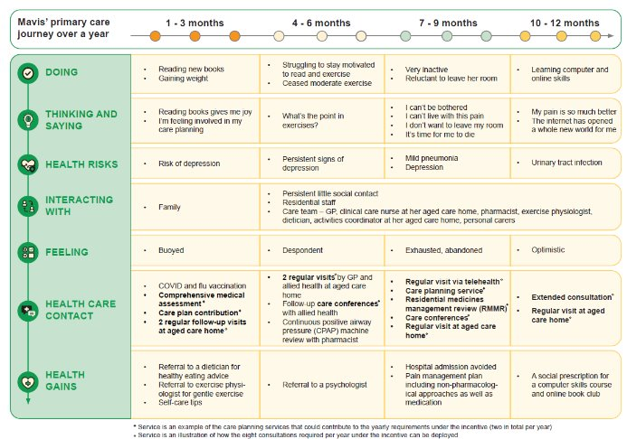
Mavis’ primary care journey over a year
Notes:
Patient story - What could good look like in residential aged care homes?​
​Mavis is an 89-year longstanding resident of a residential aged care home in a regional area of NSW. She is widowed and has two adult children, one of whom lives nearby. Both children are busy with their careers and family commitments. Mavis does not socialise much with other residents. She is well educated and had a career in school administration before she retired. She has a long-standing GP who has regularly visited her in the residential aged care home over the past three years. ​
Mavis has chronic obstructive pulmonary disease (COPD), is oxygen-dependent and lives with other conditions including sleep apnoea, congestive heart failure, and arthritis – a source of chronic pain. She experiences recurrent urinary tract infections. Mavis is on seven different medications including medication for chronic pain. Her mobility is good across short distances, and she has no history of falls. She becomes very breathless and often requires a wheelchair. ​
Mavis understands how her condition impacts on her ability to conduct day to day functions and is keen to stay well. She has some confidence in her own ability to manage her condition with the support of staff at her residential aged care home but recently has experienced frequent trips to hospital. She is seeing a physiotherapist to assist with her lung health and mobility. While she is keen to avoid any further trips to hospital, she is resistant to the physio’s suggested exercises. What matters to Mavis at this stage of her life is quality time with her family. She has lost some capacity to do the reading she used to enjoy but she still gets to it when she can. While not diagnosed, Mavis is likely to be depressed​
​Talk through the patient story.​
​Does this resonate? ​
​Point out the regular visits and the care planning services​.

Slide 11
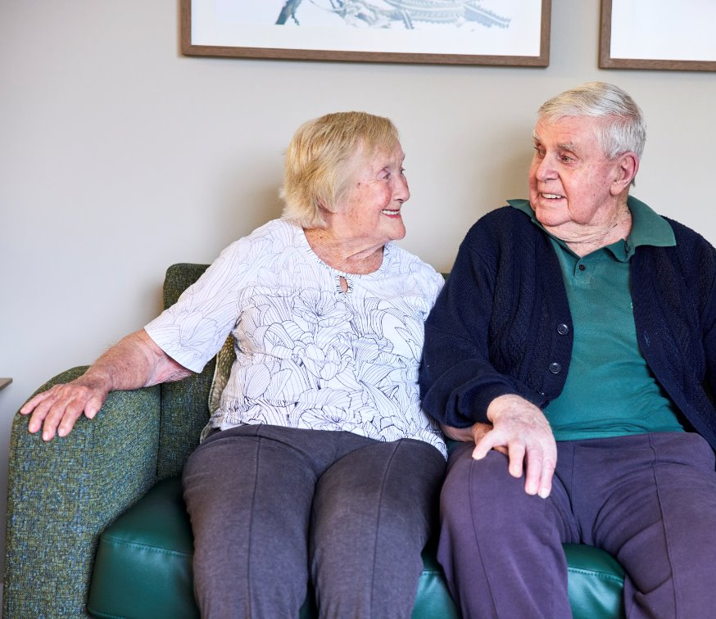
What are the potential benefits to residential aged care home residents?
More proactive and regular access to primary care services delivered in aged care homes
More regular care planning services, including health assessments and development of care plans
Greater regularity of primary care services delivered to people in aged care
Formal establishment of relationships between patient, GP, practice and other healthcare professionals
Increased continuity of care
Pull quote
Notes:
This slide outlines the benefits to people living in aged care:​
more proactive, timely care​
more regular visits​
better planning and co-ordination​
minimise avoidable hospitalisations​.

Slide 12
What do residential aged care residents need to do to participate?
Choose a preferred GP and the clinic they work in
Discuss their choices and eligibility for the incentive with them
Complete the MyMedicare registration form if they haven't already done so
Notes:
In order to access the package of care provided under the incentive program guidelines people need to:
- choose a preferred GP and the clinic they work in​
- discuss their choices and eligibility for the incentive with them​
- complete the MyMedicare registration form if they haven't already done so.

Slide 13
What are the alternatives?
If a GP does not participate in the General Practice in Aged Care Incentive:
they will still be able to deliver services to residential aged care residents as normal
residential aged care home residents will continue to have access to Medicare or DVA arrangements
there may still be out-of-pocket expenses.
Alternatively, residents may choose to find another GP who is participating in the General Practice in Aged Care Incentive.
Pull quote
Notes:
Not all GPs will choose to participate in the General Practice in Aged Care Incentive​.
​It is important for people, families and carers to talk with the usual GP to better understand:​
whether the GP is participating in the incentive, and​
the level of service they will provide.​
A GP and their practice may not be participating in the General Practice in Aged Care Incentive but willing to continue to provide care to people living in residential aged care.
If the resident prefers, they may seek to find an alternative provider who is participating in the General Practice in Aged Care Incentive and willing to take them on as a registered patient to be eligible to provide the services outlined above.​

Slide 14
Roles, rights, and choices for residential aged care residents
Residential aged care residents need to:
inform themselves about the General Practice in Aged Care Incentive, including its benefits, eligibility requirements, the service provided, and any out-of-pocket costs
inform themselves of any of the alternatives if the incentive isn't delivered
make an informed choice about voluntary registration with a GP and practice via MyMedicare
seek assistance to register if required and be supported to do so
be treated as partners in their care
serve as advocates in their residential aged care home if appropriate
Pull quote
Notes:
It is important for people, their family, friends and carers to understand their rights so that they can make informed choices.

Slide 15
In summary
The General Practice in Aged Care Incentive:
responds to shortfalls in healthcare for people living in aged care homes
delivers coordinated, quality health care at the person’s home
meets the specific needs of older people and those living in an aged care home
benefits everyone, not only patients, but the workforce too
makes extra payments to GPs and practices to provide regular, proactive services
is easy to register for
is supported by aged care providers and Primary Health Networks

Slide 16
For more information:
Residential aged care home resident information booklet​
Department of Health and Aged Care fact sheets​​
MyMedicare website ​
Ask your GP and practice​
Ask a member of the aged care home team
Pull quote

Slide 17
The following slide may be integrated into the slide deck above if needed

Slide 18
MyMedicare
MyMedicare is a voluntary patient registration model
It formalises the relationship between patients, their general practice, general practitioner (GP) and primary care teams
This does not stop you from accessing care from other GPs and practices
However, seeing the same GP regularly may lead to better health
It is voluntary and free to register if you have a Medicare Card or DVA Veterans Card
You can register online, via an app or by downloading a form
Alternatively, your GP may have a paper form you can complete
Notes:
This slide provides an overview of My Medicare. ​
​Main points include:​
MyMedicare registration with a preferred practice and GP is a requirements of the incentive​.
Patient registration with a practice and GP is voluntary for patients, the practice and the GP.​
The preferred practice and GP must be registered in MyMedicare before the patient can register​.
It is important to talk with your preferred provider about whether you can register with them and their practice to ensure they have capacity​.
For more information on MyMedicare and the registration process:​
Speak to your provider or practice staff​.
Visit: https://www.health.gov.au/our-work/mymedicare/patients.

