Slide 1
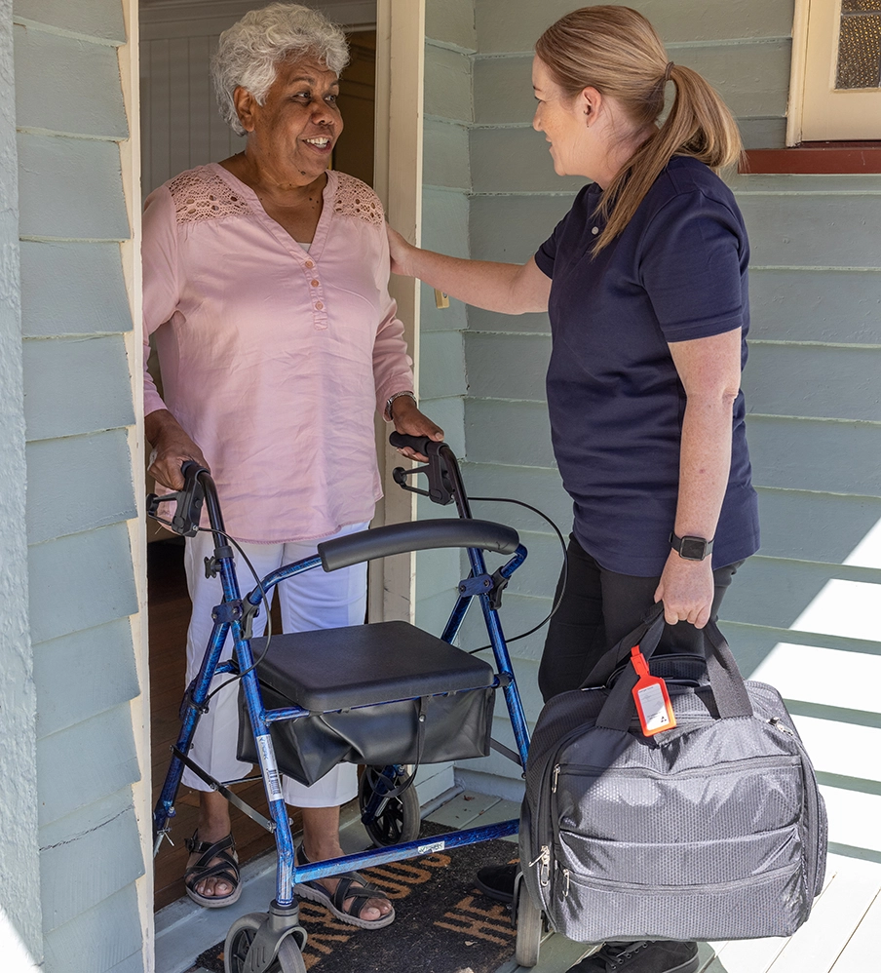
Disability Support for Older Australians
Change of Needs application
form instructional video
www.health.gov.au/our-work/disability-support-for-older-australians-dsoa-program
Notes:
Welcome to our Disability Support for Older Australians Change of Needs application form instructional video. This short step-by-step video has been designed to show you how to accurately fill out the form, and what additional key information is needed to support your application submission.

Slide 2
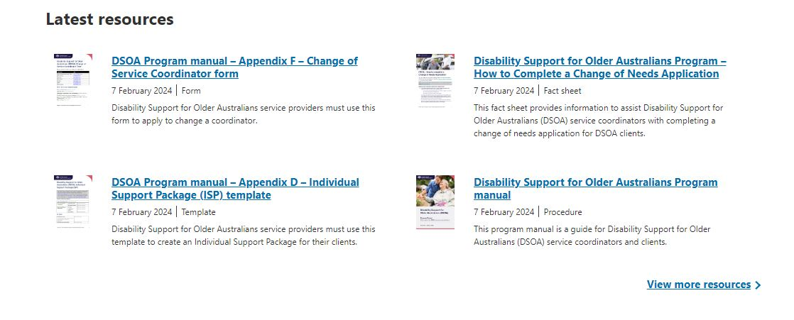
Locating the Application Form
www.health.gov.au/our-work/disability-support-for-older-australians-dsoa-program
Notes:
The Change of Needs application form can be found on the DSOA website. This link will take you to the most recent version of the form.

Slide 3
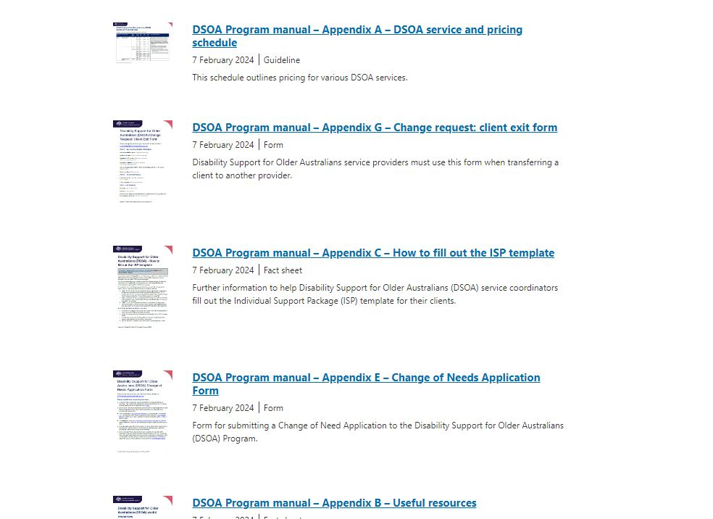
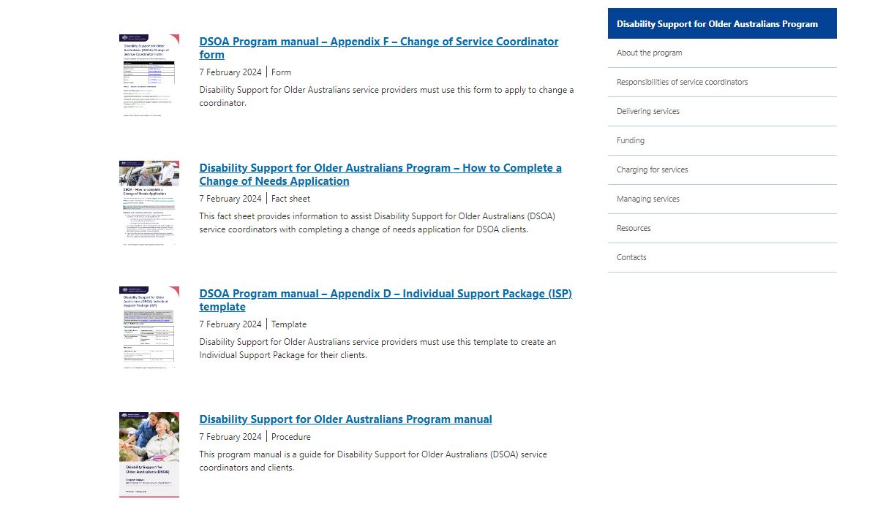
Locating the Application Form
www.health.gov.au/our-work/disability-support-for-older-australians-dsoa-program
Notes:
You will be required to scroll down until you see Appendix E.

Slide 4
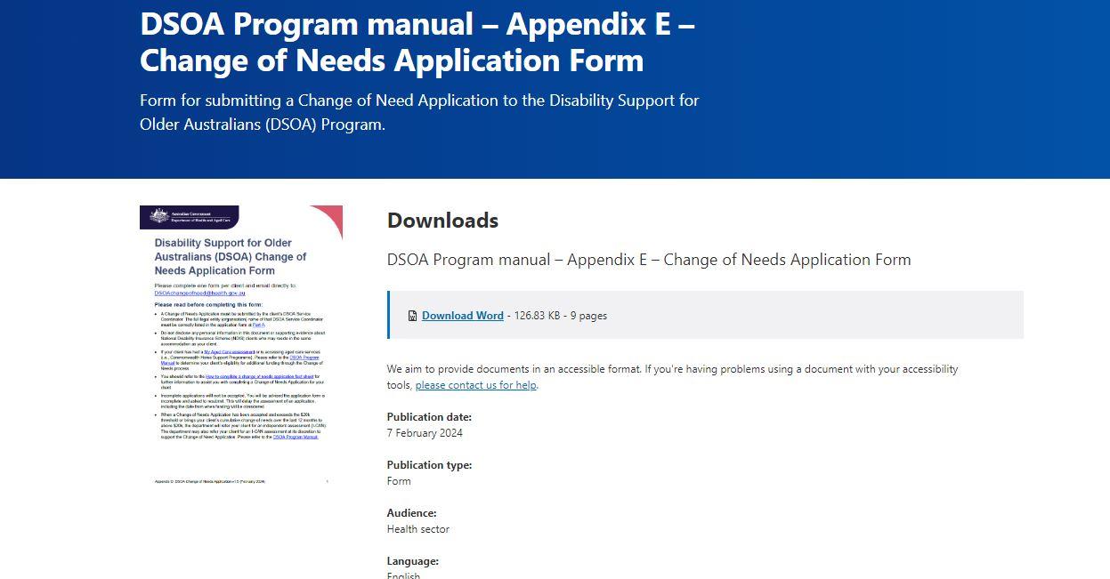
Downloading the Application Form
www.health.gov.au/our-work/disability-support-for-older-australians-dsoa-program
Notes:
Download the form in Microsoft Word format. Click “Open File” to access the form.

Slide 5
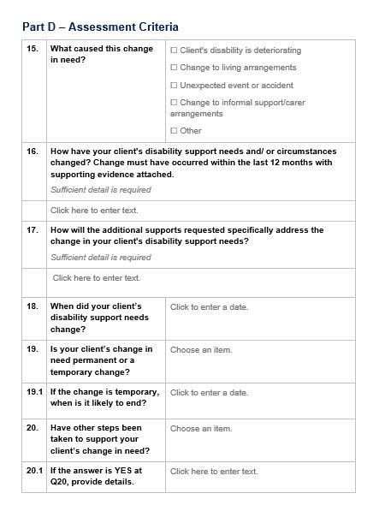
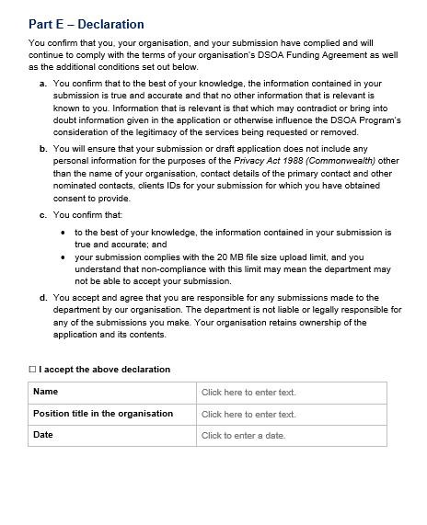
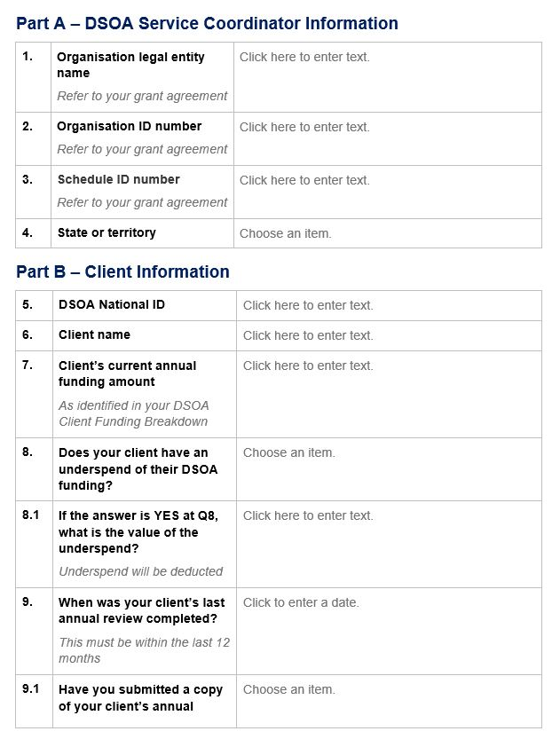
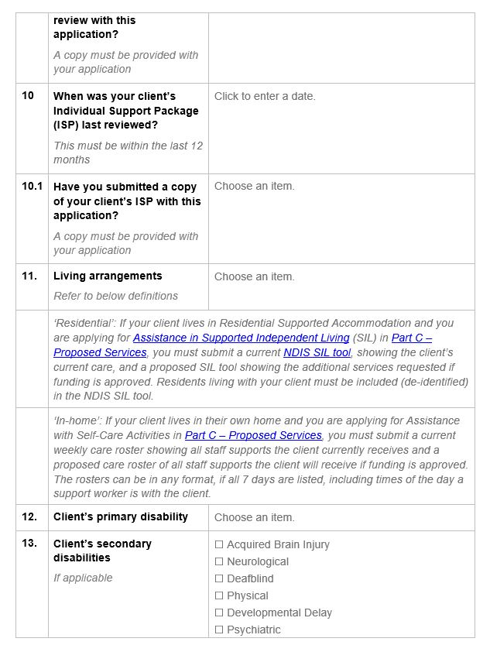
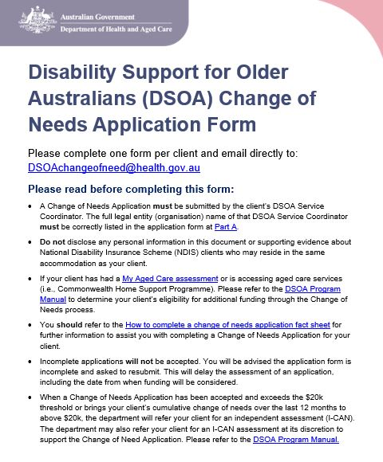
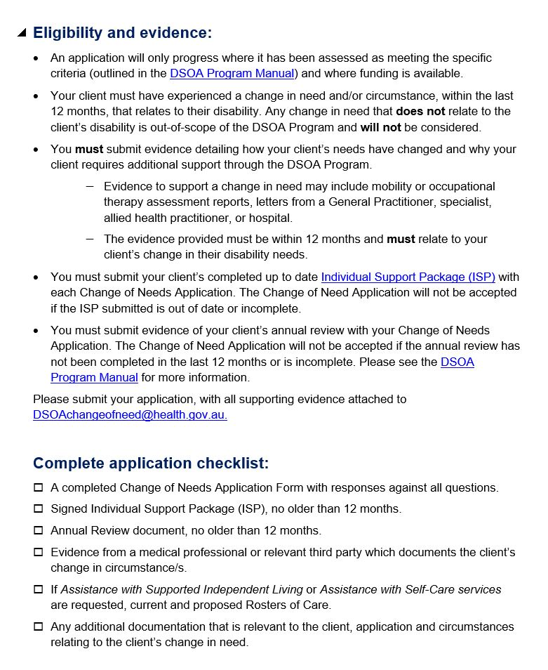
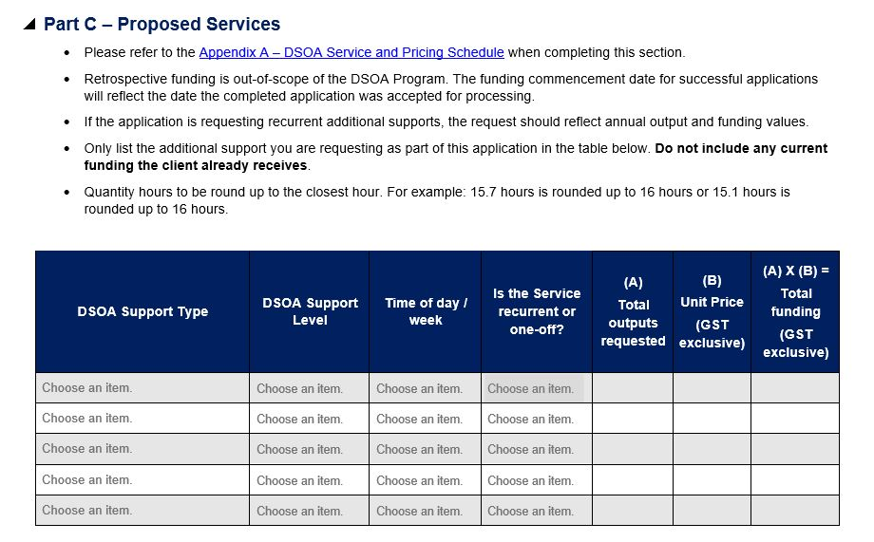
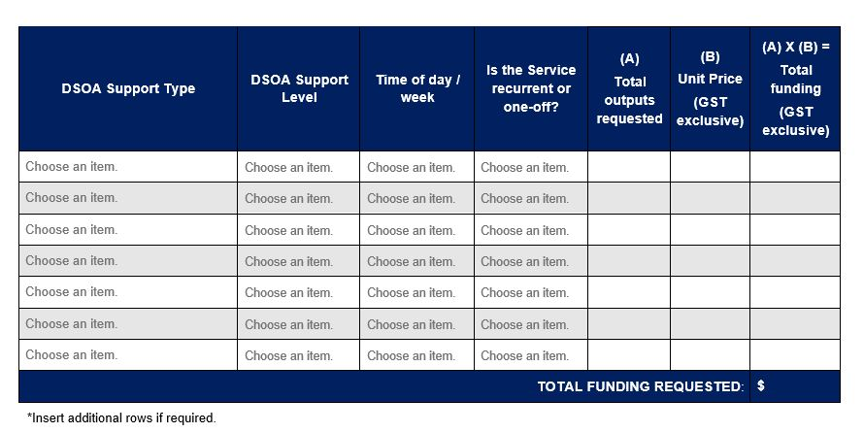
Application Form Overview
www.health.gov.au/our-work/disability-support-for-older-australians-dsoa-program
Notes:
This is what the form looks like when opened.

Slide 6
Important Information
www.health.gov.au/our-work/disability-support-for-older-australians-dsoa-program
Notes:
Please ensure to read pages 1 and 2 of the form. They contain important information about what deems a client eligible for additional funding and what evidence is required to support your submission.

Slide 7
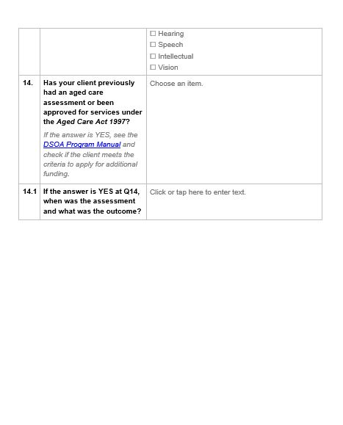
Completing Parts A & B
www.health.gov.au/our-work/disability-support-for-older-australians-dsoa-program
Notes:
When completing questions in Part A, you can refer to your program schedule or grant agreement.
When completing Part B, ensure to list your client’s correct DSOA National ID. DSOA IDs should only include 4 digits.
Make sure you list any underspend for your client in response to this question. You may wish to contact your Funding Arrangement Manager at the Community Grants Hub in your relevant state or territory for further information.
Make sure you list whether your client has had an Aged Care Assessment through My Aged Care, and if so, please provide further information.
Please note, if your client has had an Aged Care Assessment and has been found eligible for a Home Care Package or permanent residential aged care their funding is capped and they cannot access additional funding through the DSOA Program.

Slide 8
Appendix A – Service and Pricing Schedule
Completing Part C
Make sure you always visit
the DSOA website for the
most up to date pricing
www.health.gov.au/our-work/disability-support-for-older-australians-dsoa-program
Notes:
In Part C, you must list what additional DSOA Support Types your client requires to meet their change in need. This table should not include your client’s current funding. It is important to read the dot points prior to completing the table.
Click on the link to Appendix A to open the DSOA Service and Pricing Schedule. The format outlined in Appendix A should be reflected in Part C of the form for each DSOA Support Type listed.

Slide 9
Completing Part C
www.health.gov.au/our-work/disability-support-for-older-australians-dsoa-program
Notes:
Select the DSOA Support Type your client needs.
Continue to select the DSOA Support Level and the time of day or week for the chosen support.
You must also select whether the support is required on a recurrent or one-off basis.
List the total annual outputs required, the unit price and the total funding requested for the DSOA Support Type.

Slide 10
Completing Parts D & E
www.health.gov.au/our-work/disability-support-for-older-australians-dsoa-program
Notes:
When completing Part D it is important to comprehensively outline what your client’s change in need is, and how this change occurred. You must explain how the DSOA Support Types requested in Part C directly address your client’s change in need.
When answering this question, you may wish to consider whether the client has access to other informal or formal supports. Is the client eligible to access funding from other sources? For example, hospital, state-based funding or through the Commonwealth Home Support Programme (CHSP). Have you considered other accommodation options to support the client’s needs? Or are there any other services your client is receiving that can address their specific needs?
Ensure that Part E is completed and ticked by the client’s DSOA service coordinator. By completing this section, you accept and agree that you are directly responsible for any submissions made to the department by your organisation. You confirm that to the best of your knowledge, the information contained in your submission is true and accurate and that no other information that is relevant is known to you.

Slide 11
Thank you
For further information, please refer to the How to Complete a Change of Needs Application fact sheet and Section 3.3 of the DSOA Program Manual.
Submit your completed application to dsoachangeofneed@Health.gov.au.
www.health.gov.au/our-work/disability-support-for-older-australians-dsoa-program
Notes:
Thank you for watching our instructional video. The completed application form, and all supporting evidence can now be submitted to dsoachangeofneed@Health.gov.au.
For more information about the Change of Needs process, please refer to the Change of Needs Fact Sheet and Section 3.3 of the DSOA Program Manual.

