Slide 1
Quarterly Financial Report (QFR) Webinar: Quarter 2
Department of Health and Aged Care
Please note that this webinar will be recorded
agedcareengagement.health.gov.au
8 December 2022
1

Slide 2
Agenda
No. | Agenda item | Speaker
1 | Introduction and updates Quarter 1 overview Quarter 2 | Susan Trainor (15 minutes)
2 | Aged Care Quality and Safety Commission compliance insights | Elly Osborne (5 minutes)
3 | Q&A* | Susan Trainor (10 minutes)
4 | Care minutes policy | Claudia Dukats (10 minutes)
5 | Care costs and labour hours Quarter 1 data and learnings (residential and home care) | Grant Corderoy (20 minutes)
6 | Q&A* | Susan Trainor (25 minutes)
7 | Other issues and next steps Future developments | Susan Trainor (5 minutes)
* Due to time constraints, Q&A took place in the Webex chat Q&A function
agedcareengagement.health.gov.au
8 December 2022
2

Slide 3
Item 1
Introduction and updates
Quarter 1 overview
Quarter 2
Susan Trainor
Acting Assistant Secretary, Structural Adjustment Strategy

Slide 4
Quarter 1 overview
QFR submissions by date
Thank you for your quarter 1 QFR submissions.
Quarter 1 submissions were due to the department on 4 November 2022 through the Forms Administration portal.
Nearly ¾ of reports were submitted in the final week of the submission period.
The Forms Administration helpdesk received a number of enquiries on QFR sign off requirements. As with the ACFR, it is a legislative requirement that a director or member of a provider’s governing body signs the QFR.
agedcareengagement.health.gov.au
8 December 2022
4

Slide 5
Quarter 2 readiness
There are a couple of smaller changes included for the Q2 QFR:
In previous webinars, Home Care providers have asked for the addition of a ‘Centrally Held’ column in the Home Care Labour Cost and Hours section. The Q2 form will have this available, making it align with the ACFR.
Average daily spend per resident field will be auto-calculated in the food and nutrition forms for Residential Care providers.
NATSIFACP and MPS providers will need to input a new data item “Available Bed Days” in the Food and Nutrition section. This will then auto calculate the Average Daily spend fields for them.
agedcareengagement.health.gov.au
8 December 2022
5

Slide 6
Quarter 2 submission details and timeframes
The quarter 2 QFR for the 2022-23 financial year will cover the reporting period from 1 October 2022 to 31 December 2022.
Providers will submit their quarter 2 QFR through the Forms Administration QFR portal.
Providers will have 45 days (instead of 35) to submit their quarter 2 reports due to the holidays.
The portal will open for quarter 2 submissions on 1 January 2023, with submissions due on 14 February 2023.
Please note that the Quarterly Financial Statement section of the QFR is completed on a financial year to date basis, while the residential and home care labour costs and hours and food and nutrition sections are completed for the quarter only.
A helpdesk run by Forms Administration will be available to assist with the completion and lodgement of QFR. Providers can call the helpdesk on (02) 4403 0640 or email enquiries to health@formsadministration.com.au.
agedcareengagement.health.gov.au
8 December 2022
6

Slide 7
Item 2
Aged Care Quality and Safety Commission Compliance Insights
Elly Osborne
Director, Prudential Compliance, The Aged Care Quality and Safety Commission

Slide 8
Quarter 1
The QFR for quarter 1 was due on 4 November 2022
More than 1,400 approved providers were required to submit a QFR
1,255 approved providers submitted by the deadline date
Over half of those were submitted on the deadline date
54 extension requests were received
agedcareengagement.health.gov.au

Slide 9
Compliance insights
Providers that did not submit by 4/11/2022
Providers that did not submit by the deadline were referred to the Commission for compliance action
Overdue letters were sent to 195 providers that did not submit on time
As at 1 December, 77 providers have still not submitted their QFR
agedcareengagement.health.gov.au
8 December 2022
9

Slide 10
Compliance with obligations
The Commission’s preference is to avoid taking regulatory action where possible and recognises that there are different challenges for providers
All providers that submitted late have been reminded of their obligation to report by the deadline and those providers will be monitored in quarter 2
Regulatory action will be considered for all providers who fail to submit their QFR or consistently fail to meet the deadline
agedcareengagement.health.gov.au
8 December 2022
10

Slide 11
Item 3
Q&A
Susan Trainor
Acting Assistant Secretary, Structural Adjustment Strategy

Slide 12
Item 4
Care minutes policy
Claudia Dukats
Director of Policy and Care Minutes

Slide 13
Care minutes definitions – RN and EN
Registered nurse (RN)
- Registered with NMBA through AHPRA
Duties include
assessing patients
developing a nursing care plan
administering medicine
providing specialised nursing care
Enrolled nurse (EN)
- Registered with NMBA through AHPRA
Duties include
regularly recording patients’ temperature, pulse, blood pressure, and respiration
providing interventions, treatments, and therapies from patient care plans
assisting RNs and other team members with health education activities
helping patients with their activities of daily life
health.gov.au/aged-care-reforms
Department of Health and Aged Care | 8 December 2022
13

Slide 14
Care minutes definitions – personal care worker
Personal care worker
Duties include
daily living routines and direct care activities (such as self-care or personal care)
social and emotional support for residents and their families
regular monitoring and support of residents’ health and wellbeing
Social and emotional support
Social and emotional support includes activities that support residents to be and feel connected, heard, valued and fulfilled
Example activities
when a PCW spends social time with a resident to have a conversation
assists them personally to undertake personal interests (for example reading or playing a game)
assists them personally to participate in a group activity
https://www.health.gov.au/resources/publications/care-minutes-and-247-nursing-requirements-guide
health.gov.au/aged-care-reforms
Department of Health and Aged Care | 8 December 2022
14

Slide 15
Care minutes example – Personal care worker
Ingrid - Grade 1 Personal Care Worker, Level 2 Award at Leafy Gums Aged Care.
80% of her time is spent attending to the basic daily needs of residents including:
bathing and washing residents,
dressing residents,
sitting with residents and helping them eat,
assisting them with toileting accompanying them on daily outings to assist with these basic daily needs
This is considered direct/personal care and is counted towards care minutes.
Ingrid also works as a Kitchen Assistant with food prepping for residents.
20% of her time is spent helping out in the kitchen, including:
helping the Chef to plate up food,
serving food to residents in the dining room
This time is not considered direct/personal care and cannot be counted towards care minutes.
health.gov.au/aged-care-reforms
Department of Health and Aged Care | 8 December 2022
15

Slide 16
Care minutes reporting
Legislative requirement
Star ratings
Financial monitoring
Inform pricing
!
It’s important that data is accurate and of a high quality
health.gov.au/aged-care-reforms
Department of Health and Aged Care | 8 December 2022
16

Slide 17
Item 5
Care costs and labour hours
Quarter 1 data and learnings (residential and home care)
Grant Corderoy
Senior Partner, StewartBrown

Slide 18
Quarterly Financial Report (QFR)
StewartBrown have been engaged by the Department of Health and Aged Care (Department) to:
Manage a Help Desk to assist approved providers with any clarifications and queries they have in completing the residential and home care labour costs and hours reporting sections of the QFR, and
Undertake data quality reviews of the submitted QFR returns with respect to the residential direct care labour costs and staffing minutes reporting sections
The Help Desk is available for support until June 2023
As part of the QFR Help Desk the following webinars have already been held that can be used for reference https://www.health.gov.au/resources/webinars
Other support documentation has been provided by the Department including definitions, QFR guide and frequently asked questions. All are available on Forms Administration website.
Please contact the Forms Administration helpdesk with any queries on the QFR. Forms Administration will pass on technical questions related to residential and home care labour costs and labour hours to the StewartBrown Help Desk.
agedcareengagement.health.gov.au
8 December 2022
18

Slide 19
QFR Helpdesk
Quantum of Queries
123 separate queries were submitted to the QFR Help Desk in the period from August until 4 November 2022
Home Care - Frequently Asked Questions
There has been feedback on the definitions, particularly around which staff are included in the personal care classification. For clarification, this category includes staff involved in:
Domestic assistance (shopping etc)
Maintenance, including gardening
Transport
Does the QFR require information on income and expenditure on services brokered to other providers as well as self-funded (private) clients?
Yes, income and expenditure should cover packaged home care clients, private clients that meet the age requirements for home care (persons 65 years of age or older and 50 years or older for those who identify as an Aboriginal or Torres Strait Islander person) and brokered services for packaged home care clients and age eligible private clients with other providers
agedcareengagement.health.gov.au
8 December 2022
19

Slide 20
QFR Helpdesk
Home Care - Frequently Asked Questions (continued)
As with residential aged care, home care relies on agency and other contracted staff. If these persons do not provide hours of service, how should we record these services?
The contractor should be made aware of their requirement to account for client funding. While transitioning to this it is acceptable that reasonable estimates be made
agedcareengagement.health.gov.au
8 December 2022
20

Slide 21
QFR Helpdesk
Residential Aged Care - Frequently Asked Questions
Many payroll systems have labour hour data based on pay periods which do not fully align to calendar quarters. Responses were requested as to whether labour hours data be extrapolated to adjust for the difference?
Yes, the labour costs and hours data are required to be adjusted to align with QFR reporting quarters. Hours must be accrued based on the three full months in the quarter and not pay runs that straddle the quarter. The rationale for this is that care minutes will be based on occupied bed days for the full quarter. If hours are not accrued until the end of the month there will be a misalignment between occupied bed days and care minutes
What constitutes non-worked hours and worked hours?
Non-worked hours are usually those associated with leave or training, that do not represent care to residents
What is the definition of a bed? Does it include costs and hours for both respite and permanent beds?
Yes, it includes both residential and respite beds
agedcareengagement.health.gov.au
8 December 2022
21

Slide 22
QFR Quality Review Submission Statistics
Residential Aged Care - Frequently Asked Questions (continued)
What should be included in the average hourly pay rates?
The average base rate for the staff in those classifications. Does not include overtime or other oncosts
Are we allowed to consolidate co-located facilities for QFR reporting?
No, as all facilities receive separate funding, they are required to submit expenditure individually. If systems cannot accurately collect this information, allocation based on reasonable apportionment can be used
When reporting RN shift hours, do these need to be in-line with the shift hours given as a reference?
No, the capture of this information should fit in as best as possible with the actual shifts for your facility. The capture of this information is required to understand the impact of policy settings on facilities. This particularly is in reference to the impact 24/7 nursing coverage on facilities
agedcareengagement.health.gov.au
8 December 2022
22

Slide 23
QFR Data
Key facts and figures
2,676 facilities were submitted in the Quarter 1 QFR returns
Approximately 70% of QFR returns did not require further review following the initial detailed checking and cleansing process
As at Friday 25 November:
Almost 93% of the QFR returns have now been assessed as being within the expected range and no further review is required
7% of QFR returns still requires a further review process as they remain outside the expected range
Over 400 Queries were answered through the StewartBrown Helpdesk from 15 November regarding Provider’s QFR submissions
agedcareengagement.health.gov.au
8 December 2022
23

Slide 24
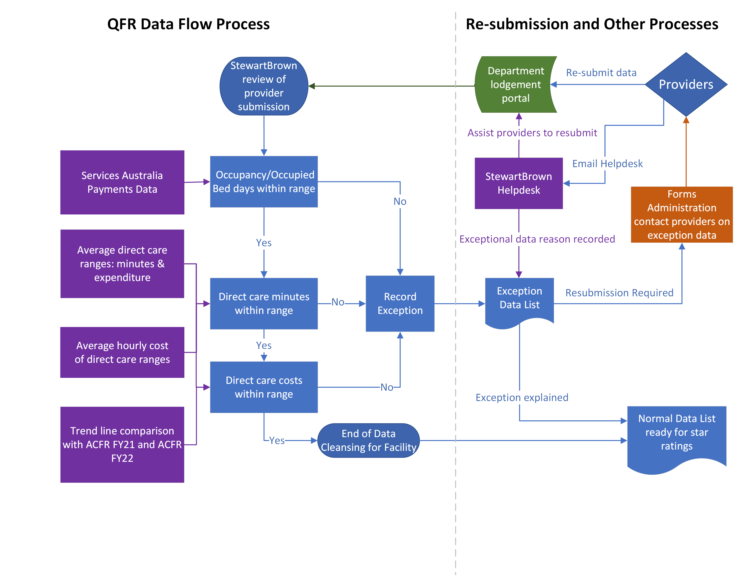
QFR Cleansing Flowchart
agedcareengagement.health.gov.au
8 December 2022
24

Slide 25
QFR Data Quality Reviews
The data quality review to date has focused on material factors that impact direct care staffing hours and expenditure
These areas were:
Occupancy (occupied bed days and available bed days)
Direct care minutes to direct care funding received
Direct care expenditure to direct care funding received
Trend data on direct care minutes and expenditure covering; FY21, FY22, and FY23 Quarter 1
agedcareengagement.health.gov.au
8 December 2022
25

Slide 26
QFR Data Quality Reviews
Occupancy (occupied bed days and available bed days)
Data is normalised using the occupied bed days metric. It is very important that the occupied days are accurately reported as any variation will impact the resulting care minutes calculation
Available bed days is also relevant for context when analysing data submitted in the QFR. Significant occupancy shifts can impact results. These shifts can be assessed by the Department when calculating occupancy. This context and relationship is relevant when facilities data is being considered
agedcareengagement.health.gov.au
8 December 2022
26

Slide 27
QFR Data Quality Reviews
Direct care minutes compared to direct care funding received
It is expected that most facilities will report direct care minutes that are relative to their funding levels received
As an example, although an average of 200 minutes will be expected across the sector, where a facility may have only received an average ACFI of $150 per resident per day (prpd), 200 minutes of care would not be expected. Alternatively, if average ACFI of $200 prpd was received, 150 minutes of care would not be expected
For the first quarter funding was based on ACFI, in future periods funding will be based on AN-ACC funding
agedcareengagement.health.gov.au
8 December 2022
27

Slide 28
QFR Data Quality Reviews
Direct care expenditure to direct care funding received
Direct care expenditure is a measure of the expected percentage of funding spent on direct care labour
This data is relevant for the Independent Hospitals and Aged Care Pricing Authority (IHACPA) to utilise in their considerations on average pricing of care which will inform future subsidy funding
It is important to understand the relationship between the funding levels and staffing minutes for each facility
Those facilities that were identified as having over 100% or less than 60% of direct care staffing costs were queried. At the high end it is relevant to understand the pressures that facilities are under to provide the care required to residents. At the lower end it is relevant to understand why not all care funding is utilised. Often this may be due to other funding sources
agedcareengagement.health.gov.au
8 December 2022
28

Slide 29
QFR Data Quality Reviews
Trend data on direct care minutes and expenditure covering; FY21, FY22, and FY23 Quarter 1
There may be changes in trend data for facilities as they adjust their models of care to cater for changes to legislative requirements
Definitions should be followed that relate to the period in question. There was an amendment to the Departments advice in relation to personal care workers, but this was after the Q1 period, so old definitions should have been used
Providers should use the data submitted in the FY21, FY22 ACFR and FY23 QFR’s to understand how their direct care minutes are moving. This will be the information that the Department and IHACPA will use moving forward to inform policy
agedcareengagement.health.gov.au
8 December 2022
29

Slide 30
Item 6
Q&A
Susan Trainor
Acting Assistant Secretary, Structural Adjustment Strategy

Slide 31
Item 7
Other issues and next steps
Future developments
Susan Trainor
Acting Assistant Secretary, Structural Adjustment Strategy

Slide 32
Future developments
The department is developing a new IT platform for the QFR which will be introduced in 2023.
To ensure the new system has been designed with provider input we’ve conducted co-design activities with the sector:
User experience sessions to inform early design
A QFR workshop with providers was conducted last month to showcase and seek opinion using an early version of the system in development.
Future opportunities for collaboration with providers are being investigated and we hope to engage members of the department’s Digital Transformation Sector Partners group in the new year.
agedcareengagement.health.gov.au
8 December 2022
32

Slide 33
QFR workshop findings
A poll to survey opinion on the developing system was conducted.
Building on previous user experience research the workshop showcased progress on the future system.
Participants provided feedback to tell us:
Error messages and validations are useful and intuitive.
Table navigation tools such as ‘jump to’, minimising rows, and header placement make tables easier to navigate.
Further opportunities for data upload should be considered.
From what you’ve seen today, how easy would the system be to use?
8 December 2022
33

Slide 34
Don’t forget…
Providers will submit their second QFR using the Forms Administration’s data collection portal, which will open for quarter 2 submissions on 1 January 2023.
The latest QFR template, definitions, guide and frequently asked questions will be located on the department’s QFR webpage and Forms Administration’s website.
Slides, a recording and transcript from this webinar will also be made available on the above webpages shortly.
A helpdesk run by Forms Administration will be available to assist with the completion and lodgement of the QFR. Providers can call the helpdesk on (02) 4403 0640 or email enquiries to health@formsadministration.com.au.
In the meantime, please email any questions to ffbconsultation@health.gov.au.
agedcareengagement.health.gov.au
8 December 2022
34

Slide 35
Aged Care Registered Nurses' Payment
Aged Care Providers – last week to apply for the Aged Care Registered Nurses' Payment
Applications for the Aged Care Registered Nurses' Payment to reward clinical skills and leadership are due to close on Wednesday, 14 December 2022.
The payment rewards registered nurses who work for the same aged care provider for the duration of either a six-month or 12-month eligibility period with payments worth up to $6,000.
Employers are responsible for applying for the payment on behalf of their eligible registered nurses.
The Australian Government wants all eligible nurses to receive their payments.
If you are yet to apply, please do so as a matter of urgency.
Further information, FAQs and the application form can be found via GrantConnect at www.grants.gov.au.
If you have any further questions about this grant round please contact the department via Grant.ATM@health.gov.au.
agedcareengagement.health.gov.au
8 December 2022
35

Slide 36
agedcareengagement.health.gov.au
Phone 1800 200 422
(My Aged Care’s free call phone line)

